Slide 1
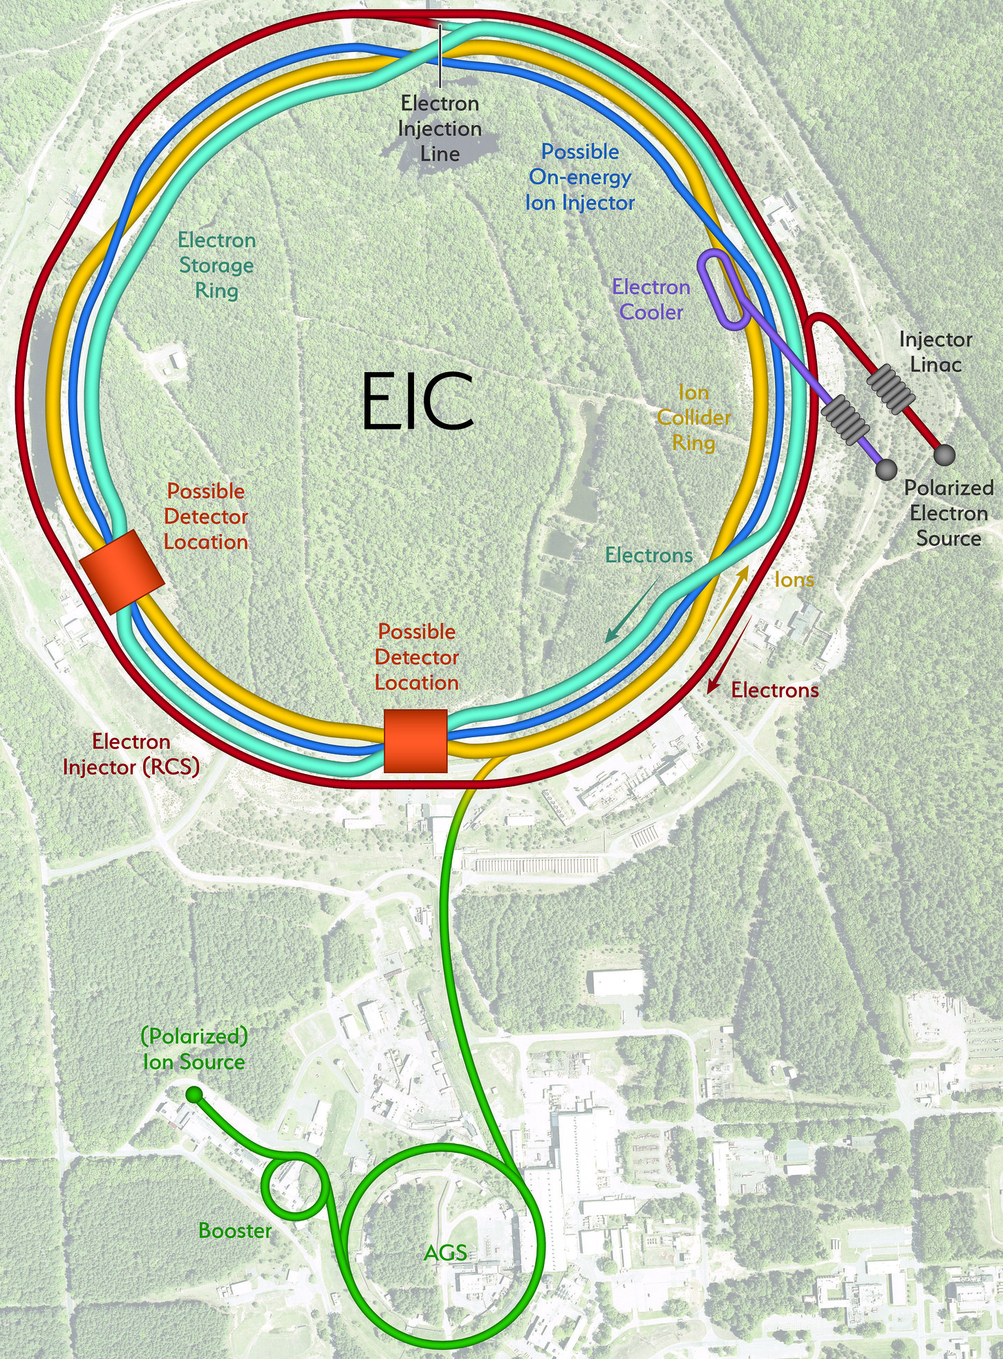

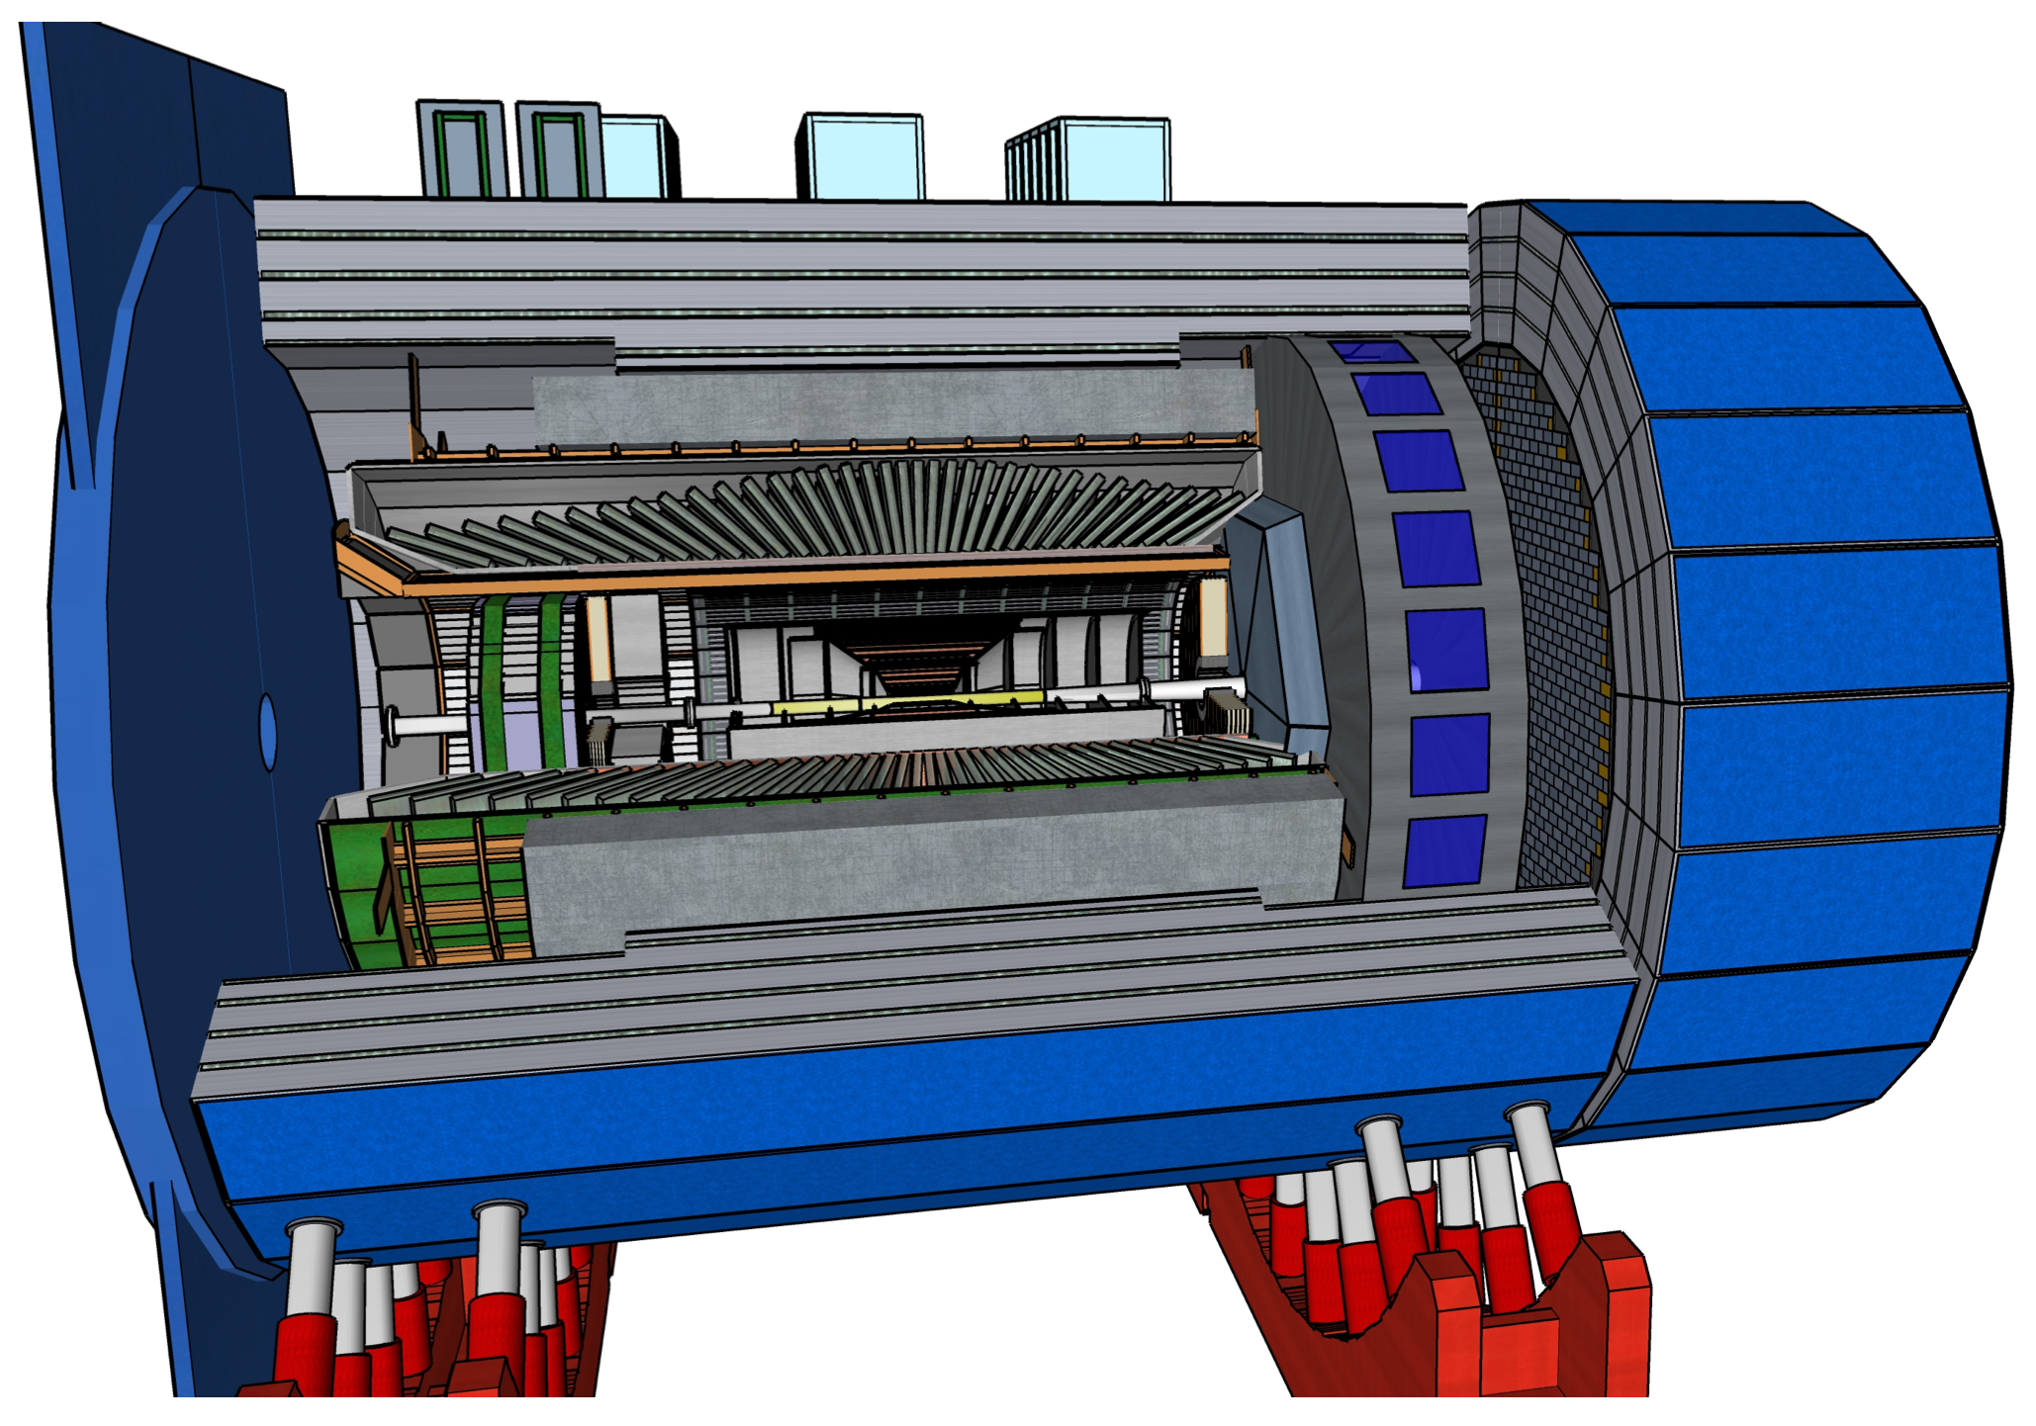


The ePIC Detector
John Lajoie
for the ePIC Collaboration
2022 RHIC/AGS ANNUAL USERS’ MEETING

Slide 2
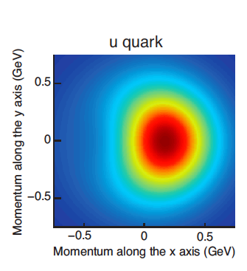
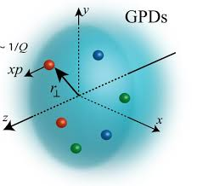
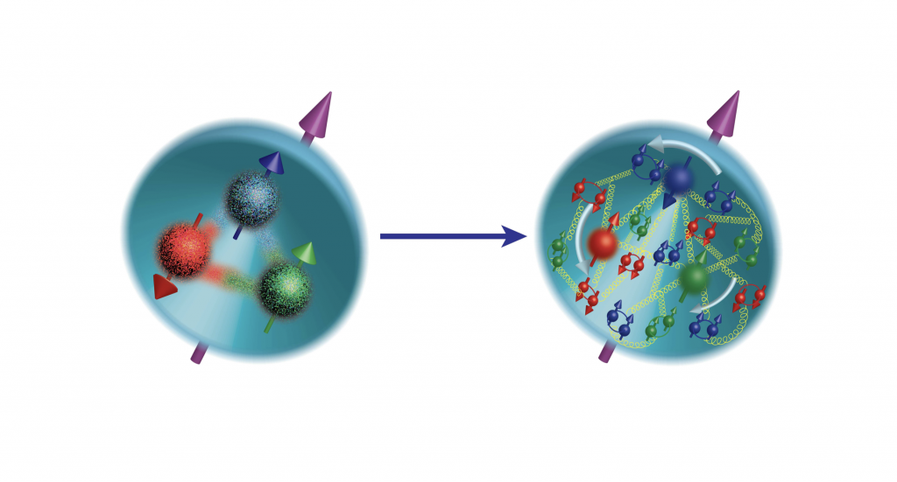


The EIC Physics Program
Multidimensional imaging of the structure of the proton
The Proton
(1970s)
The Proton (2000s)
QCD dynamics that can affect the identity of nucleons in a nucleus
See talk by
A. Deshpande (Monday)
Notes:
Need brief introduction to emphasize the reach of the EIC physics program to be addressed by ePIC

Slide 3
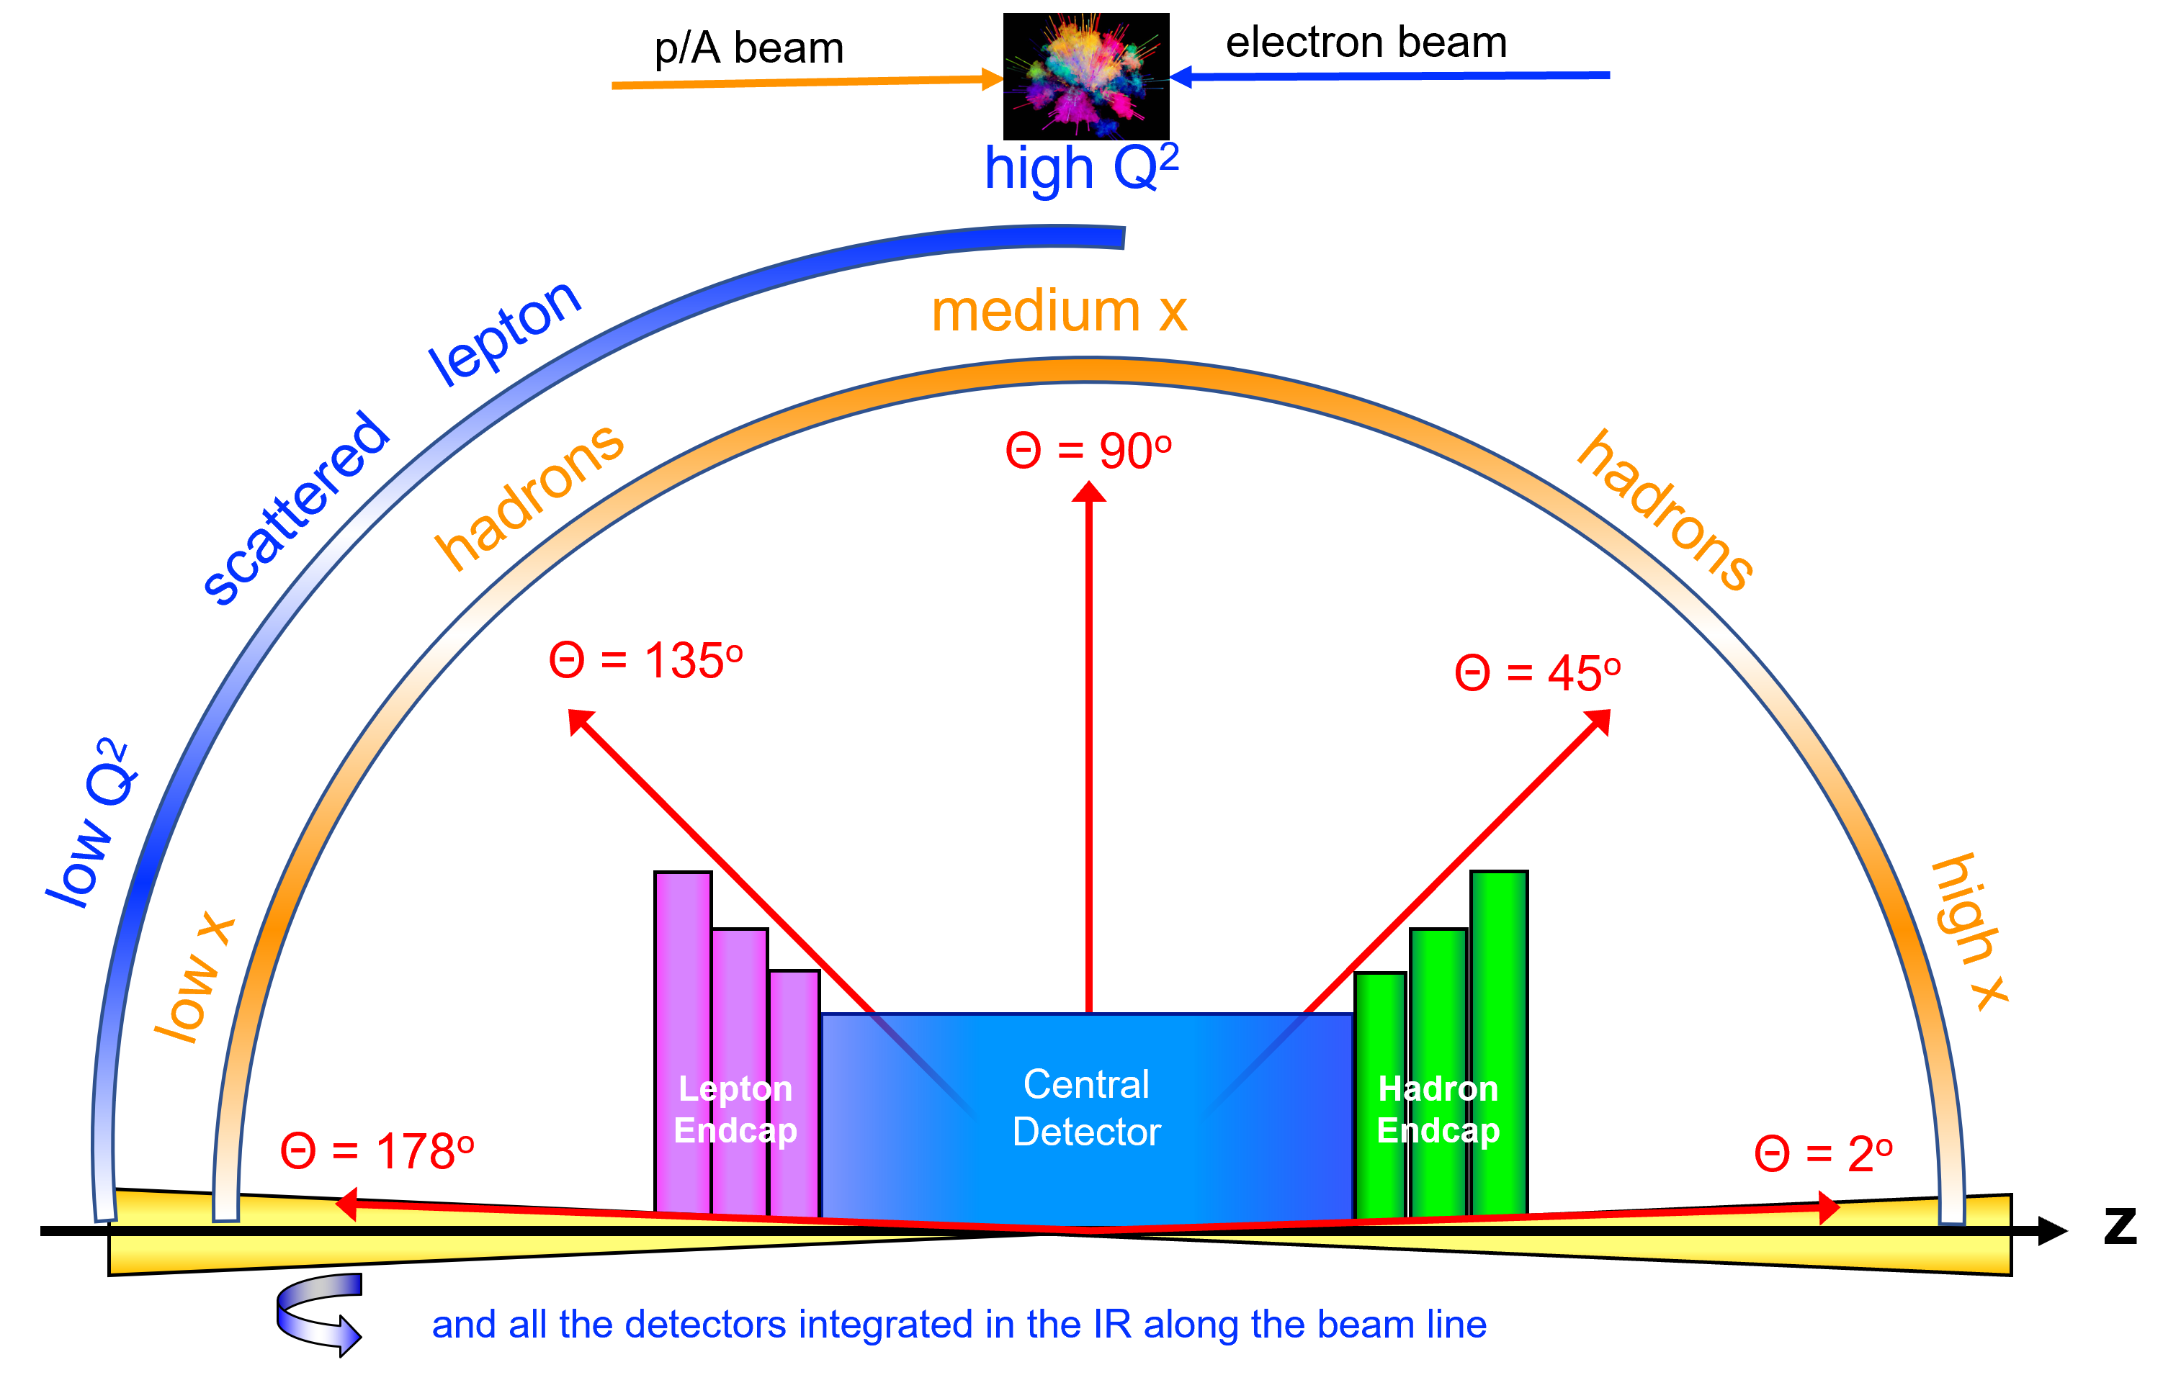
Requirements for an a EIC Detector
Vertex detector → Identify primary and secondary vertices,
  Low material budget: 0.05% X/X₀ per layer;
  High spatial resolution: 10 mm pitch CMOS Monolithic Active Pixel Sensor
Central tracker → Measure charged track momenta
  MAPS – tracking layers in combination with micro pattern gas detectors
  MPGD: μRWell or MicroMegas
electron and hadron endcap tracker → Measure charged track momenta
  MAPS – disks in combination with micro pattern gas detectors
Particle Identification → pion, kaon, proton separation on track level
  RICH detectors (modular and dual radiator RICH, DIRC) & Time-of-Flight
  high resolution timing detectors (LAPPDs, LGAD) 10 – 30 ps
  novel photon sensors: MCP-PMT / LAPPD
Electromagnetic calorimeter → Measure photons (E, angle), identify electrons
  PbWO₄ Crystals (backward), W/SciFi Spacal (forward)
  Barrel: Pb/SciFi+imaging part or new Scintillating glass
Hadron calorimeter → Measure charged hadrons, neutrons and K_{L}⁰
  challenge achieve ~50%/√E + 10% for low E hadrons (<E> ~ 20 GeV)
  Fe/Sc sandwich with longitudinal segmentation
DAQ & Readout Electronics: trigger-less / streaming DAQ
  Integrate AI into DAQ → cognizant Detector
Very forward and backward detectors → scattered particles under very small angles
  Silicon tracking layers in lepton and hadron beam vacuum
  Zero – degree high resolution electromagnetic and hadronic calorimeter
Radius/Distance from IP

Slide 4
A Brief Timeline
EICUG Yellow Report (2020-21)
Call for proposals issued jointly by BNL and JLab in March 2021
  Proposals due Dec. 1, 2021
  ATHENA, CORE and ECCE proposals submitted
Public DPAP meetings Dec. 13-15, 2021
  Presentations from proto-collaborations
  Panel-assigned homework questions
Second DPAP session Jan. 19-21, 2022
DPAP closeout March 8th, 2022
  Final report available March 21st, 2022
  ECCE proposal chosen as basis for first EIC detector reference design
Spring/Summer 2022 – ATHENA and ECCE form joint leadership team
  Joint WG’s formed and consolidation process undertaken
  Coordination with EIC project on development of technical design
Collaboration formation process started July, 2022
  First IB Meeting July 18th
  Charter writing committee formed and active – DE&I built in from start!
First ePIC Collaboration meeting July 26-29, 2022
ePIC Charter approved Dec. 14th, 2022
ePIC Detector
To be sited at IP6 (25mr crossing angle)
Addresses EIC science program as outlined in the EIC white paper and NAS report
Must be ready for Day-1 EIC operations
Working towards pre-TDR and CD-2/3A
Notes:
Mention DE&I in context of charter – modern collaboration, built in from the start.

Slide 5
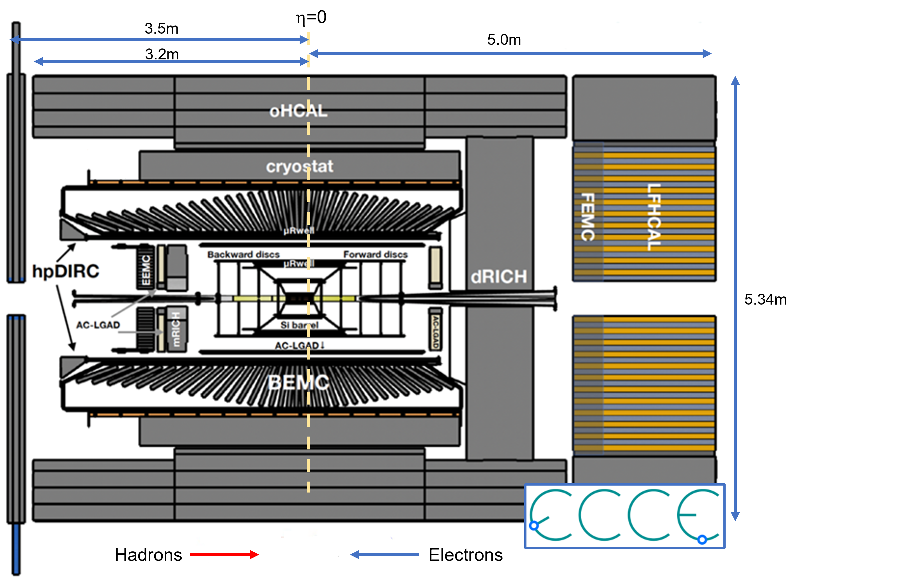
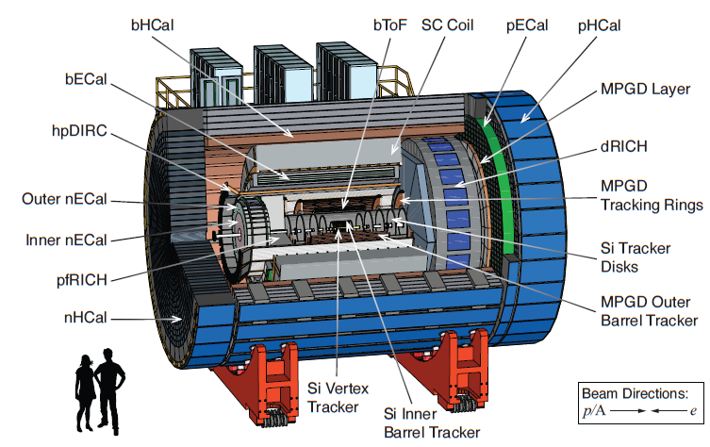

ECCE and ATHENA
Key conceptual differences – bore size and magnetic field!
Notes:
BaBar 2.8M 1.4T ATHENA 3.2M 3.0T

Slide 6
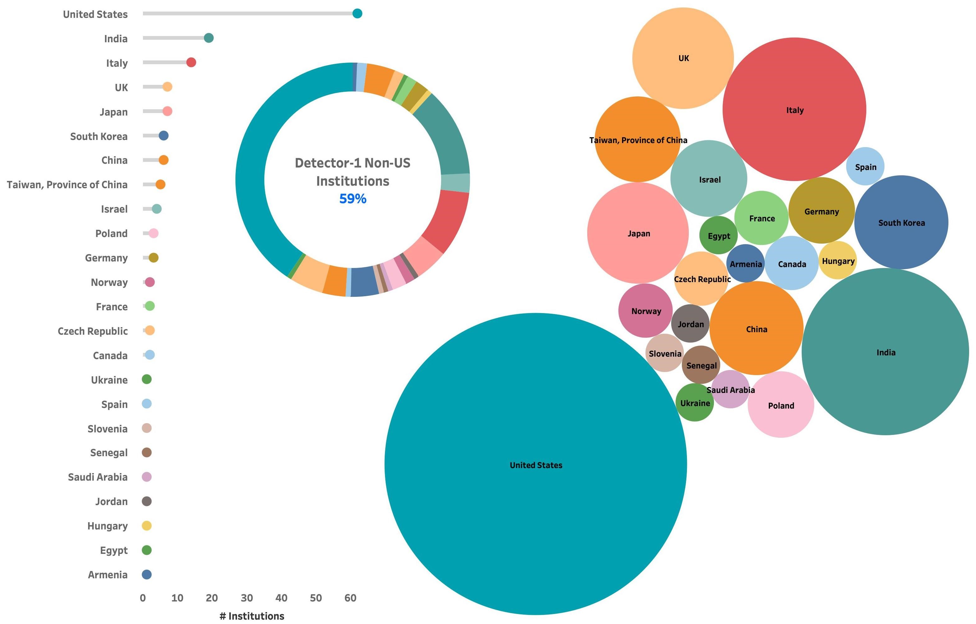
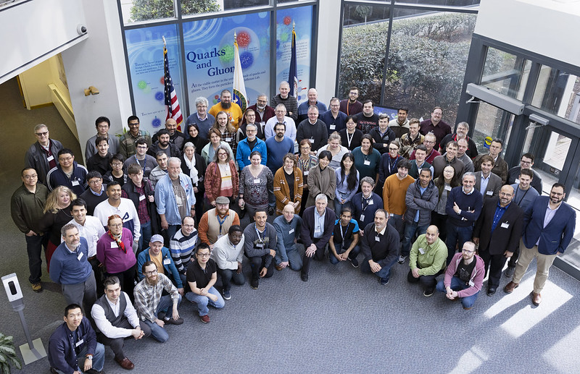
The ePIC Collaboration
160+ institutions
24 countries
500+ participants
A truly global pursuit for a new experiment at the EIC!
ePIC non-US
Institutions
59%
Notes:
24 countries total

Slide 7
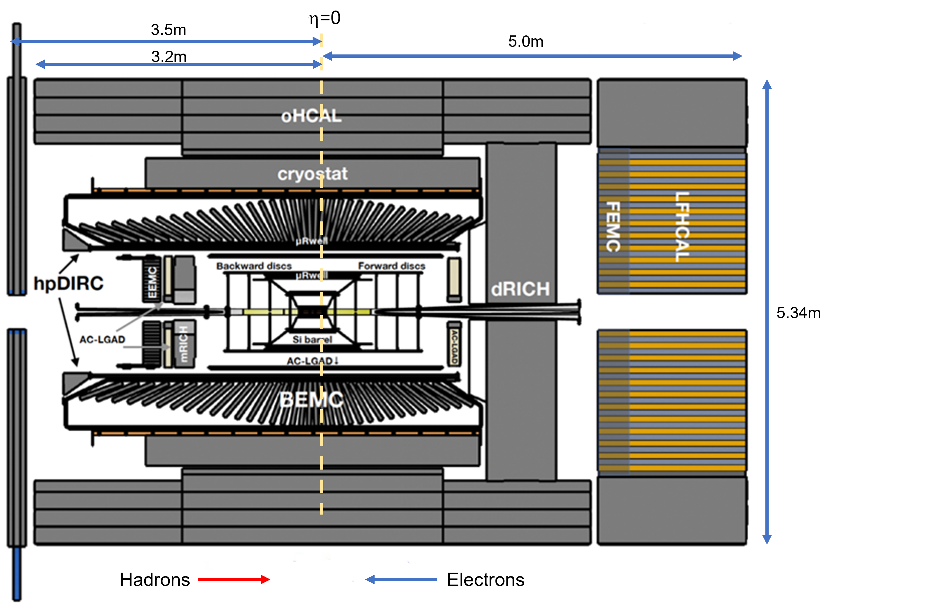
ePIC Detector Design (Current)
Tracking:
  New 1.7T solenoid
  Si MAPS Tracker
  MPGDs (μRWELL/μMegas)
PID:
  hpDIRC
  mRICH/pfRICH
  dRICH
  AC-LGAD (~30ps TOF)
Calorimetry:
  SciGlass/Imaging Barrel EMCal
  PbWO4 EMCal in backward
  direction
  Finely segmented EMCal +HCal
  in forward direction
  Outer HCal (sPHENIX re-use)
  Backwards HCal (tail-catcher)

Slide 8
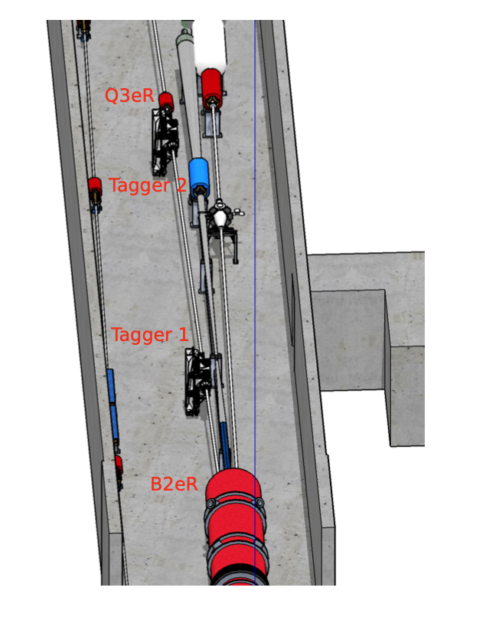
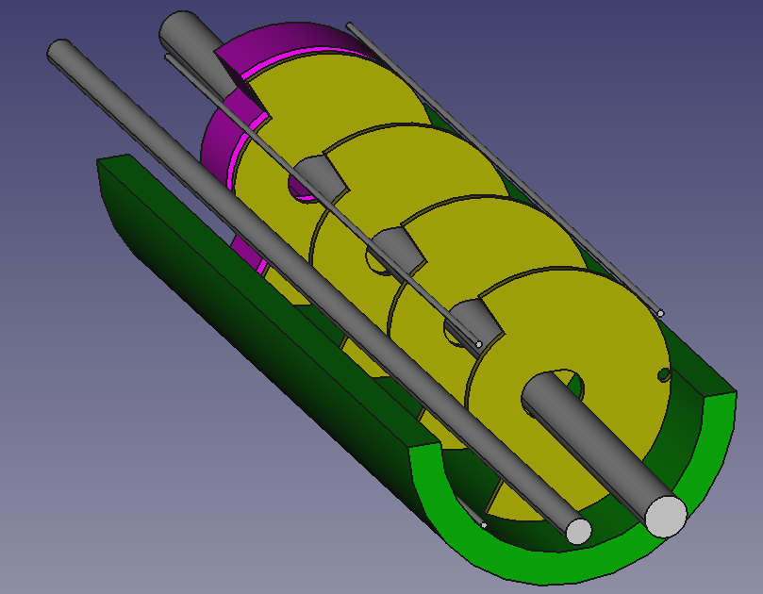
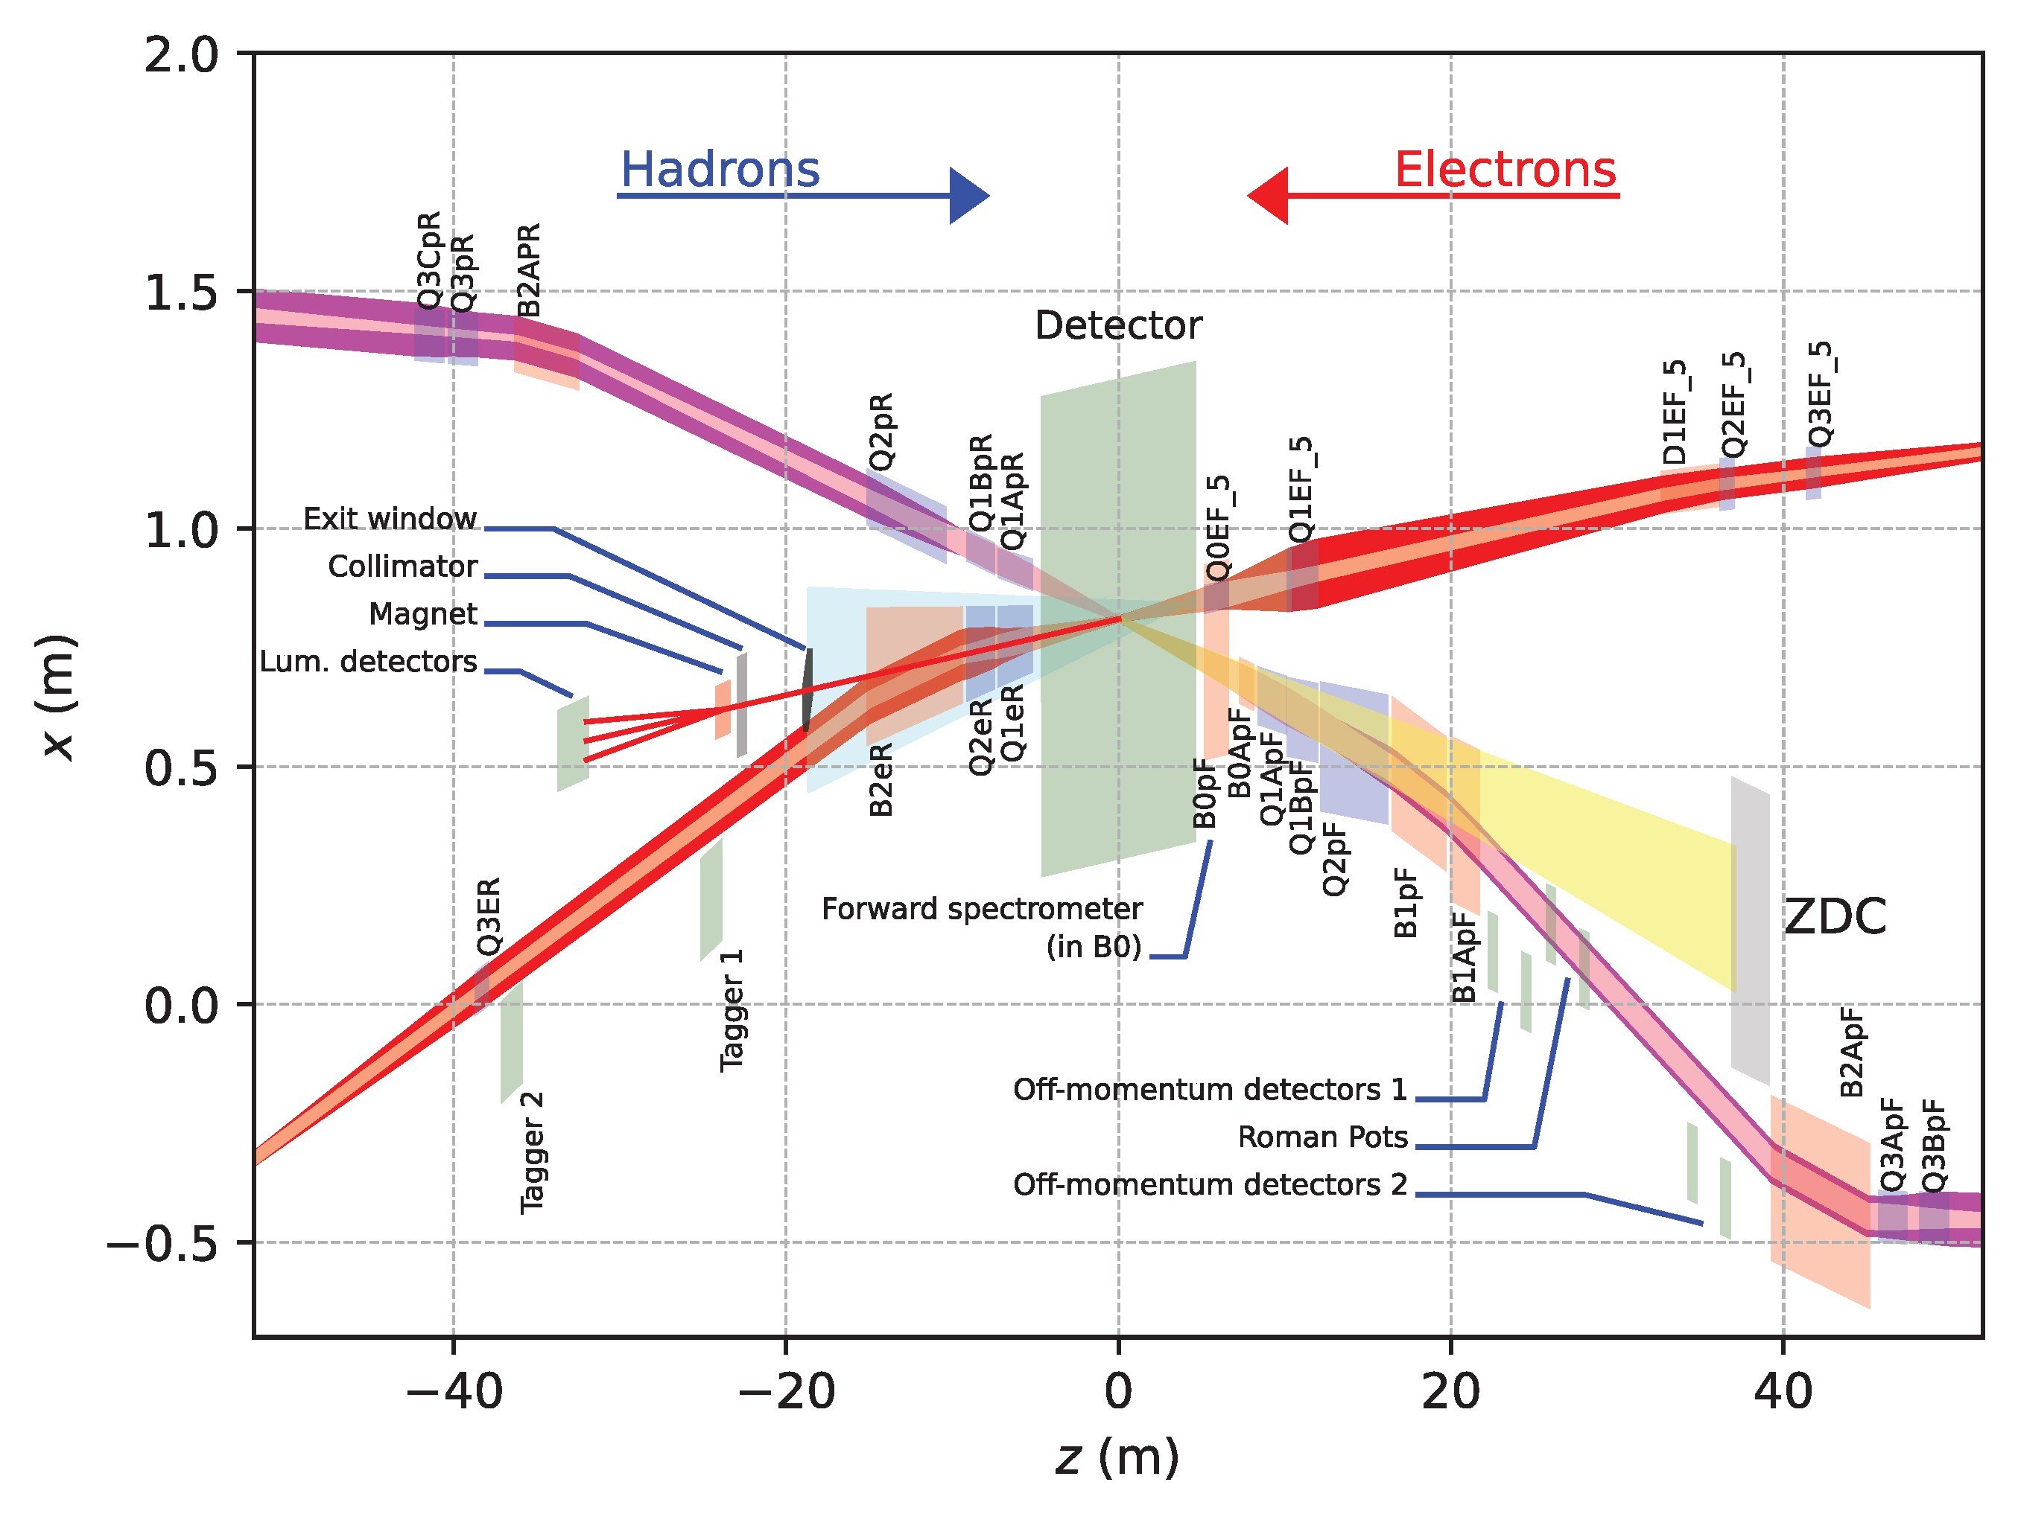
Far-Forward and Far-Backward Detectors
8.5m
PbW04 EMCAL
Si Tracking
Far-Backward Detectors
Luminosity monitor
Low-Q² Tagging Detectors
Far-Forward Detectors
B0 Tracking and Photon Detection
Roman Pots and Off-Momentum Detectors
Zero-Degree Calorimeter

Slide 9
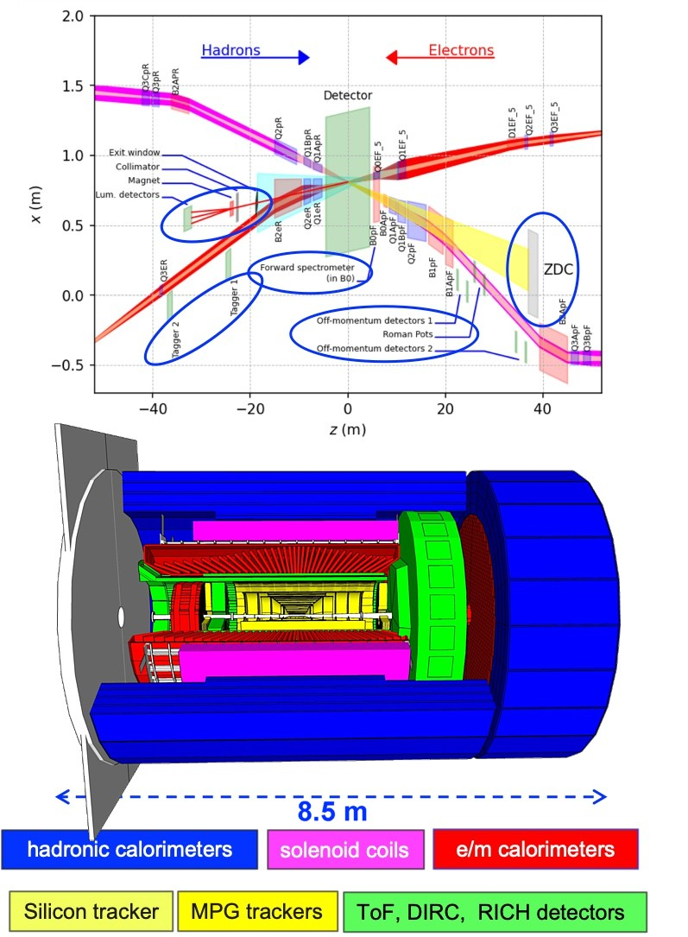
The Far-Forward Detectors
PbW04 EMCAL
Si Tracking
B1apf
Detector | Acceptance
Zero-Degree Calorimeter (ZDC) | 𝜽 < 5.5 mrad (𝜂 > 6)
Roman Pots (2 stations) | 0.0* < 𝜽 < 5.0 mrad (𝜂 > 6)
Off-Momentum Detectors (2 stations) | 0.0 < 𝜽 < 5.0 mrad (𝜂 > 6)
B0 Detector | 5.5 < 𝜽 < 20.0 mrad (4.6 < 𝜂 < 5.9)
See talk by A. Jentsch
(Wednesday)

Slide 10
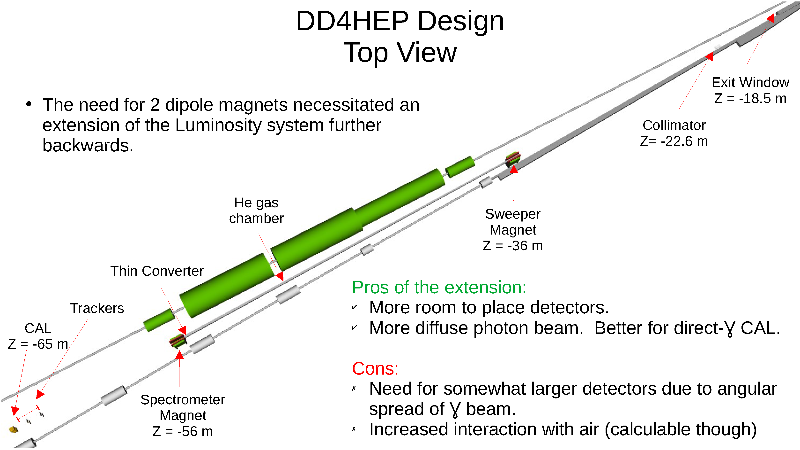
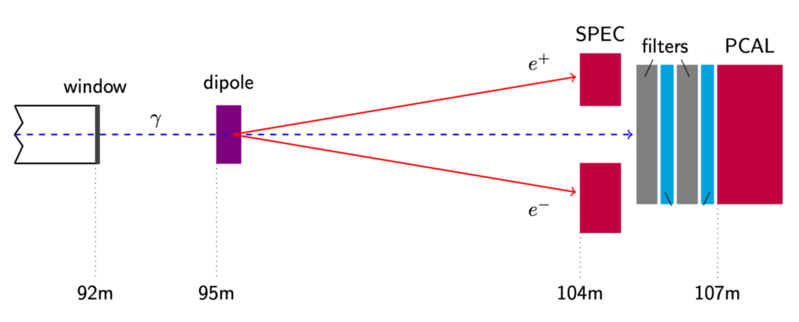
Far Backwards Detectors
Luminosity Spectrometer
Low-Q² tagger
~1% measure of luminosity
relative luminosity to 10⁻⁴
e+p → e γ p
e+Au → e γ Au
Clean photoproduction signal for
10⁻³ < Q² < 10⁻¹

Slide 11
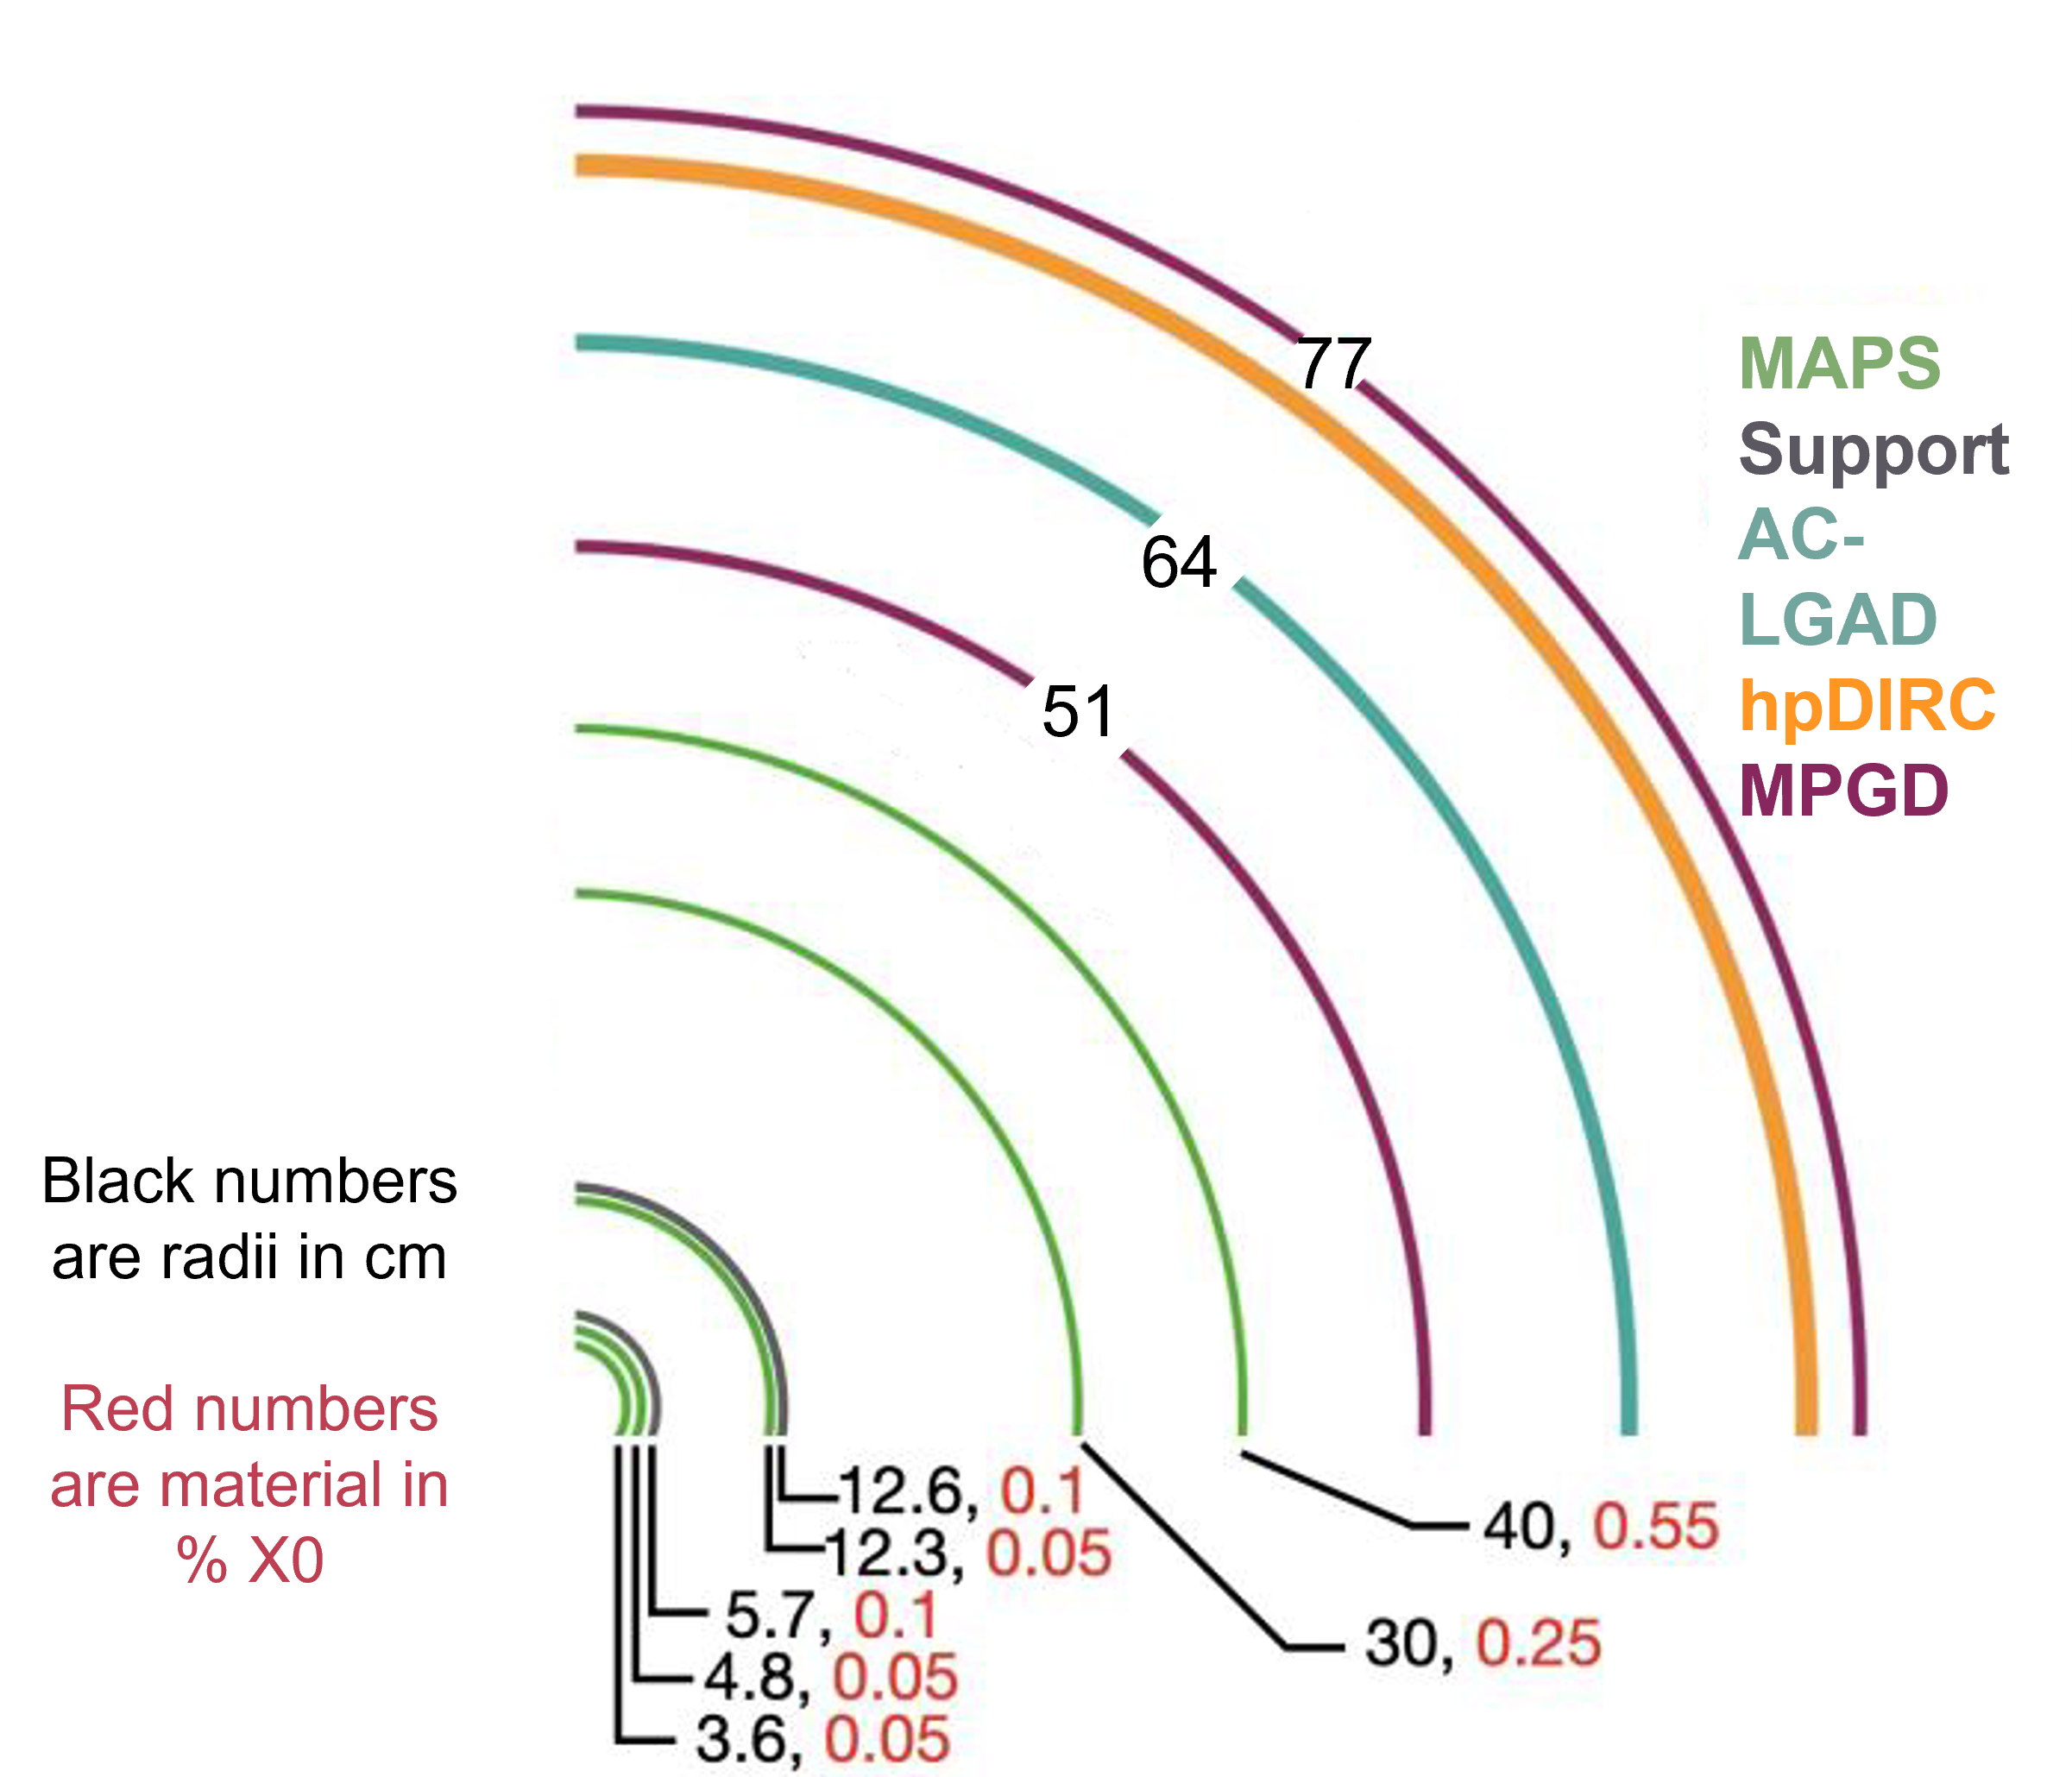
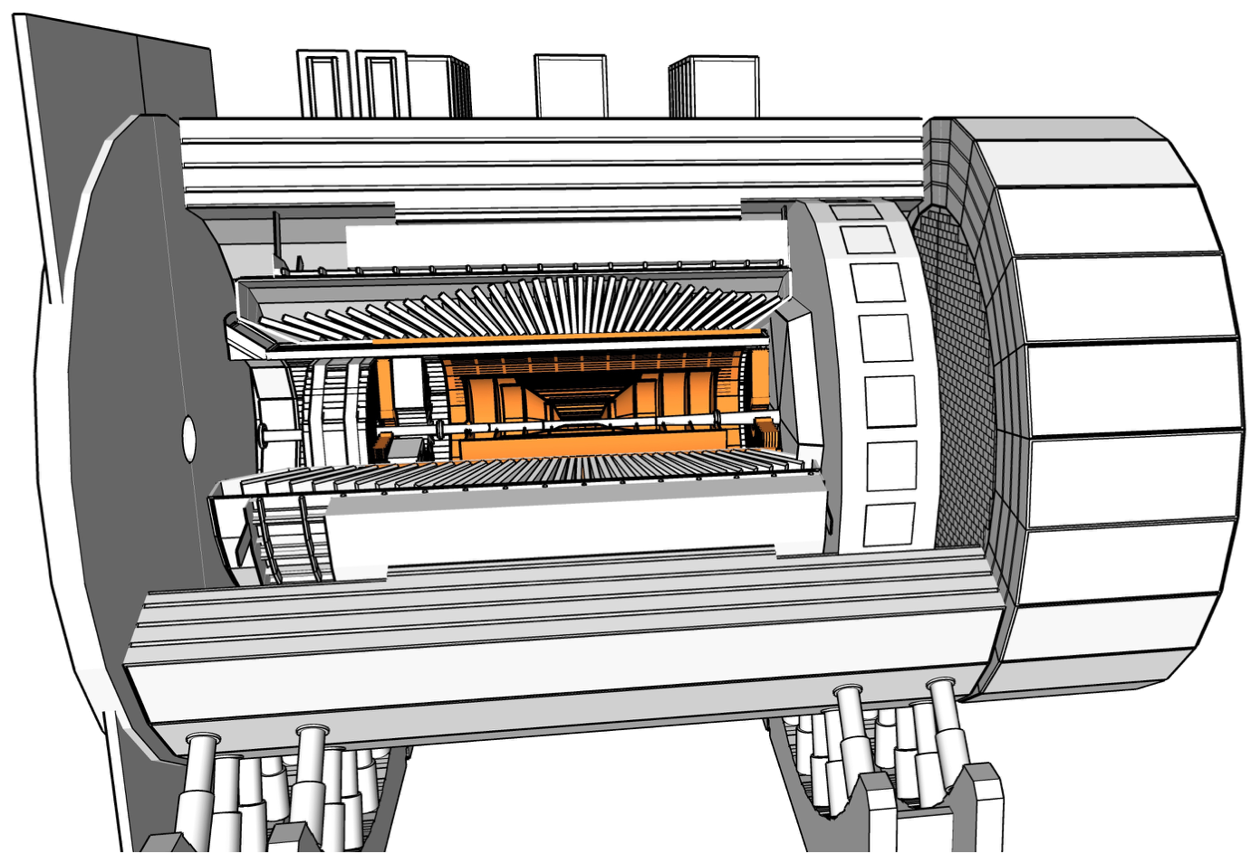
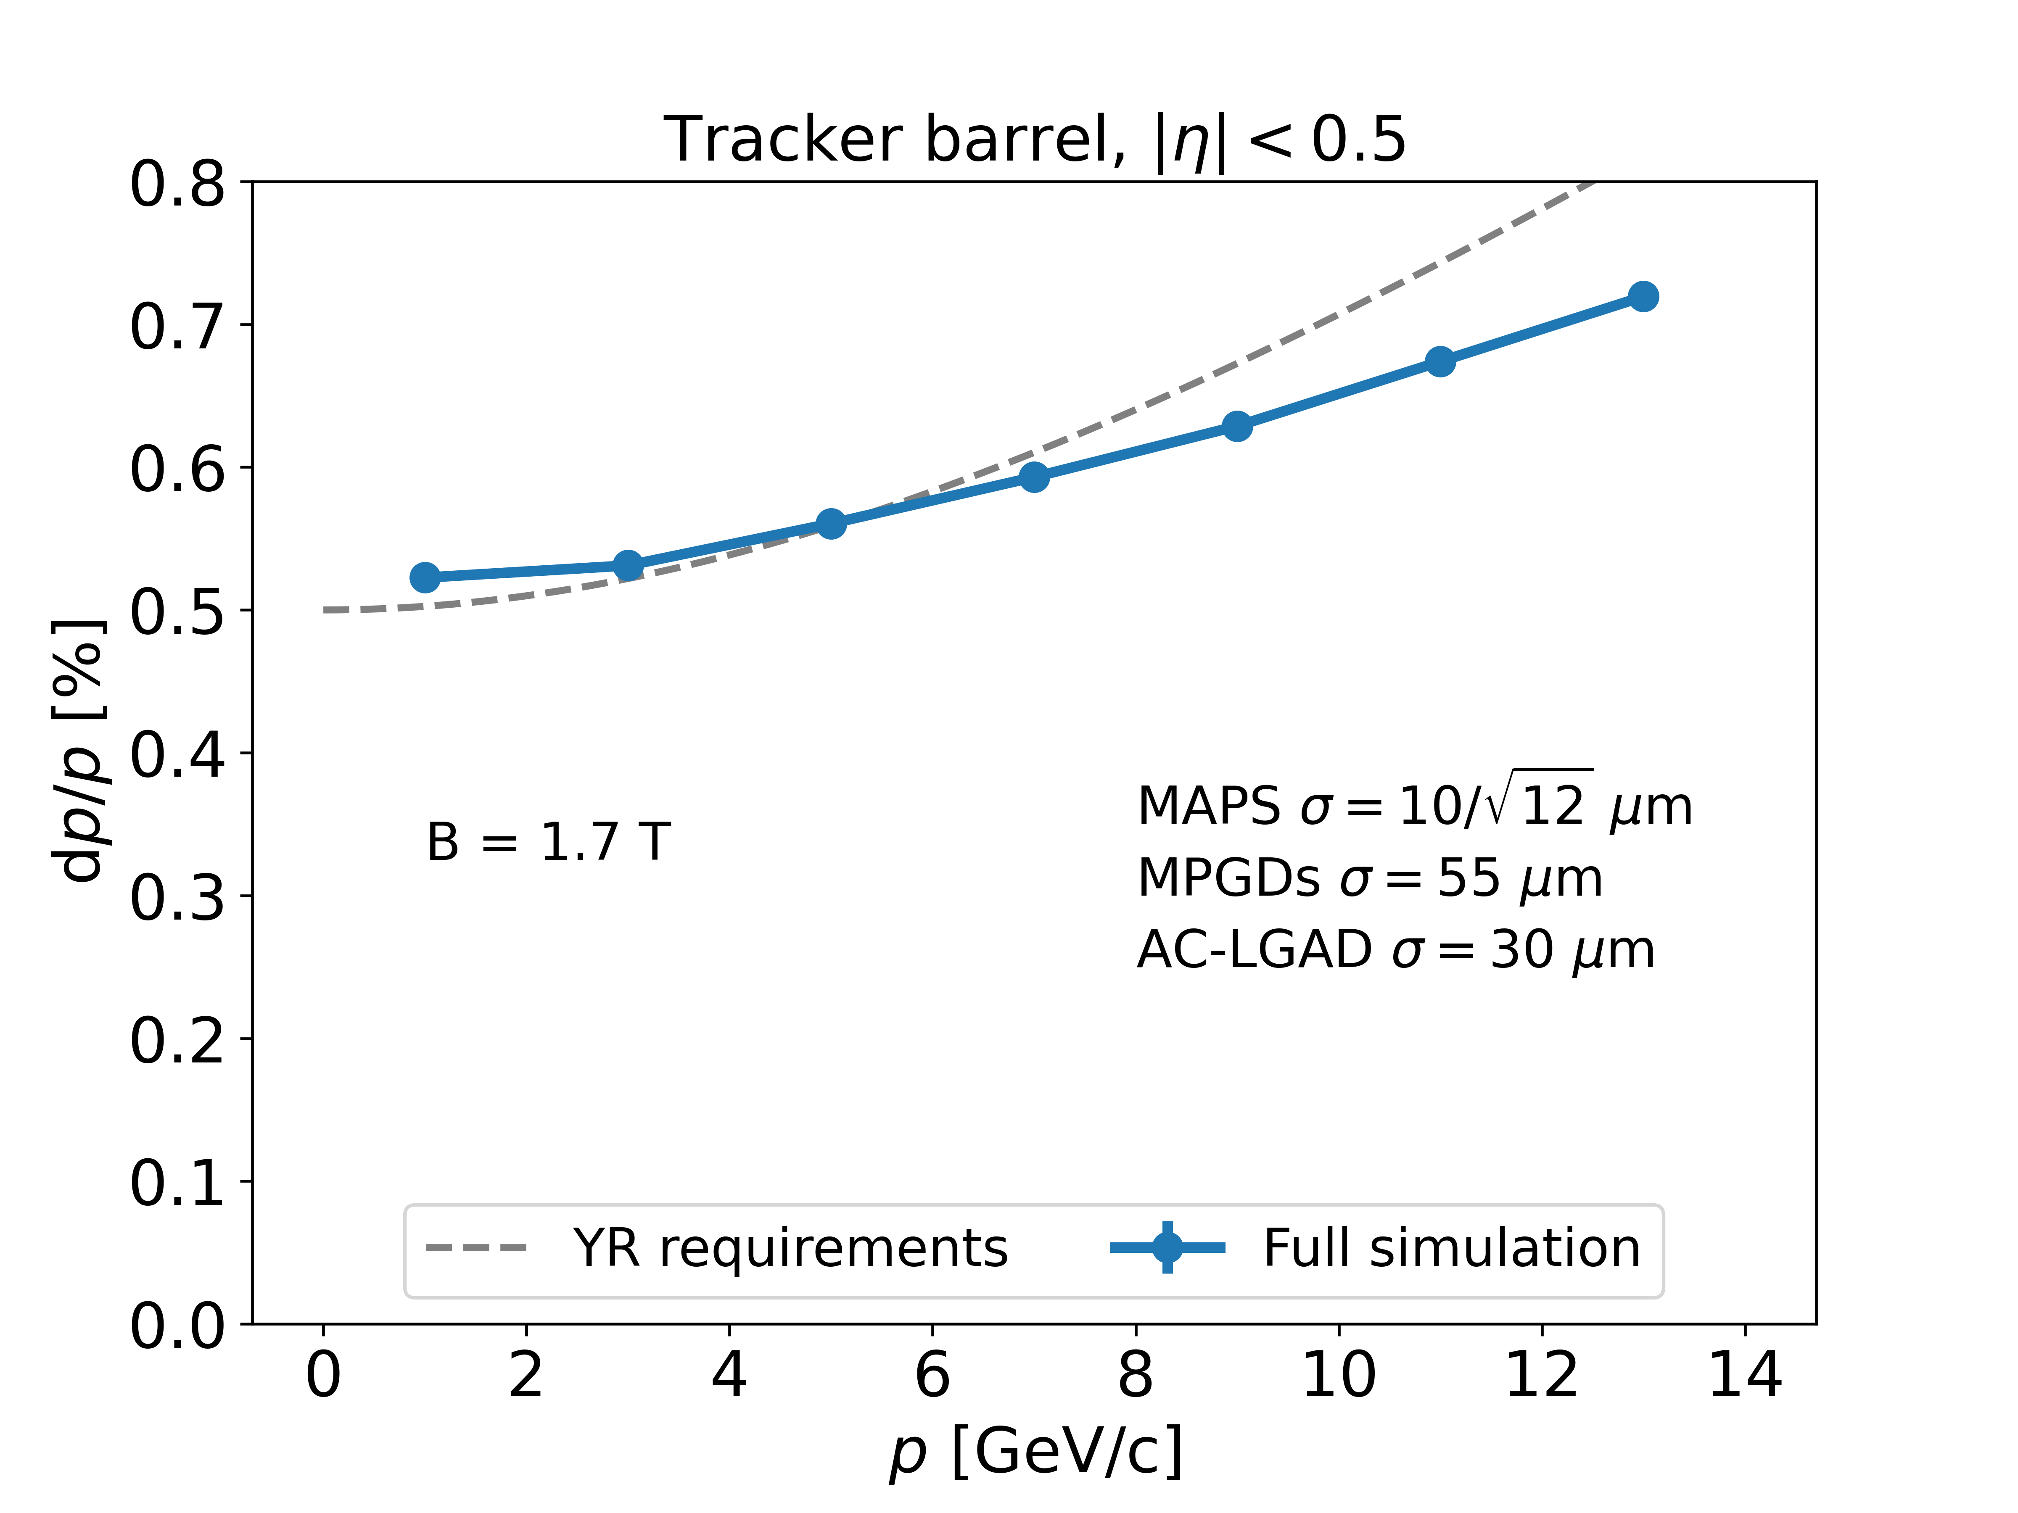
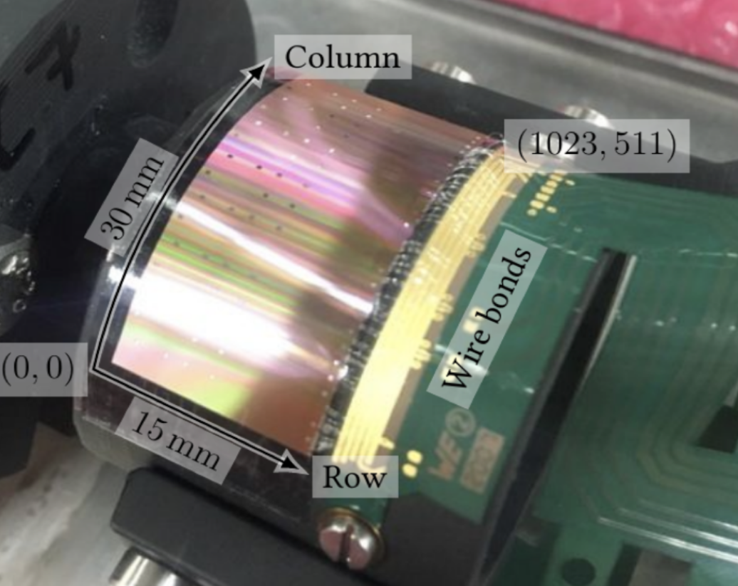
Tracking
Si Tracker based on ALICE ITS3 65nm MAPS sensors.
Five layers in barrel, supplemented by MPGDs for pattern recognition.
Five discs in forward/backward directions (+MPGD in forward)
Meets EICUG Yellow Report design requirements.
First “μITS3” assembly at CERN

Slide 12
Tracking
Inner two vertex layers optimized for beam pipe bakeout and ITS3 sensor size.
Third layer dual-purpose (vertex + sagitta)
Cylindrical μMega/TOF provide pattern recognition redundancy
μRWell behind hpDIRC provides ring seed direction, space point for pattern recognition
AC-LGAD TOF
services cone
planar μRWell MPGD
(behind hpDIRC)
Barrel tracking layers
cylindrical μMega layer
Backward/Forward tracking discs (5 layers)

Slide 13
Tracking
services cone
Five discs in forward/backwards direction (ITS-3 based large area sensor design)
Increase lever arm by maximizing tracker extent in z (ongoing optimization)
AC-LGAD TOF
planar μRWell MPGD
(behind hpDIRC)
Barrel tracking layers
cylindrical μMega layer
Backward/Forward tracking discs (5 layers)

Slide 14
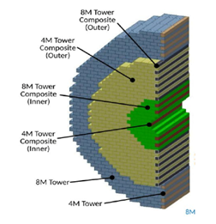
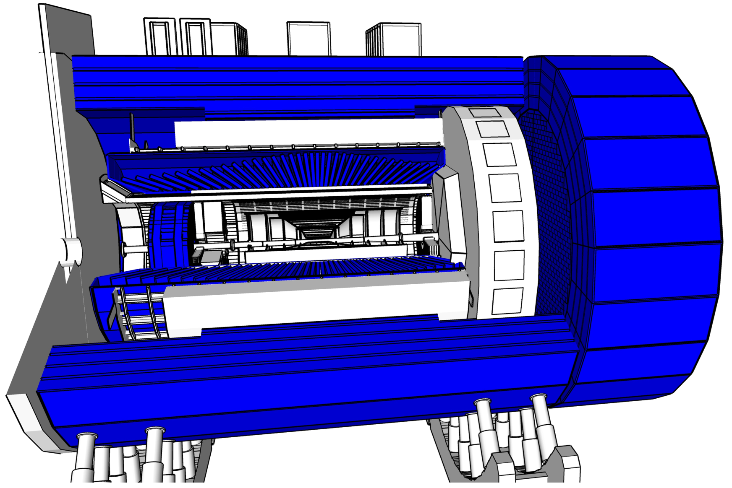
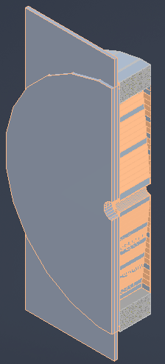
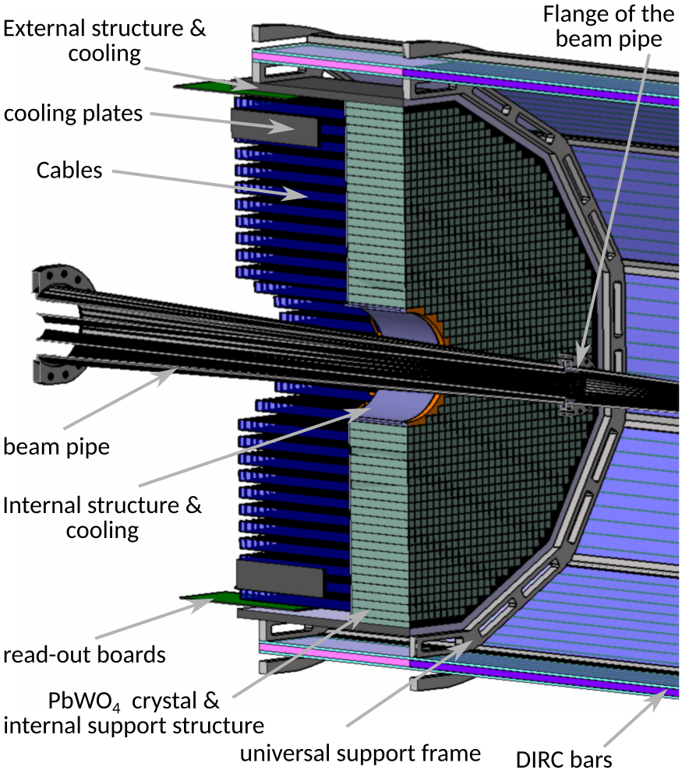
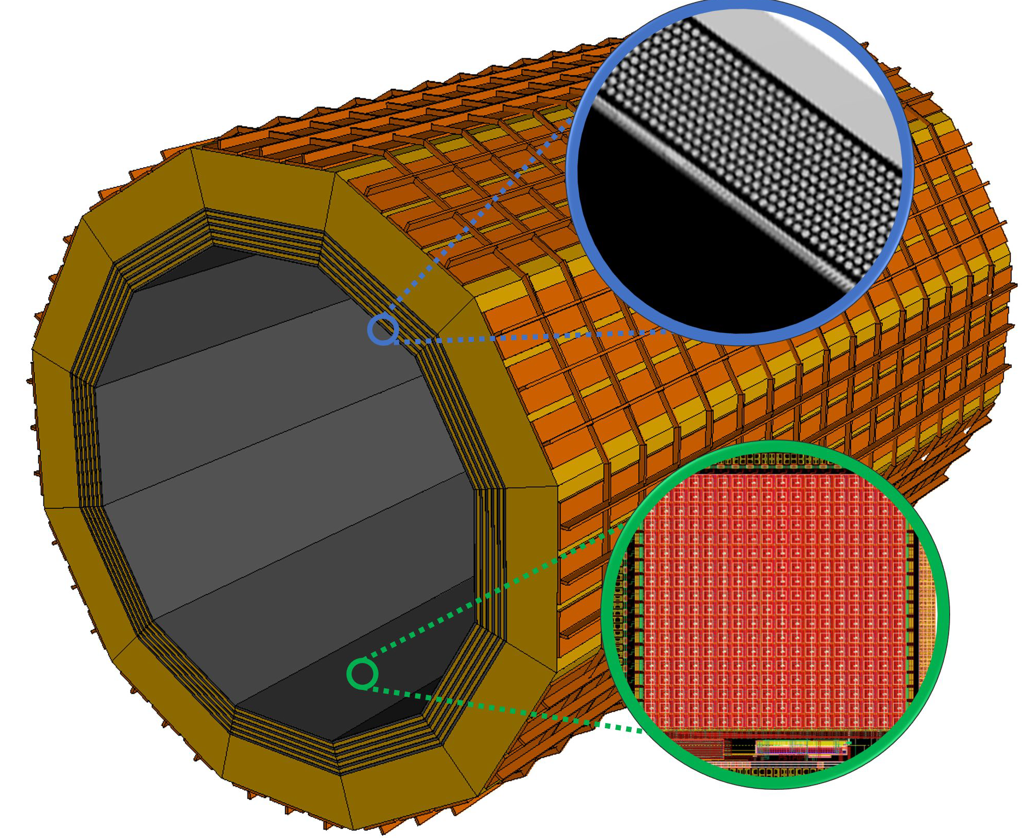
Calorimetry
Barrel HCAL
(sPHENIX re-use)
Backwards HCal
Steel/Sc Sandwich
tail catcher
High granularity
W/SciFi EMCal
Longitudinally separated HCAL with high-η insert
PbSc Layer
Complementary options for BECAL:
SciGlass or
Imaging Calorimeter
Imaging Layer
Backwards EMCal
PbW04 crystals

Slide 15
Barrel ECal Technology Selection
ePIC Internal Review March 13-14, 2023
Homogeneous Calorimeter:
SciGlass: cost-effective radiator
Geometry and mechanical design based on PANDA
Anticipated readout with SiPM matrices
Hybrid Design:
Imaging calorimetry based on monolithic silicon sensors (AstroPix)
6 layers of imaging Si sensors interleaved with 5 SciFi/Pb layers
Followed by a large section of SciFi/Pb (can serve as inner HCAL)

Slide 16
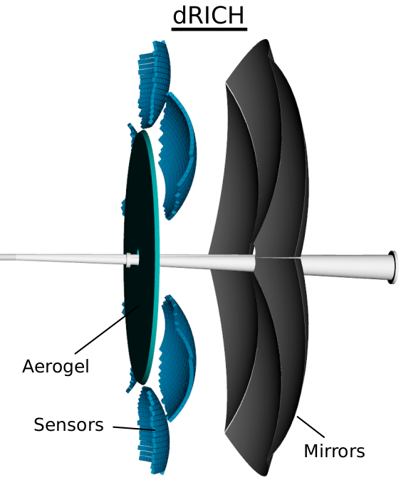
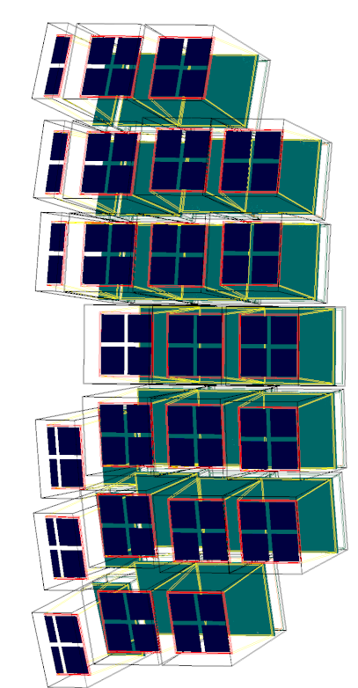
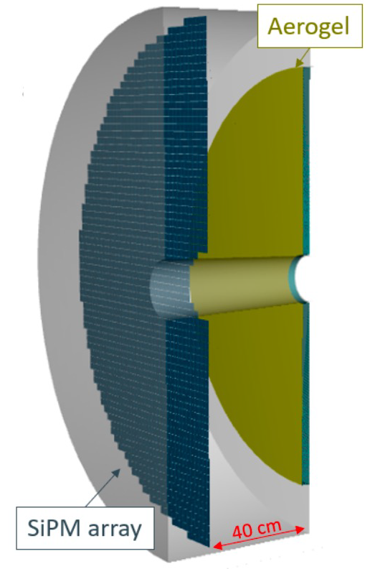
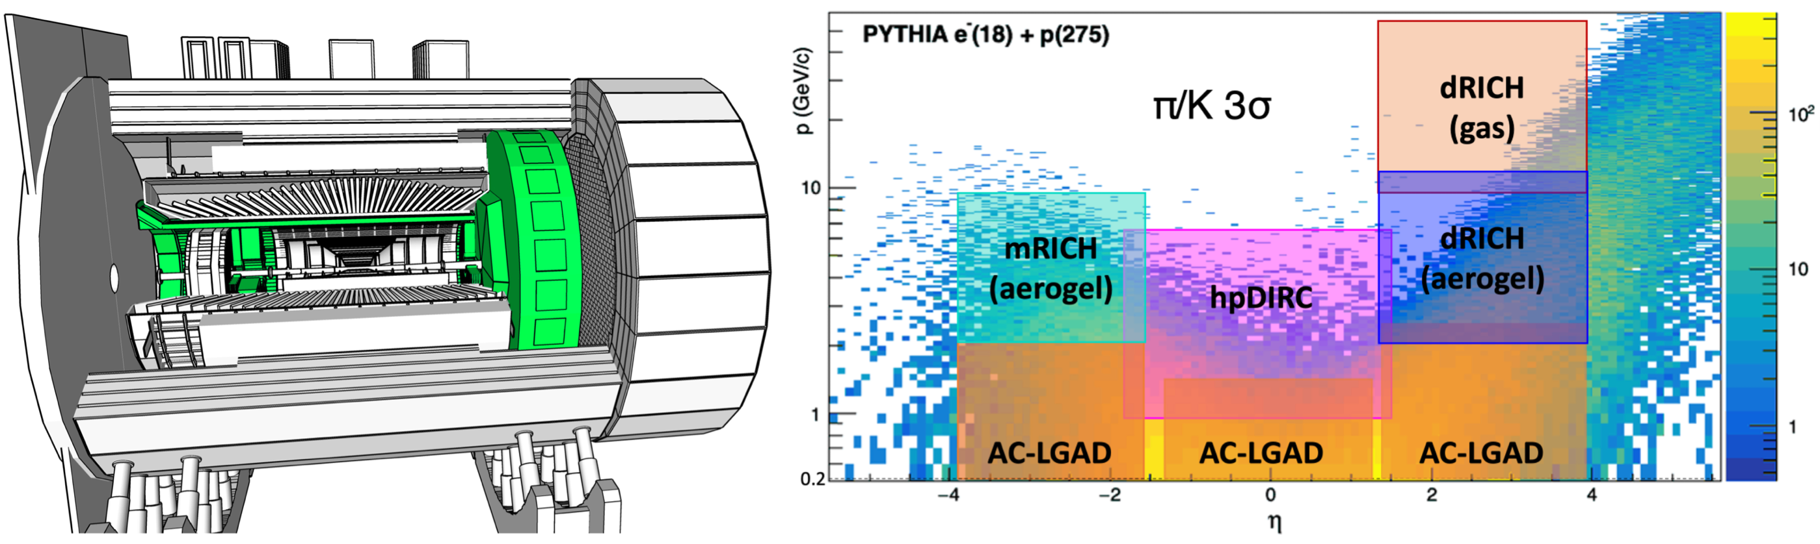
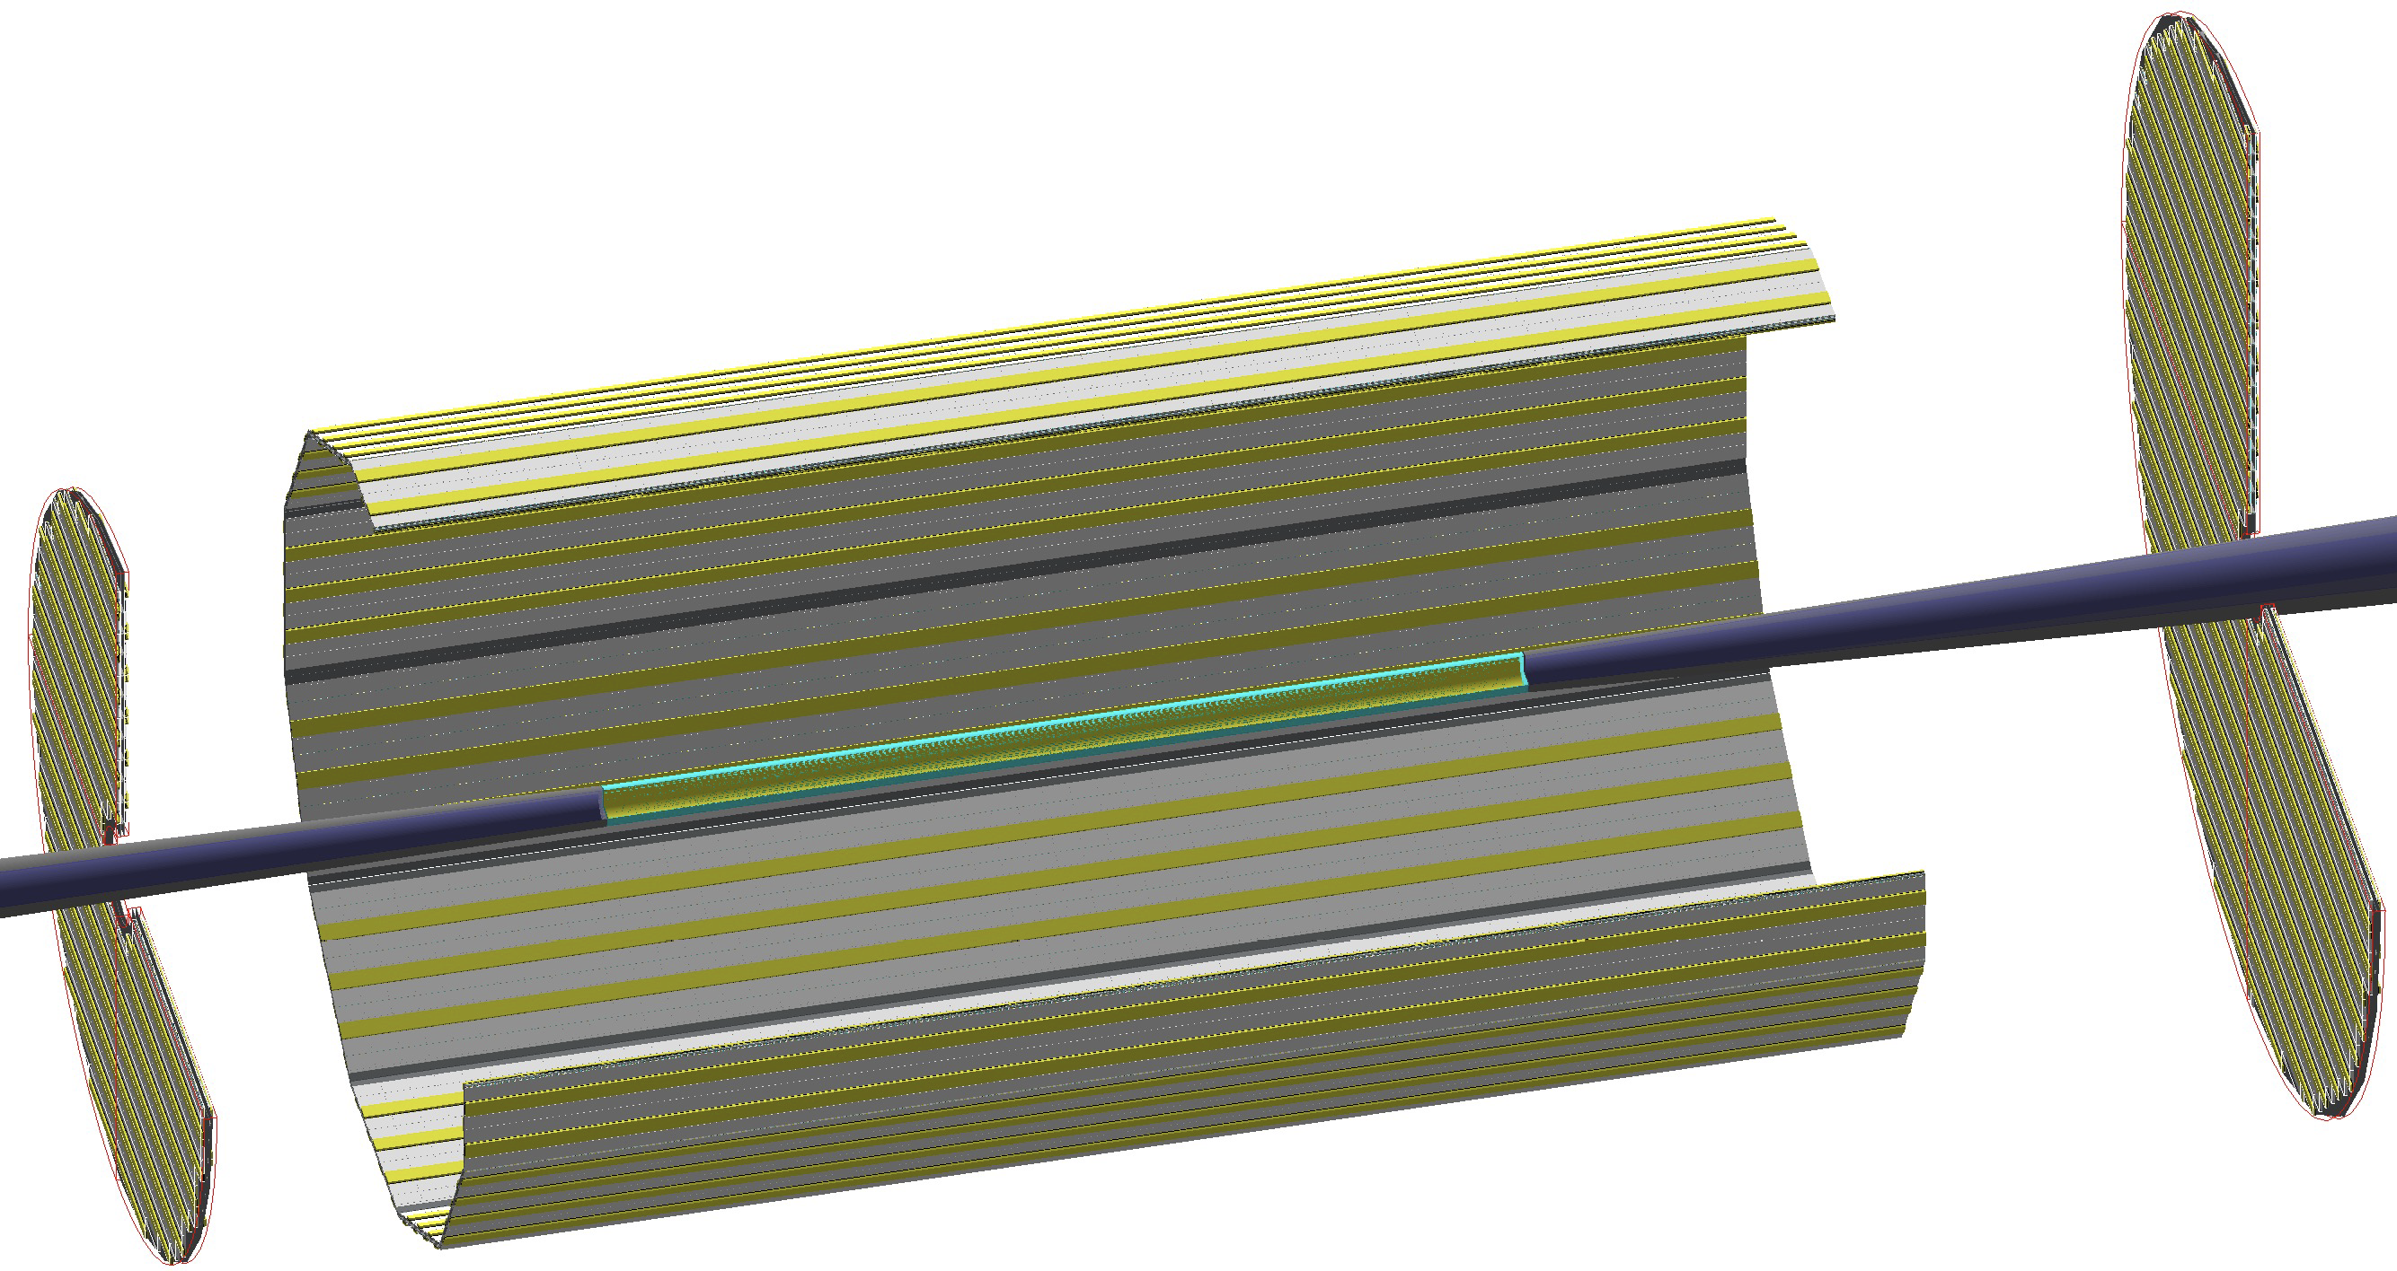
Particle ID
Dual-Radiator RICH (dRICH)
High-Performance DIRC
Modular (mRICH)
or Proximity Focused (pfRICH)
AC-LGAD
TOF (~30ps)
LAPPD

Slide 17
Backwards PID Technology Selection
ePIC Internal Review March 20-21, 2023
Modular RICH (mRICH)
Aerogel radiator
Longitudinally compact due to Fresnel lens focusing
Modules have dead area
Proximity Focusing RICH (pfRICH)
Aerogel radiator
Gas threshold-based electron ID
Requires expansion volume
Both with use LAPPD/HRPPD readout to provide additional timing information.

Slide 18
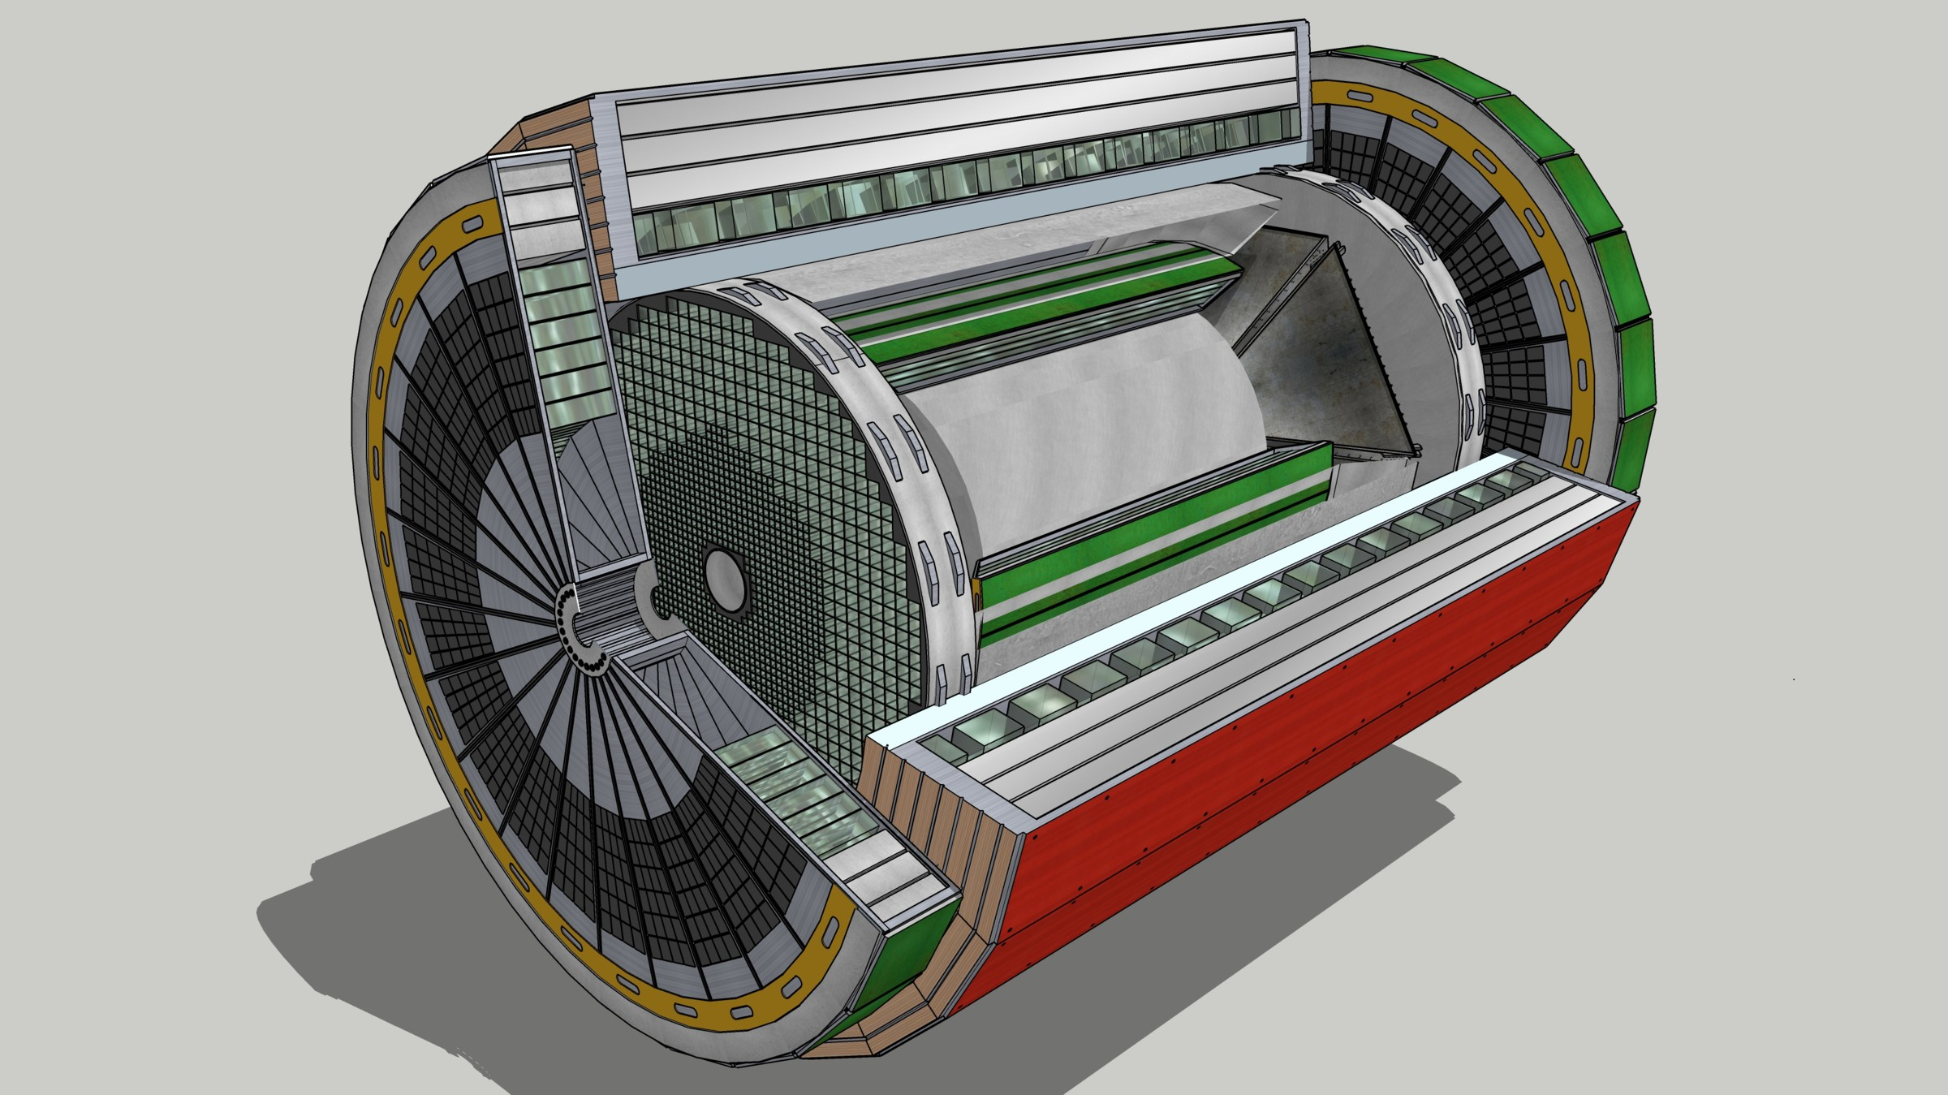
ePIC Streaming DAQ
Data
Configuration & Control
Power
Detector
FEB
(Front End Board)
FEP
(Front End Processor)
DAQ
(Data Acquisition)
No External trigger
All collision data digitized but aggressively zero suppressed at FEB
Low / zero deadtime
Event selection can be based upon full data from all detectors (in real time, or later)
Collision data flow is independent and unidirectional-> no global latency requirements
Avoiding hardware trigger avoids complex custom hardware and firmware
Data volume is reduced as much as possible at each stage
BW: O(100 Tbps)
BW: O(10 Tbps)
Global timing, busy & sync
Beam collision clock input
L ~ 100 m
fiber
ASIC
Goal: O(100 Gbps)
Fiber
Switch / Server / Link-Exchange:
Readout
Switch / Server: Processing
Switch / Server: Buffer
FEB
Storage
FPGA
Fiber
Monitoring
FEP
FEB
LVDS ~ 5m
Analog ~ 20m
Power Supply System
(HV, LV, Bias)
Cooling Systems

Slide 19
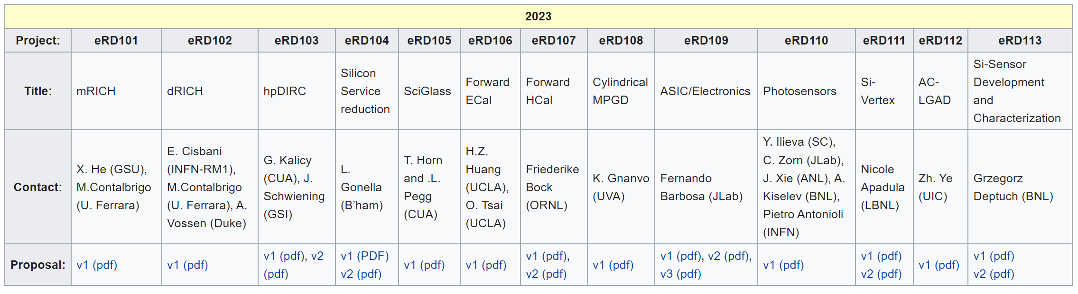
EIC Project R&D Activities
https://wiki.bnl.gov/conferences/index.php/ProjectRandDFY23
See also EIC generic detector R&D: https://www.jlab.org/research/eic_rd_prgm

Slide 20
Work Underway on ePIC Design
Tracking optimization
  Achieve a realistic, low-mass design with good performance
    Efficiency/seeding studies w/backgrounds
    MPGD configuration
    Integrate support and services
Alternative technologies for barrel EMCal
PID in backwards region
(competing implementations)
Process is driven by physics performance!
Iterative process between ePIC Collaboration and EIC Project

Slide 21
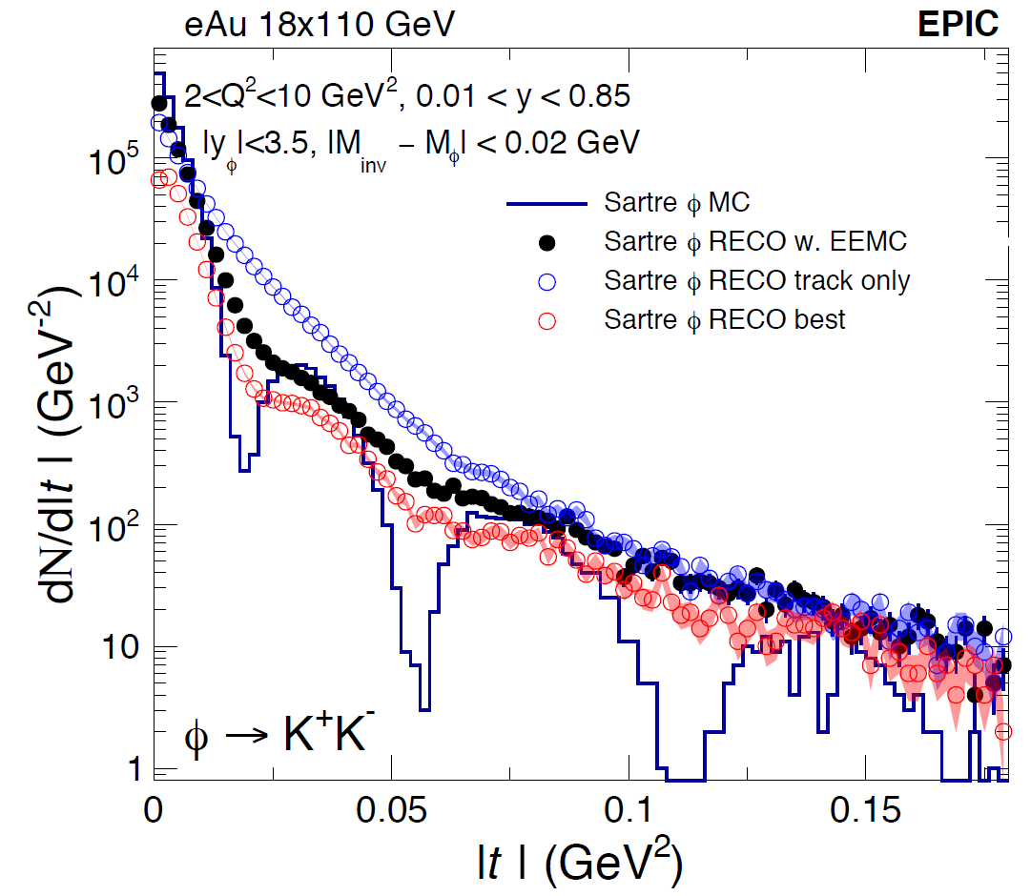
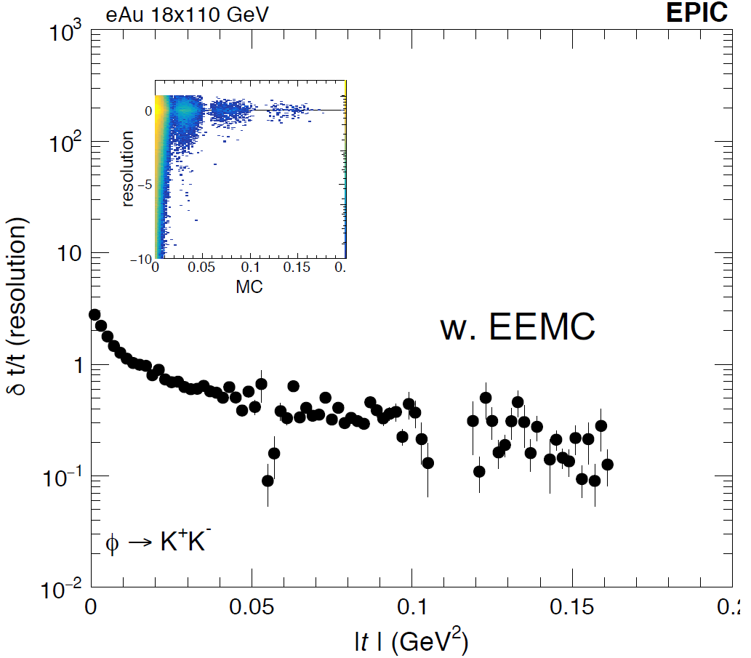
ePIC Physics Studies
First large-scale simulation campaign completed
Anticipate full simulation campaigns every quarter
Projected A₁ Uncertainties
Leptonic
Reconstruction
Double-Angle
Reconstruction
Charlotte Van Hulse
Ralf Seidl
Kong Tu

Slide 22
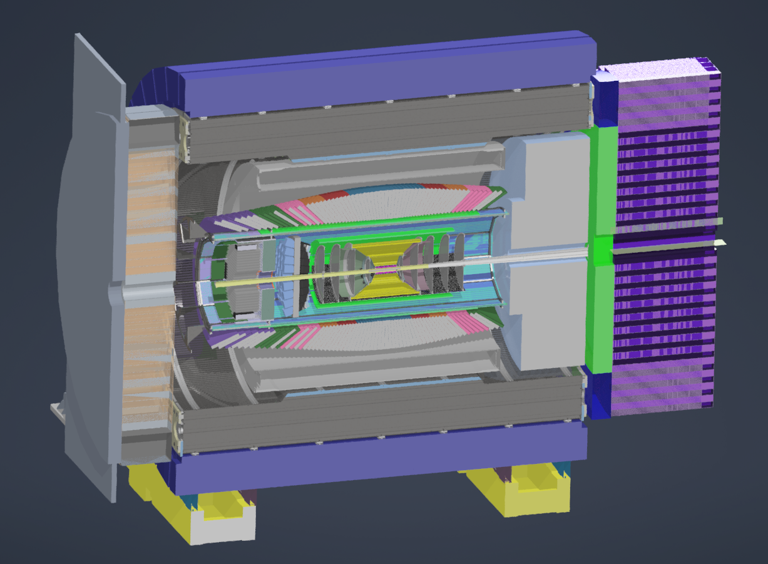
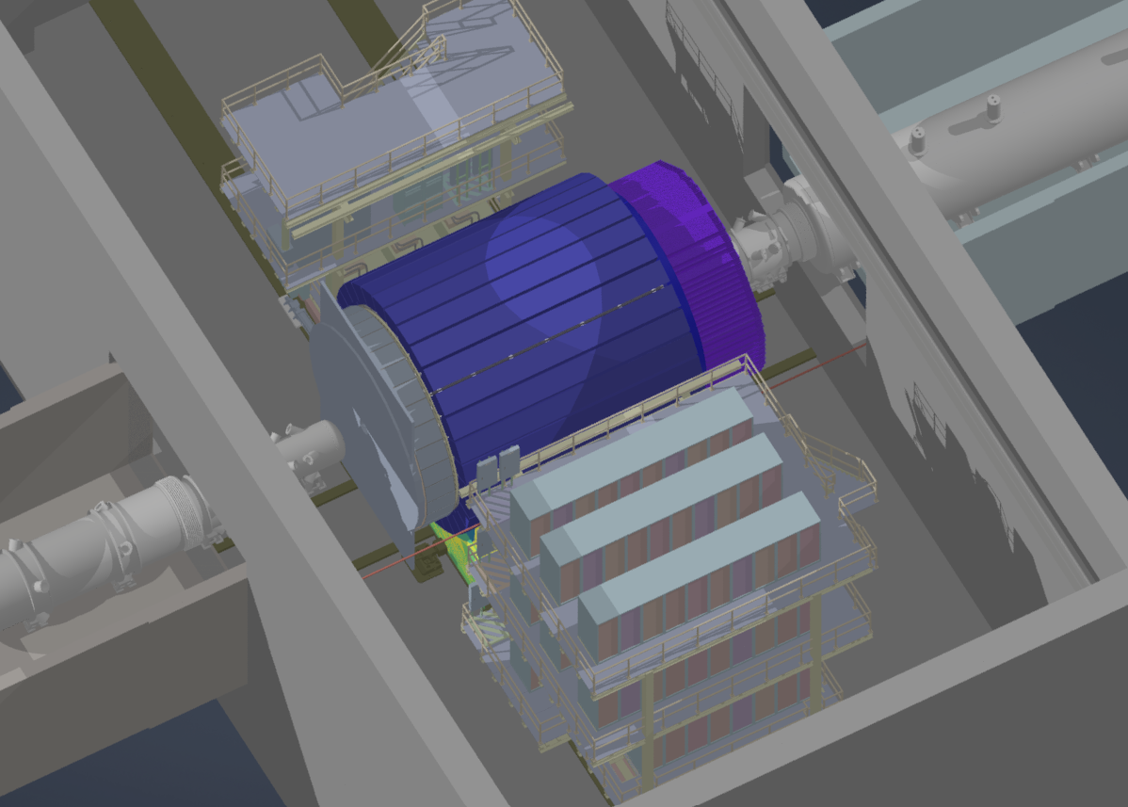
Engineering Design
Full CAD design of ePIC ongoing to facilitate realistic detector integration, including cabling and services.

Slide 23
EIC Project Schedule
Conclusion of
RHIC Operations
06/2025
CD-2
01/2025
early
CD-4A
04/2031
early CD-4
CD-4A
04/2032
CD-0
12/2019
CD-1
06/2021
CD-3A
01/2024
CD-3
04/2025
CD-4
04/2034
Conceptual
Design
Preliminary
Design
Final
Design
Construction
Transition into
Operations
Start of
Operations
&
Science
Final Design LLPs
Approve final design
for all subdetectors
Design Maturity: ~90%
Need TDR
January 2023:
start change control
process for detector
April 2023:
train EVMS process
Approve preliminary design
for all subdetectors
Design Maturity: >60%
Need “pre-”TDR
Define Baseline:
Subdetector technologies,
Scope, Cost & Schedule
Long Lead Procurement items
Design Maturity: ~90%
Plan is tracked through EVMS
& Change control process
Need TDR for LLPs

Slide 24

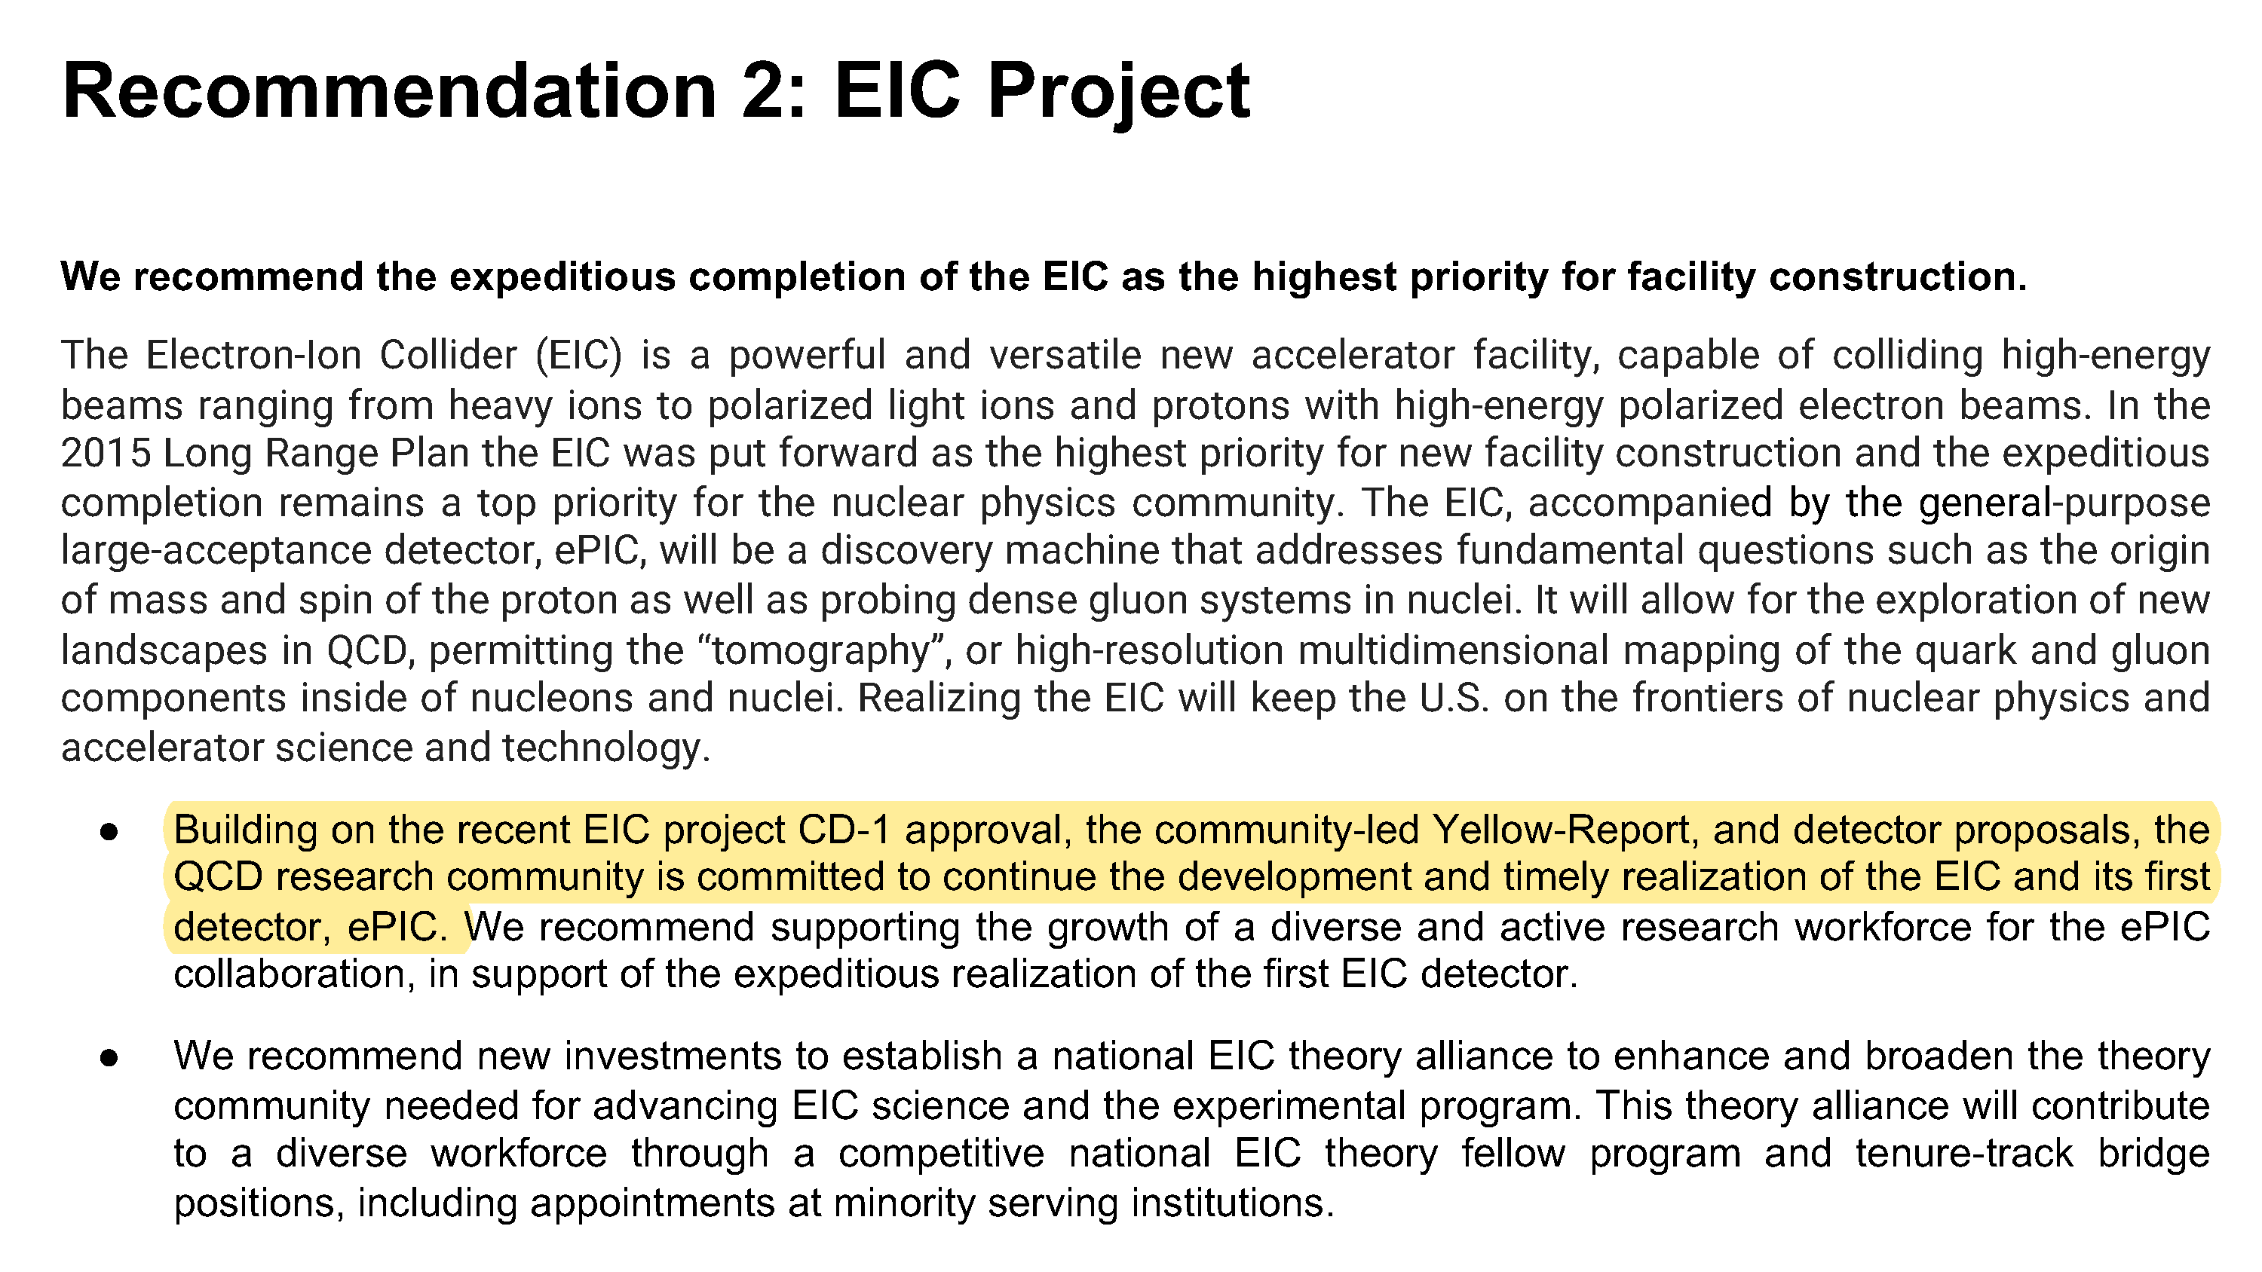
NSAC Long Range Plan - QCD Town Hall

Slide 25
Conclusions
The ePIC Collaboration has kicked-off:
  Charter approved Dec. 14, 2022
    Leadership elections underway
  Second collaboration meeting Jan. 9-11, 2023
    https://indico.bnl.gov/event/17621/
  Ongoing WG meetings focused on developing the ePIC technical
  design for CD-2/3A
    Forum to focus community and R&D consortium expertise
  Strong support and participation from EIC community
The ePIC Detector is maturing into a detailed technical design
  EIC detectors are an enormous undertaking that will require participation and expertise from both the RHIC and JLab communities
  International participation is key!
  Progress towards DOE milestones CD-3A/CD-2/CD-3 in 2023

Slide 26
ePIC Resources
Indico Meeting Agenda:
  https://indico.bnl.gov/category/402/
ePIC Wiki:
  https://wiki.bnl.gov/EPIC/index.php?title=Main_Page
ePIC Mailing Lists:
  https://lists.bnl.gov/mailman/listinfo
  Look for “eic-projdet-xxx” lists

Slide 27


Slide 28
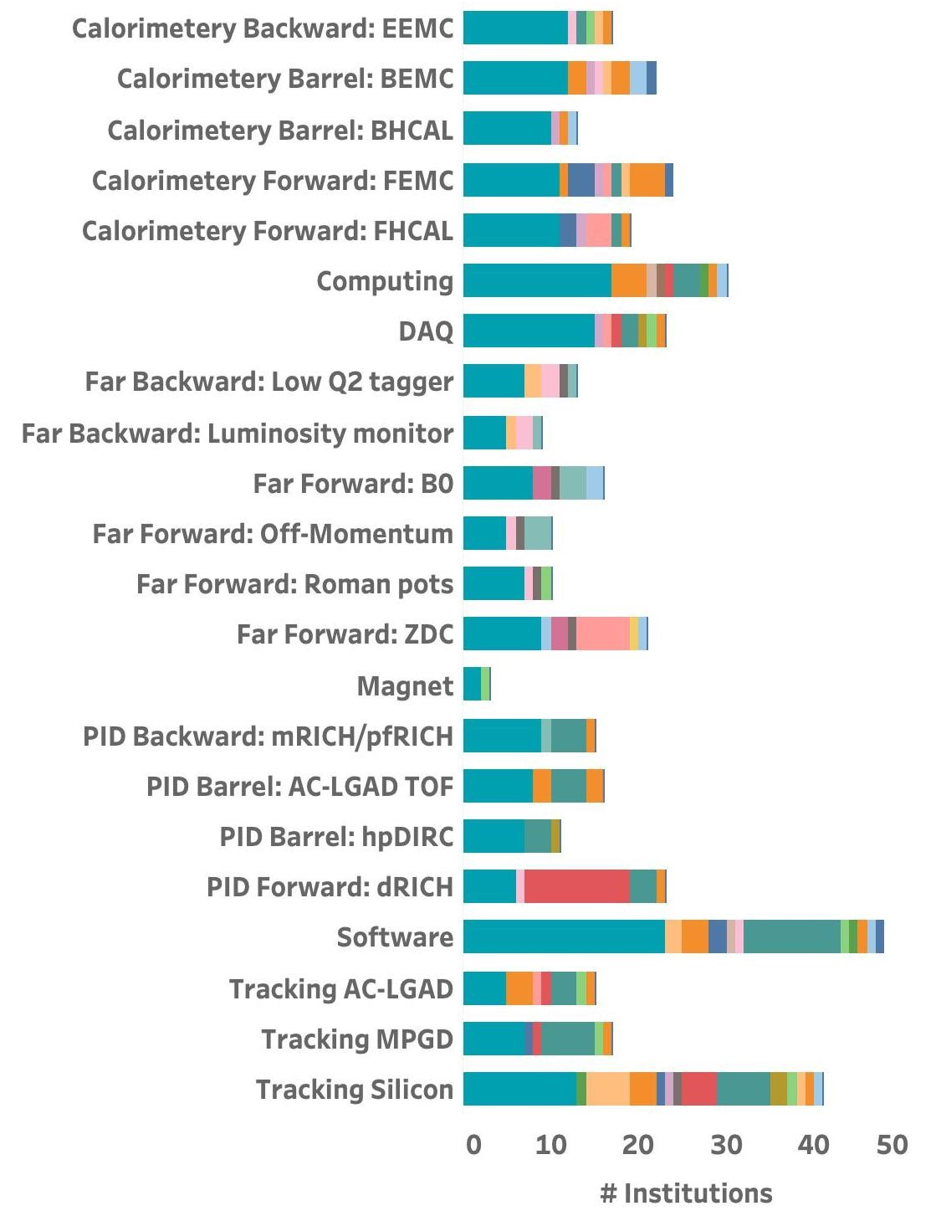
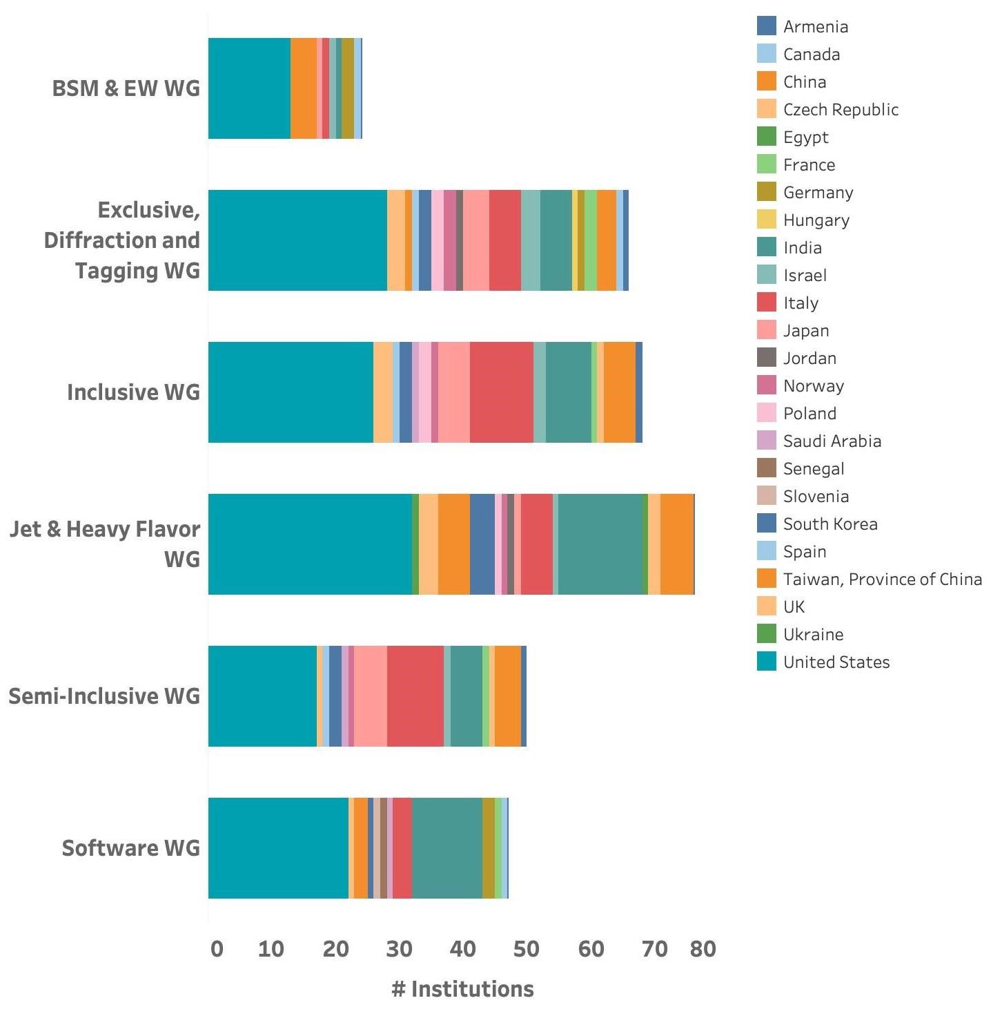
The ePIC Collaboration
Extensive expertise and a wide array of physics interests.

Slide 29
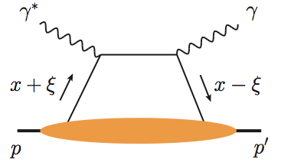
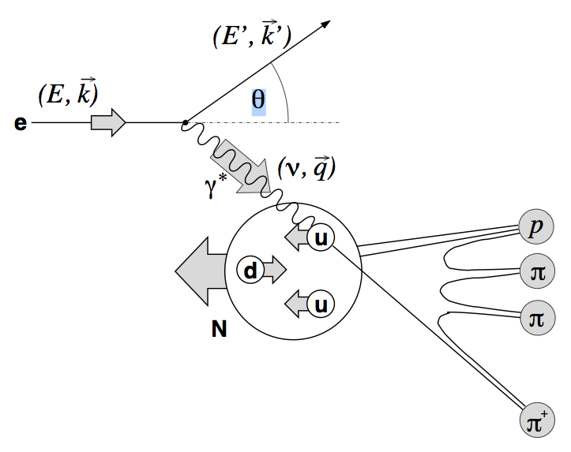
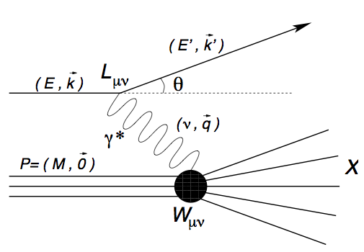
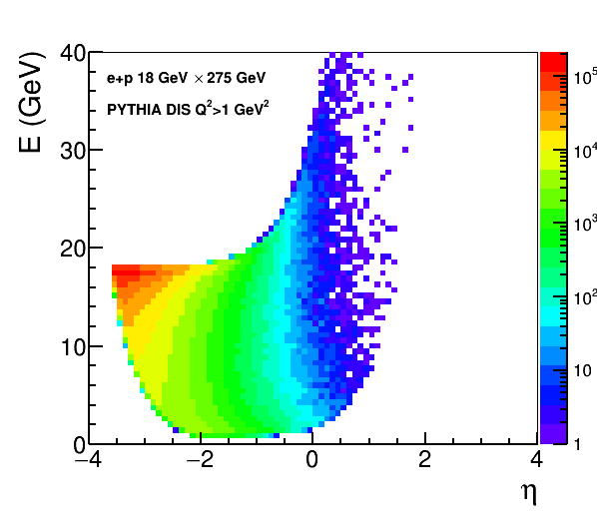
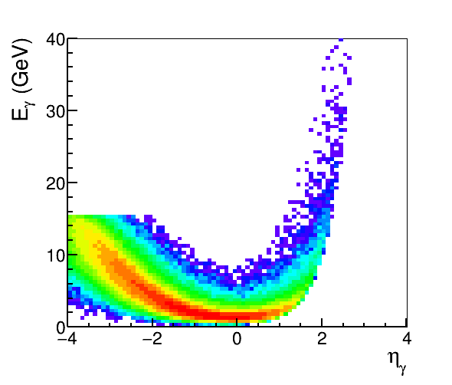
Example: EM
Calorimetry Requirements
Electron/photon PID, energy, angle/position:
Coverage (in rapidity and energy), resolution, e/𝜋, granularity, projectivity
DIS e
DVCS photons
SIDIS π0
MILOU DVCS
e+p 18×275 GeV
PYTHIA
18 x 275 GeV
e-endcap
Barrel
h-endcap

Slide 30
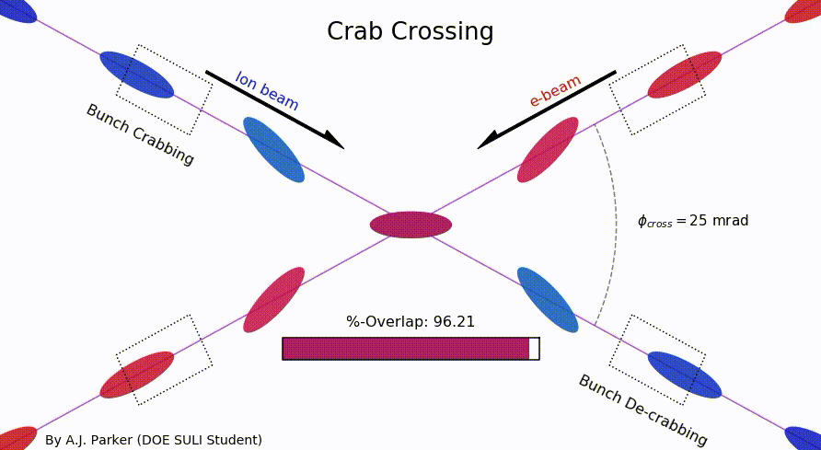
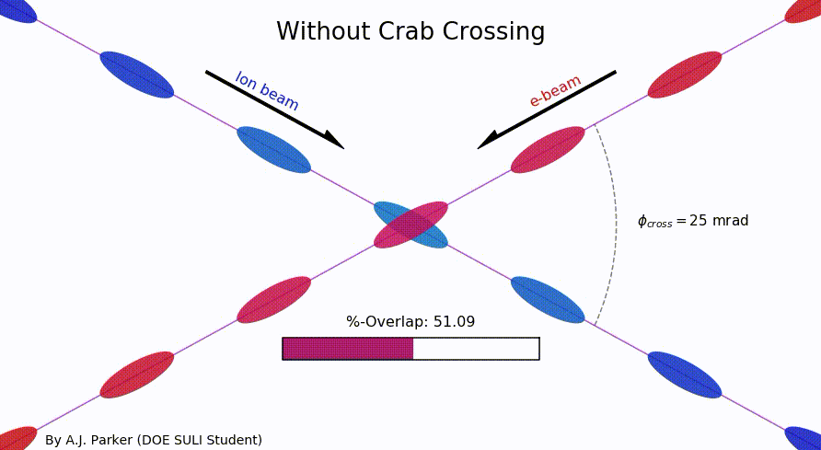
Why a Crossing Angle?
Brings focusing magnets close to IP
→ High luminosity
Beam separation without separation dipoles
→ Reduced synchrotron radiation background
But significant loss of luminosity!
Solution: Crab crossing
Head-on collision geometry is restored by rotating the bunches before colliding (“crab crossing”)
Bunch rotation (“crabbing”) is accomplished by transversely deflecting RF resonators (“crab cavities”)
Actual collision point moves laterally during bunch interaction
Completely new concept for a collider

