Slide 1

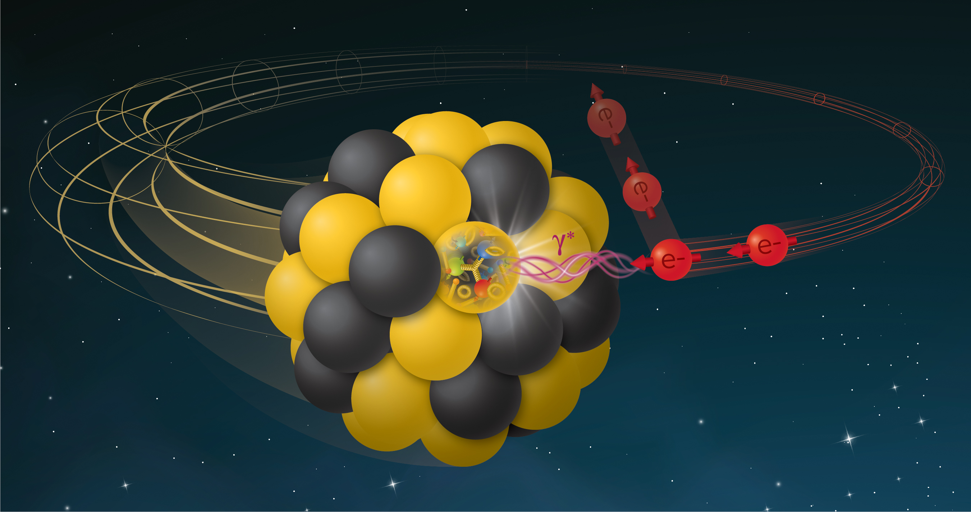
Epic – leveraging the eic on day 1
APS DNP 2024
Sylvester joosten
Markus diefenthaler
Argonne National Laboratory
Jefferson Lab
This work is supported by the U.S. Department of
Energy, Office of Science, Office of Nuclear Physics,
under contract DE-AC02-06CH11357.
Monday, October 7, 2024

Slide 2
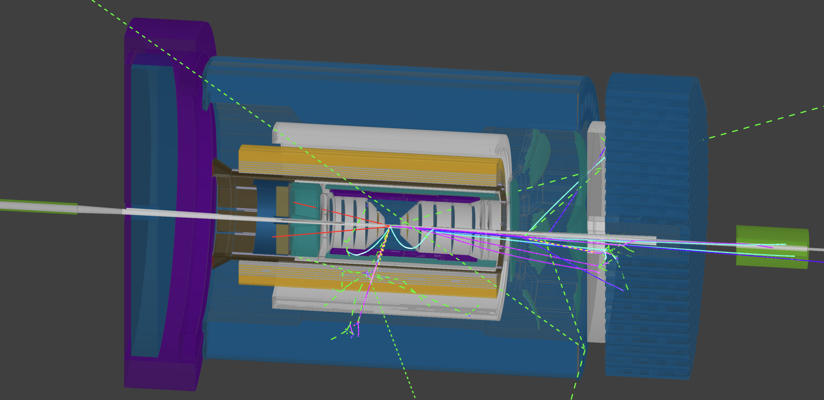
Epic in a nutshell
Joosten & Diefenthaler, DNP 2024
ePIC is the primary experiment at the Electron-Ion Collider (EIC).
It is a highly integrated, multi-purpose experiment.
The ePIC Experiment is being realized by the ePIC Collaboration, jointly with the EIC Project.
The collaboration, formed in 2022/2023, is international in scope
In our presentation, we will summarize the status and planning for ePIC

Slide 3
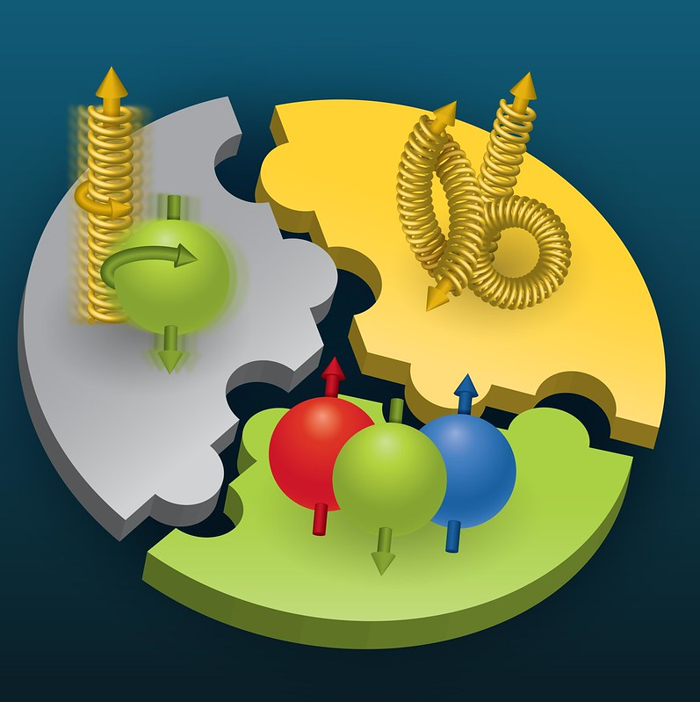
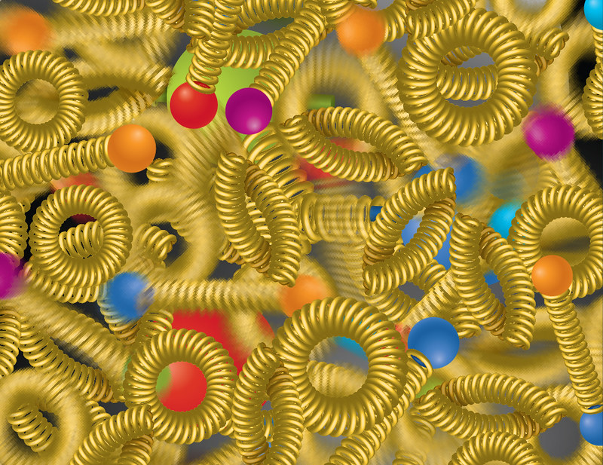
The dynamical nature of nuclear matter
Proton structure emerges from the complex dynamics of its constituents
Nuclear Matter – Interactions and structures are inextricably mixed up
Observed properties – such as mass and spin – emerge out of the complex system
Ultimate goal – Understand how matter at its most fundamental level is made
To reach goal – precisely image quarks and gluons and their interactions

Slide 4
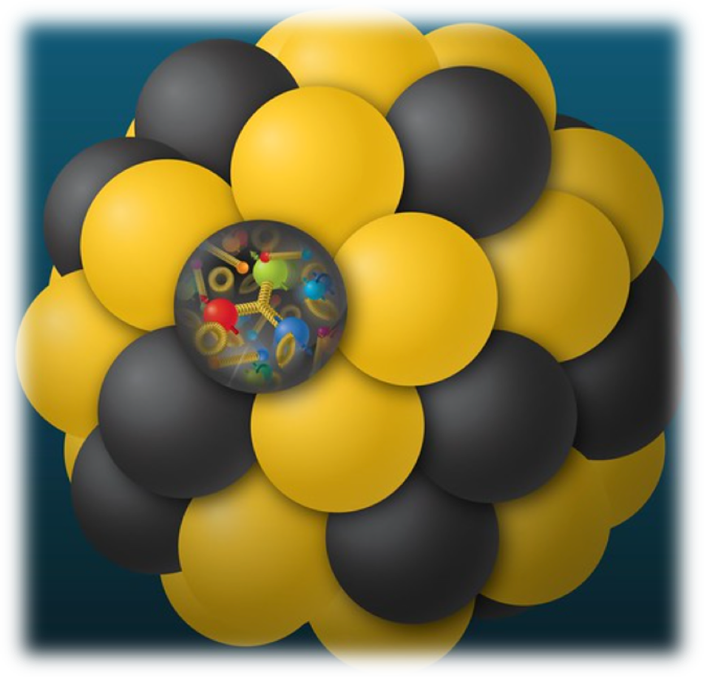
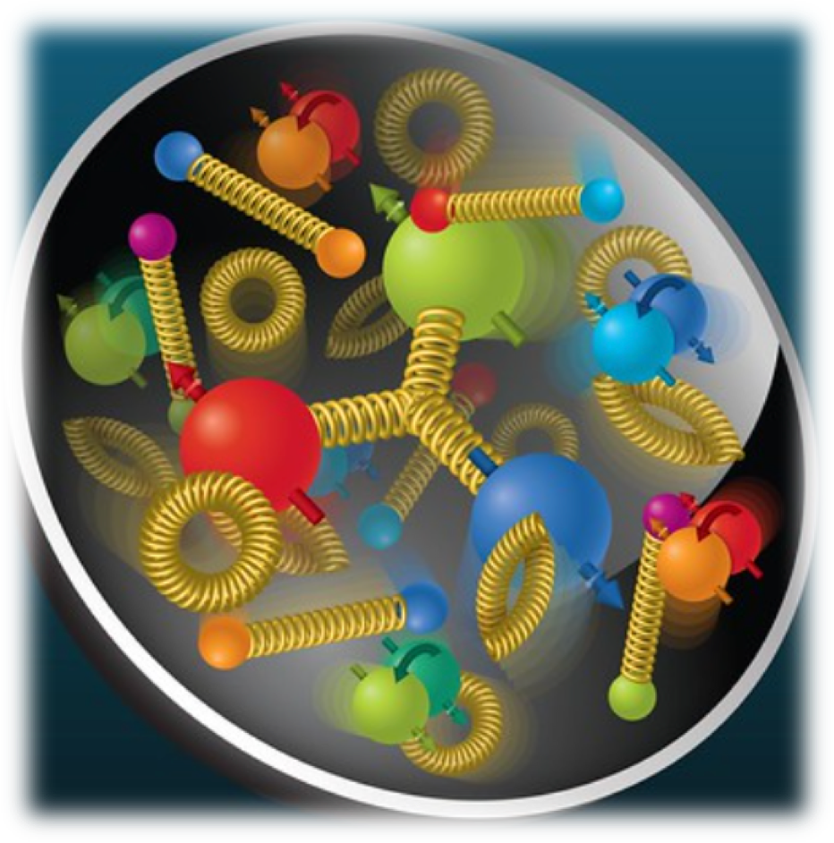
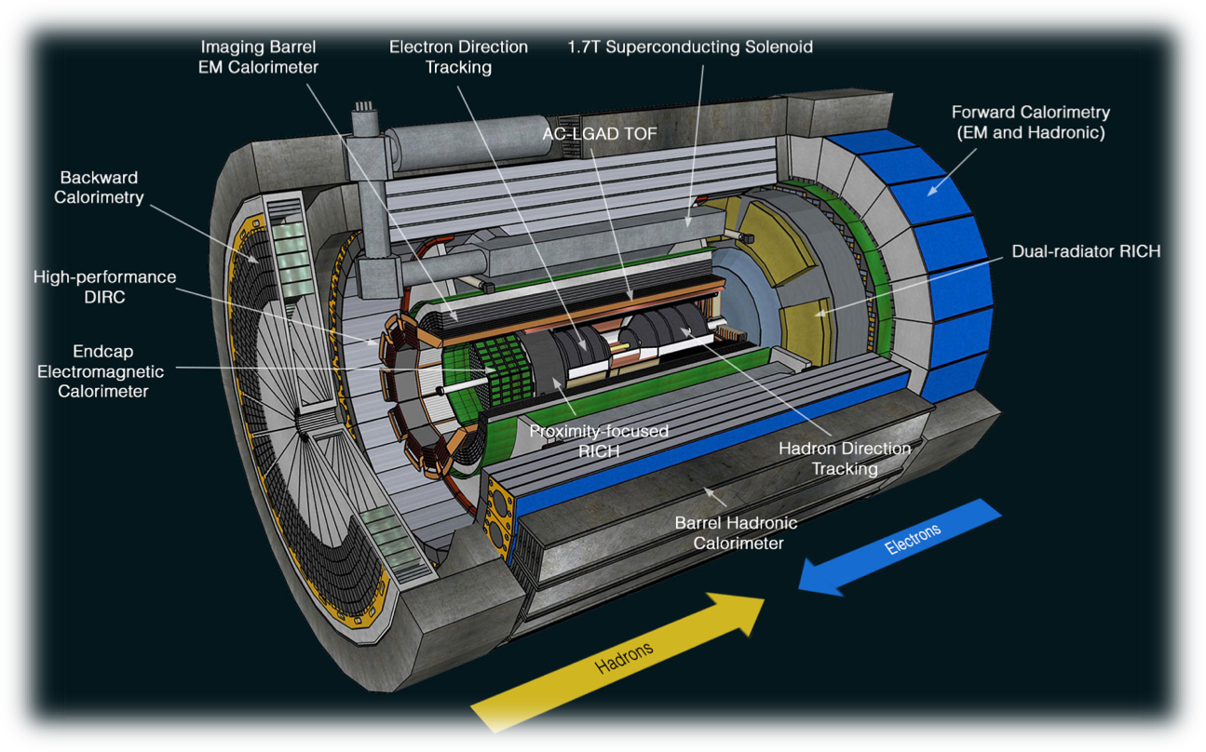
Eic science in a nutshell
Explore the nucleon in terms of the quark and gluon dynamics.
Detailed mapping of the quark & gluon dynamics that account for > 99% of the mass of our visible universe!
Development of cutting-edge technologies to build a state-of experiment, leveraging advances in accelerator, detector, readout, and computing technologies.
EIC will provide transformational insights into the heart of matter.

Slide 5
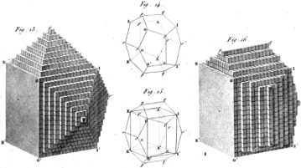
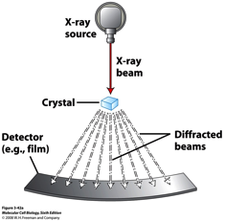
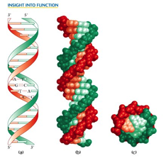
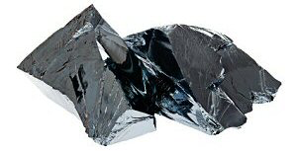
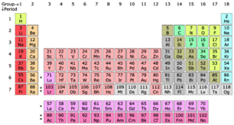
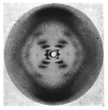


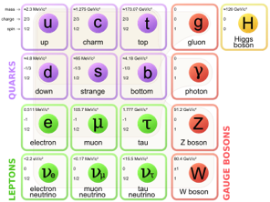
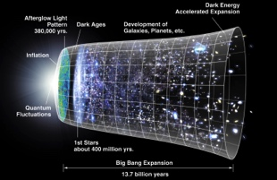
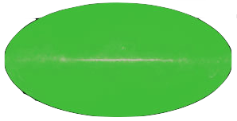
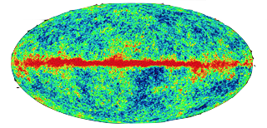
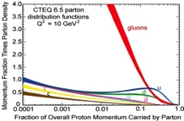
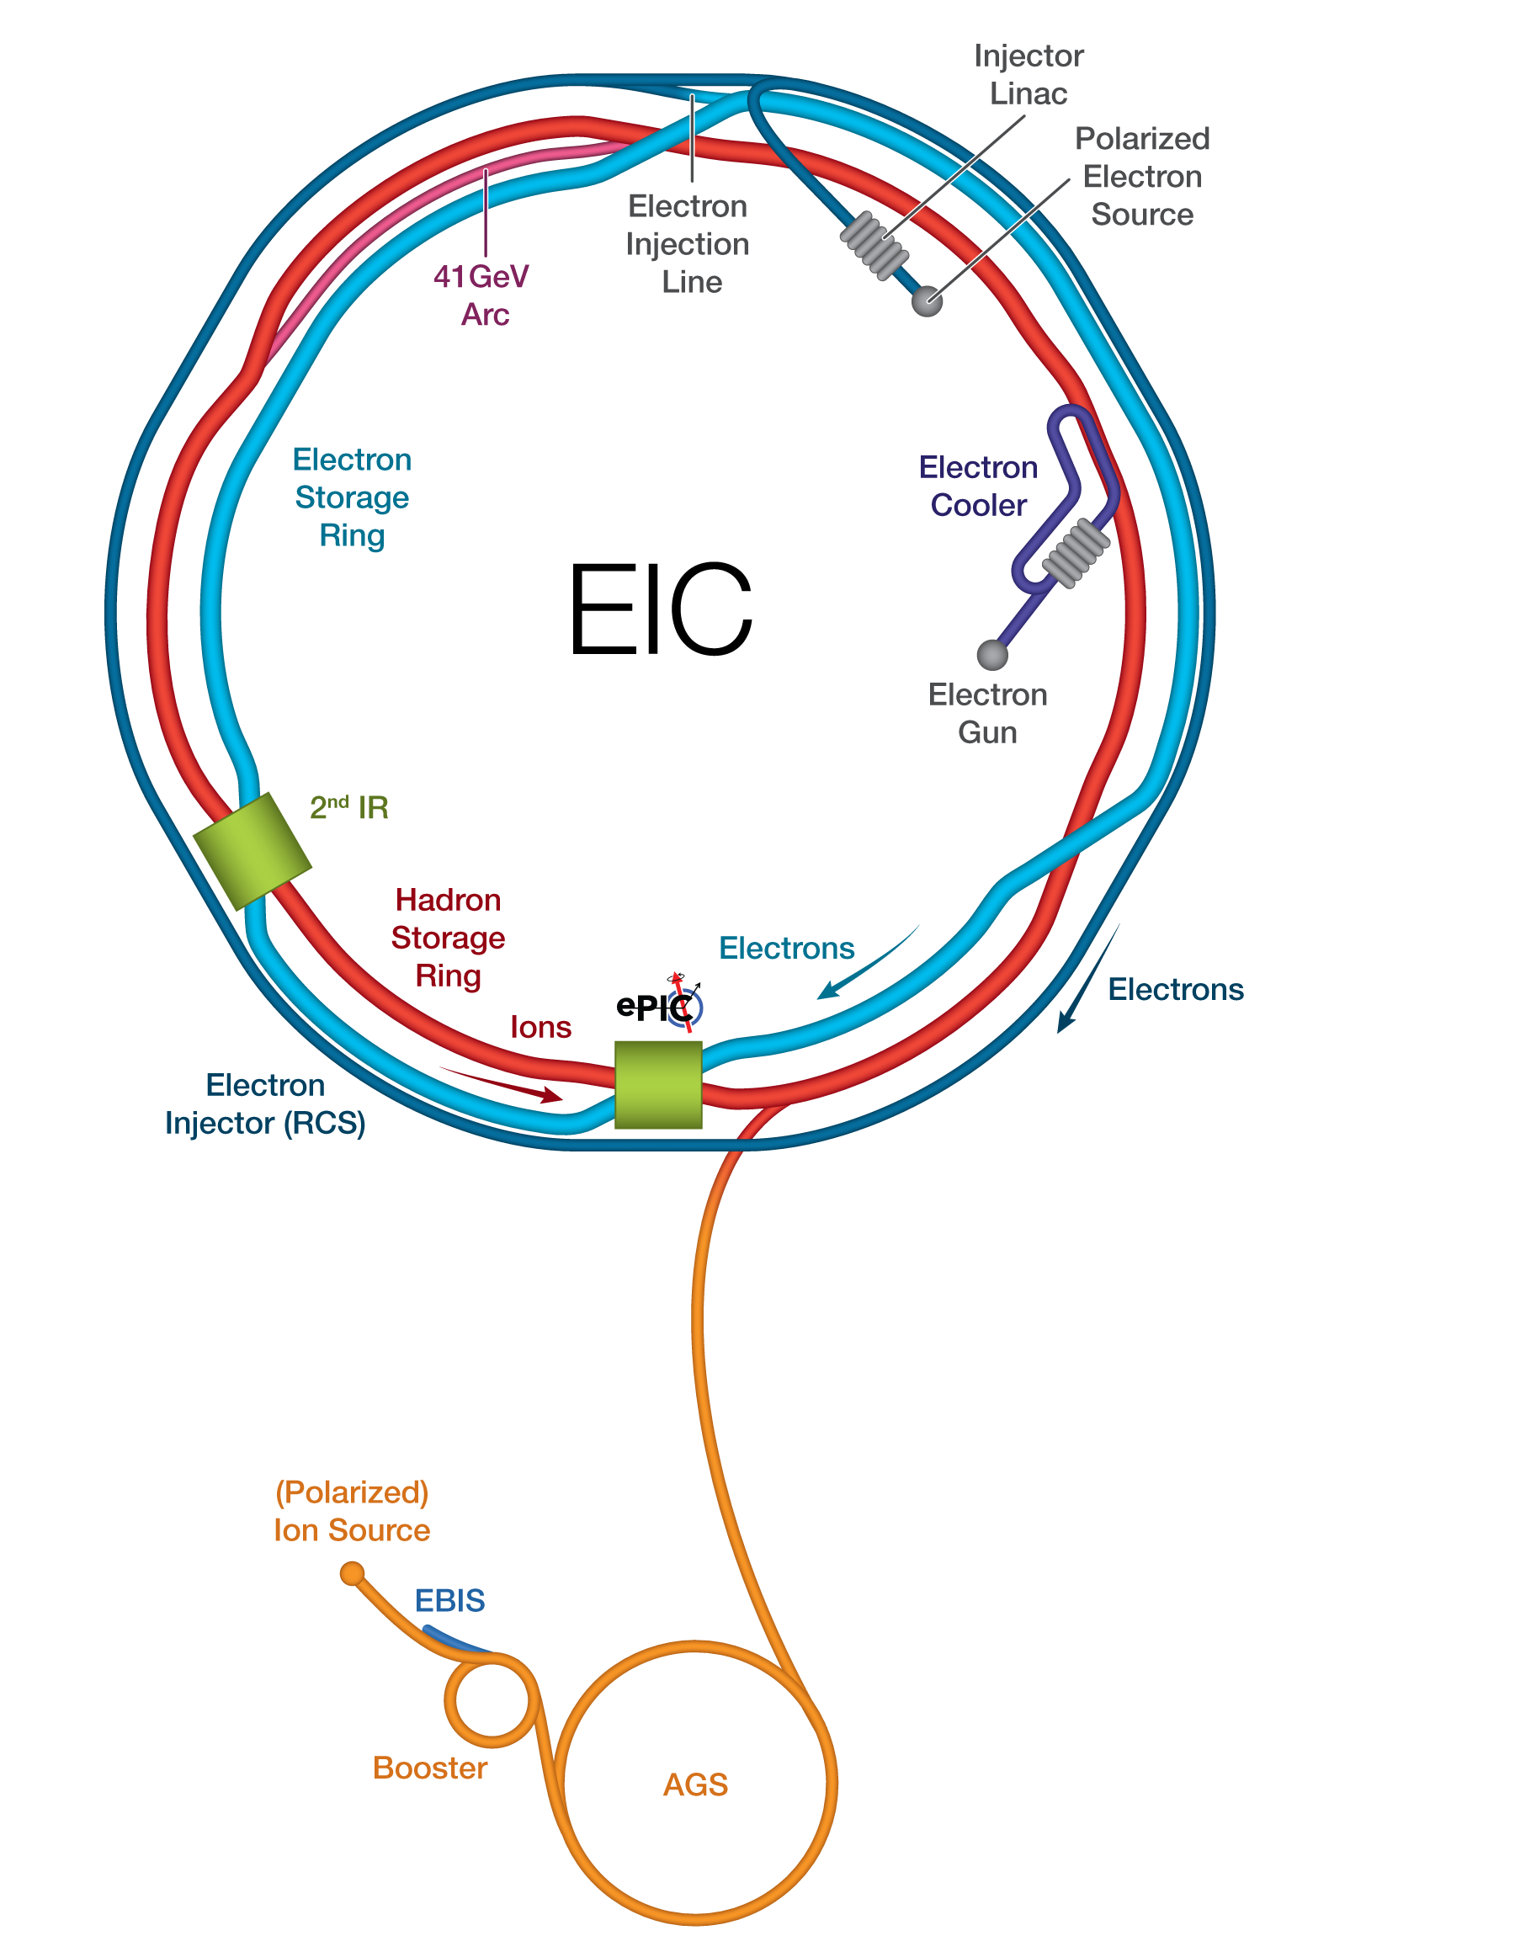
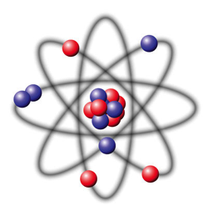




Eic brings a new frontier in science!
Dynamical System | Fundamental Knowns | Unknowns | Breakthrough Structure Probes (Date) | New Sciences, New Frontiers
Solids
Electromagnetism
Atoms
Structure
X-ray Diffraction
(~1920)
Solid state physics
Molecular biology
1801
DNA
Universe
General Relativity
Standard Model
Quantum Gravity,
Dark matter, Dark
energy. Structure
Large Scale Surveys
CMB Probes
(~2000)
Precision
Observational
Cosmology
CMB 1965
Nuclei
and Nucleons
Perturbative QCD
Quarks and Gluons
Non-perturbative QCD Structure
Electron-Ion Collider
(2030+)
Structure & Dynamics in QCD
2017

Slide 6
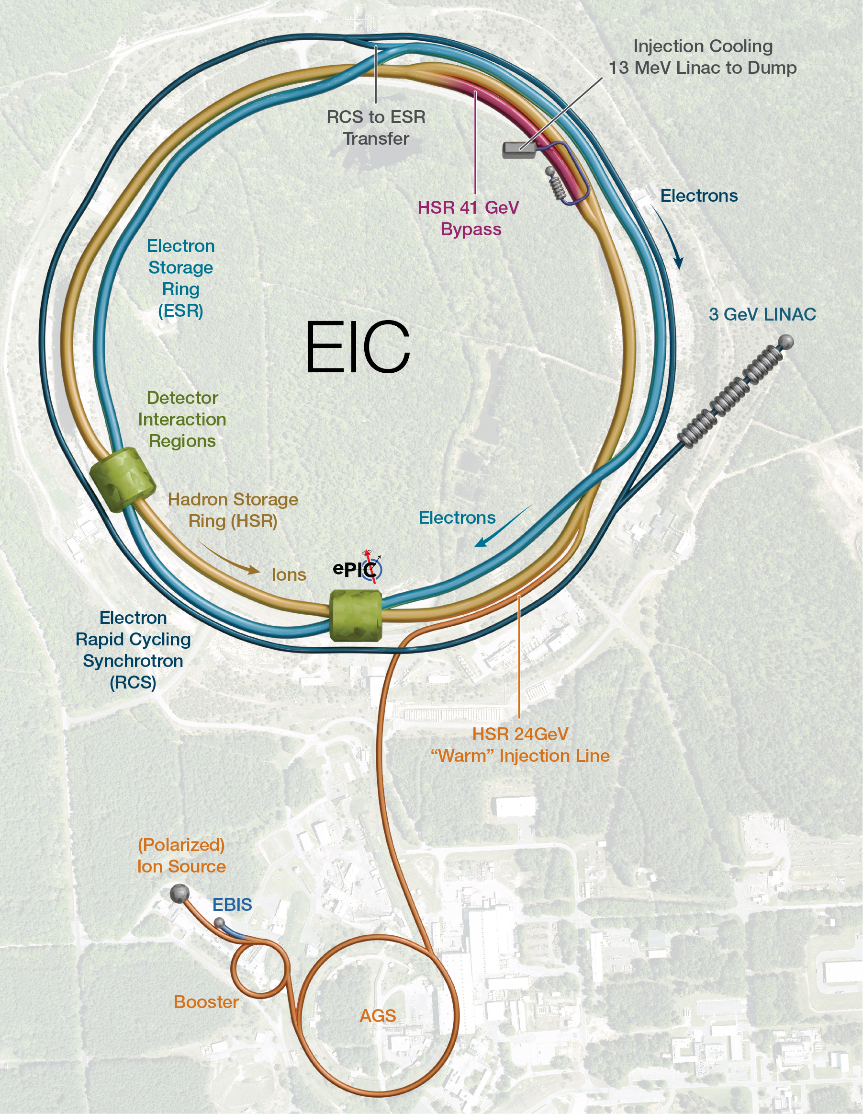
The electron-ion collider
A Frontier Accelerator in the USA
World’s first collider of:
  Polarized electrons and polarized protons,
  Polarized electrons and light ions (d, 3He),
  Electrons and heavy ions (up to Uranium).
A versatile machine:
  Versatile range of beam polarizations, up to 70%,
  Versatile range of beam species,
  Versatile range of center of mass energies, Ecm = 29 – 140 GeV.
High luminosity up to L = 1034 cm-2 s-1 = 10 kHz/μb:
  The e-p cross section at peak luminosity is about 50 μb. This corresponds to a signal event rate of about 500 kHZ.
BNL and Jefferson Lab are the host laboratories for the EIC Experimental Program, sharing leadership roles.

Slide 7
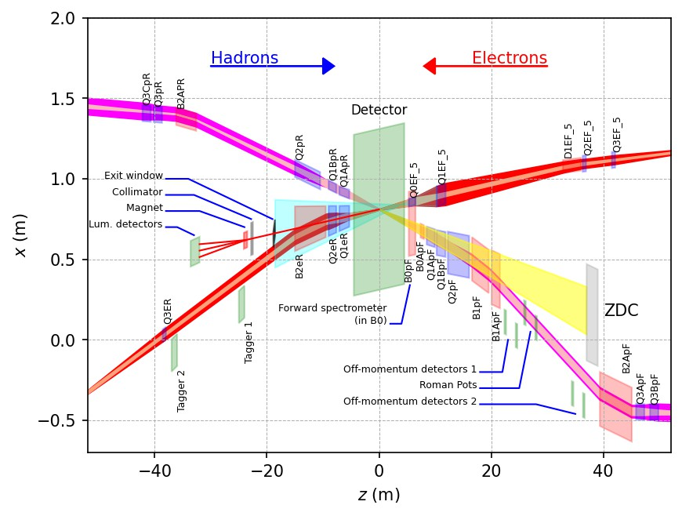
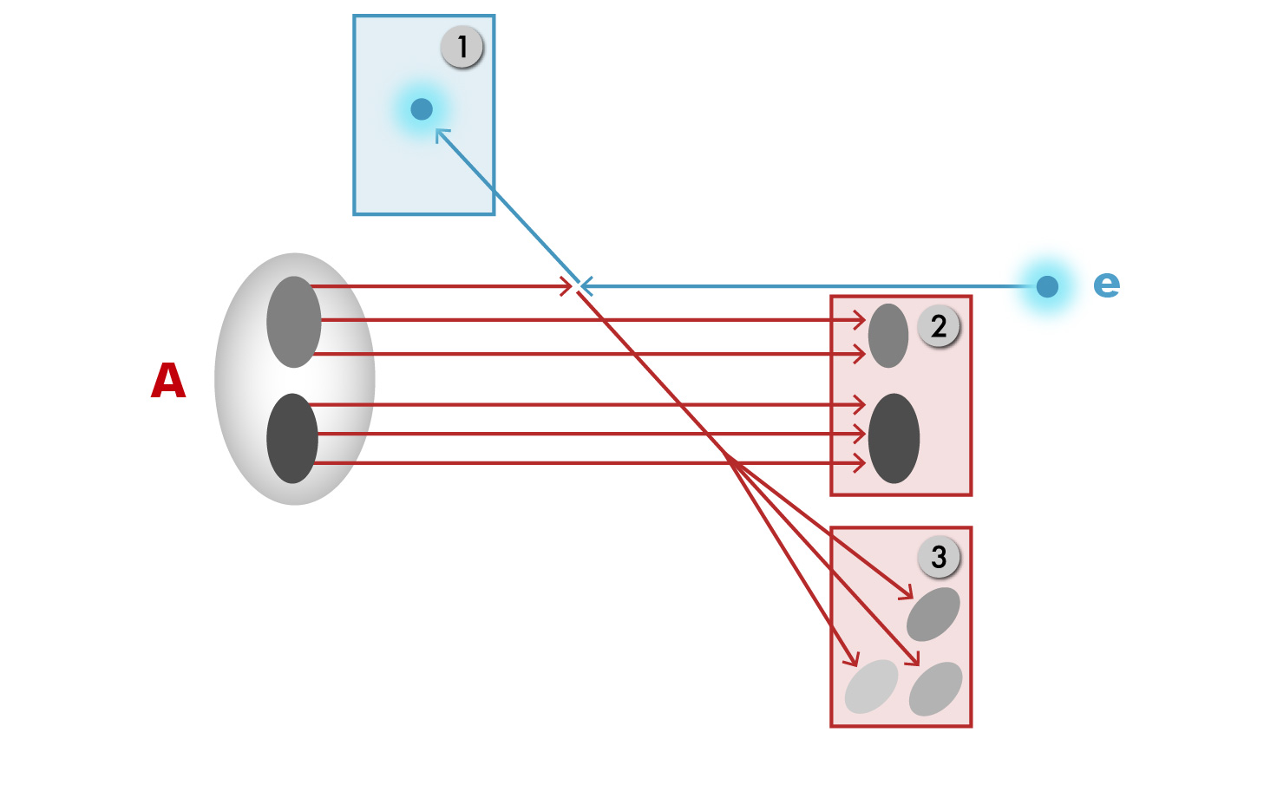
Maximizing the physics reach
Integrated Interaction Region and Detector Design
The aim is to get near-full acceptance for all final state particles, with good resolution.
Scattered DIS electron
Particles associated with initial ion
Particles associated with struck quark
Possible to get close to full acceptance for the whole event:
  Beam crossing angle of 25mrad creates room for forward dipoles.
  Dipoles create space for detectors in the forward ion and electron direction and analyze the forward particles.
  Experimental challenges:
  Beam elements limit forward acceptance.
  Central Solenoid not effective for forward

Slide 8
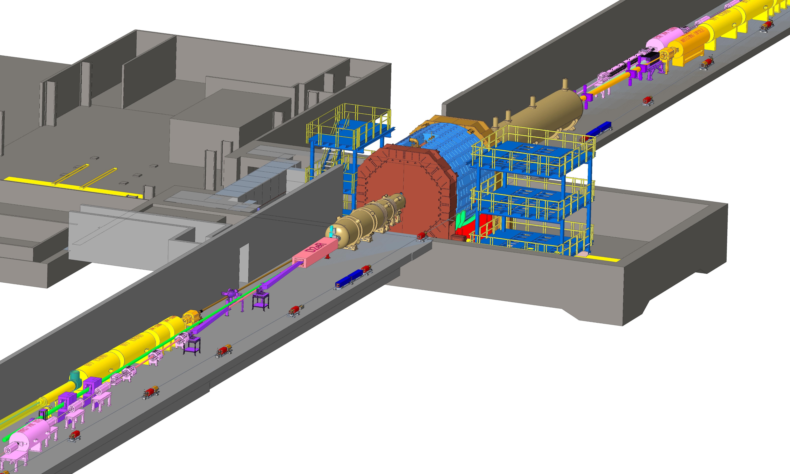

So the epic detector is … 90 meters long!
8
Joosten & Diefenthaler, DNP 2024

Slide 9
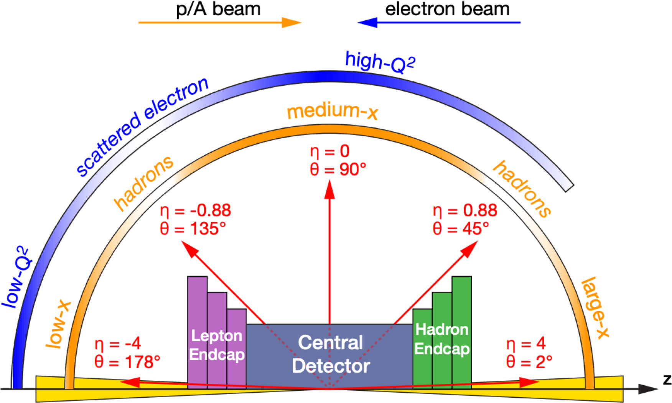
Physics-driven detector design
Inclusive DIS requires fine binning in x_{B}, Q²:
  Large coverage (-3.5 < η < 3.5) for wide phase space reach
  Excellent EM-calorimetry with PID support for e/π separation.
  Fine resolution tracking with low mass
Semi-inclusive DIS requires multidimensional binning in five or more variables (x_{B}, Q², z, p_{T}, φ_{h} , …):
  Fine p_{T} resolution.
  Extended PID systems for hadron identification,
  Hadron calorimetry to attempt TMD studies with jets.
Exclusive processes require multidimensional binning in four or more variables (x_{B}, Q², t, φ_{h} , …):
  Extend acceptance at extremely small scattering angles by far forward detectors.
  Fine vertex resolution by tracking.

Slide 10
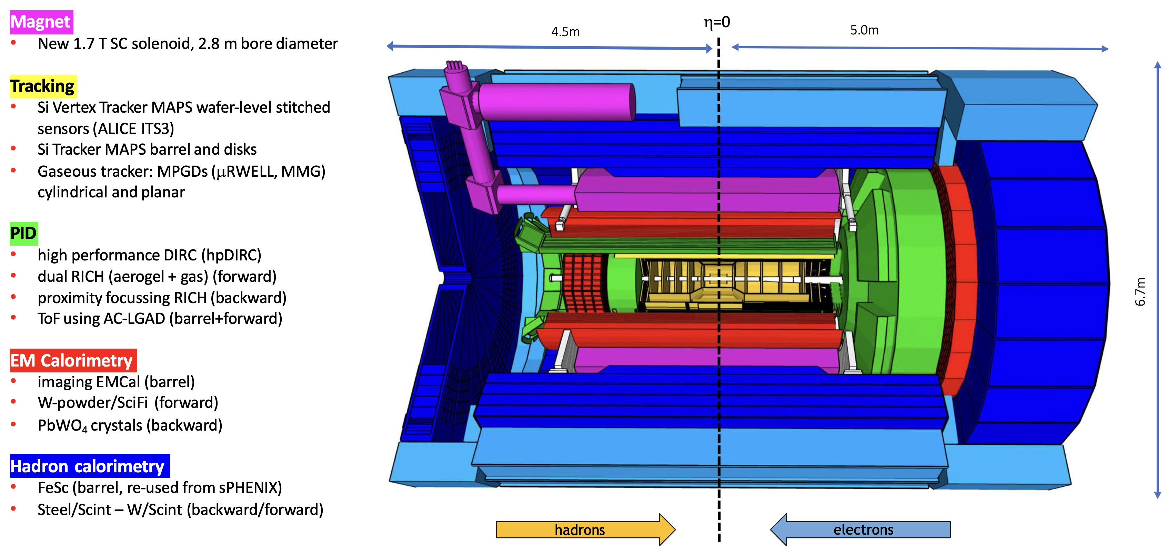
The central epic detector

Slide 11
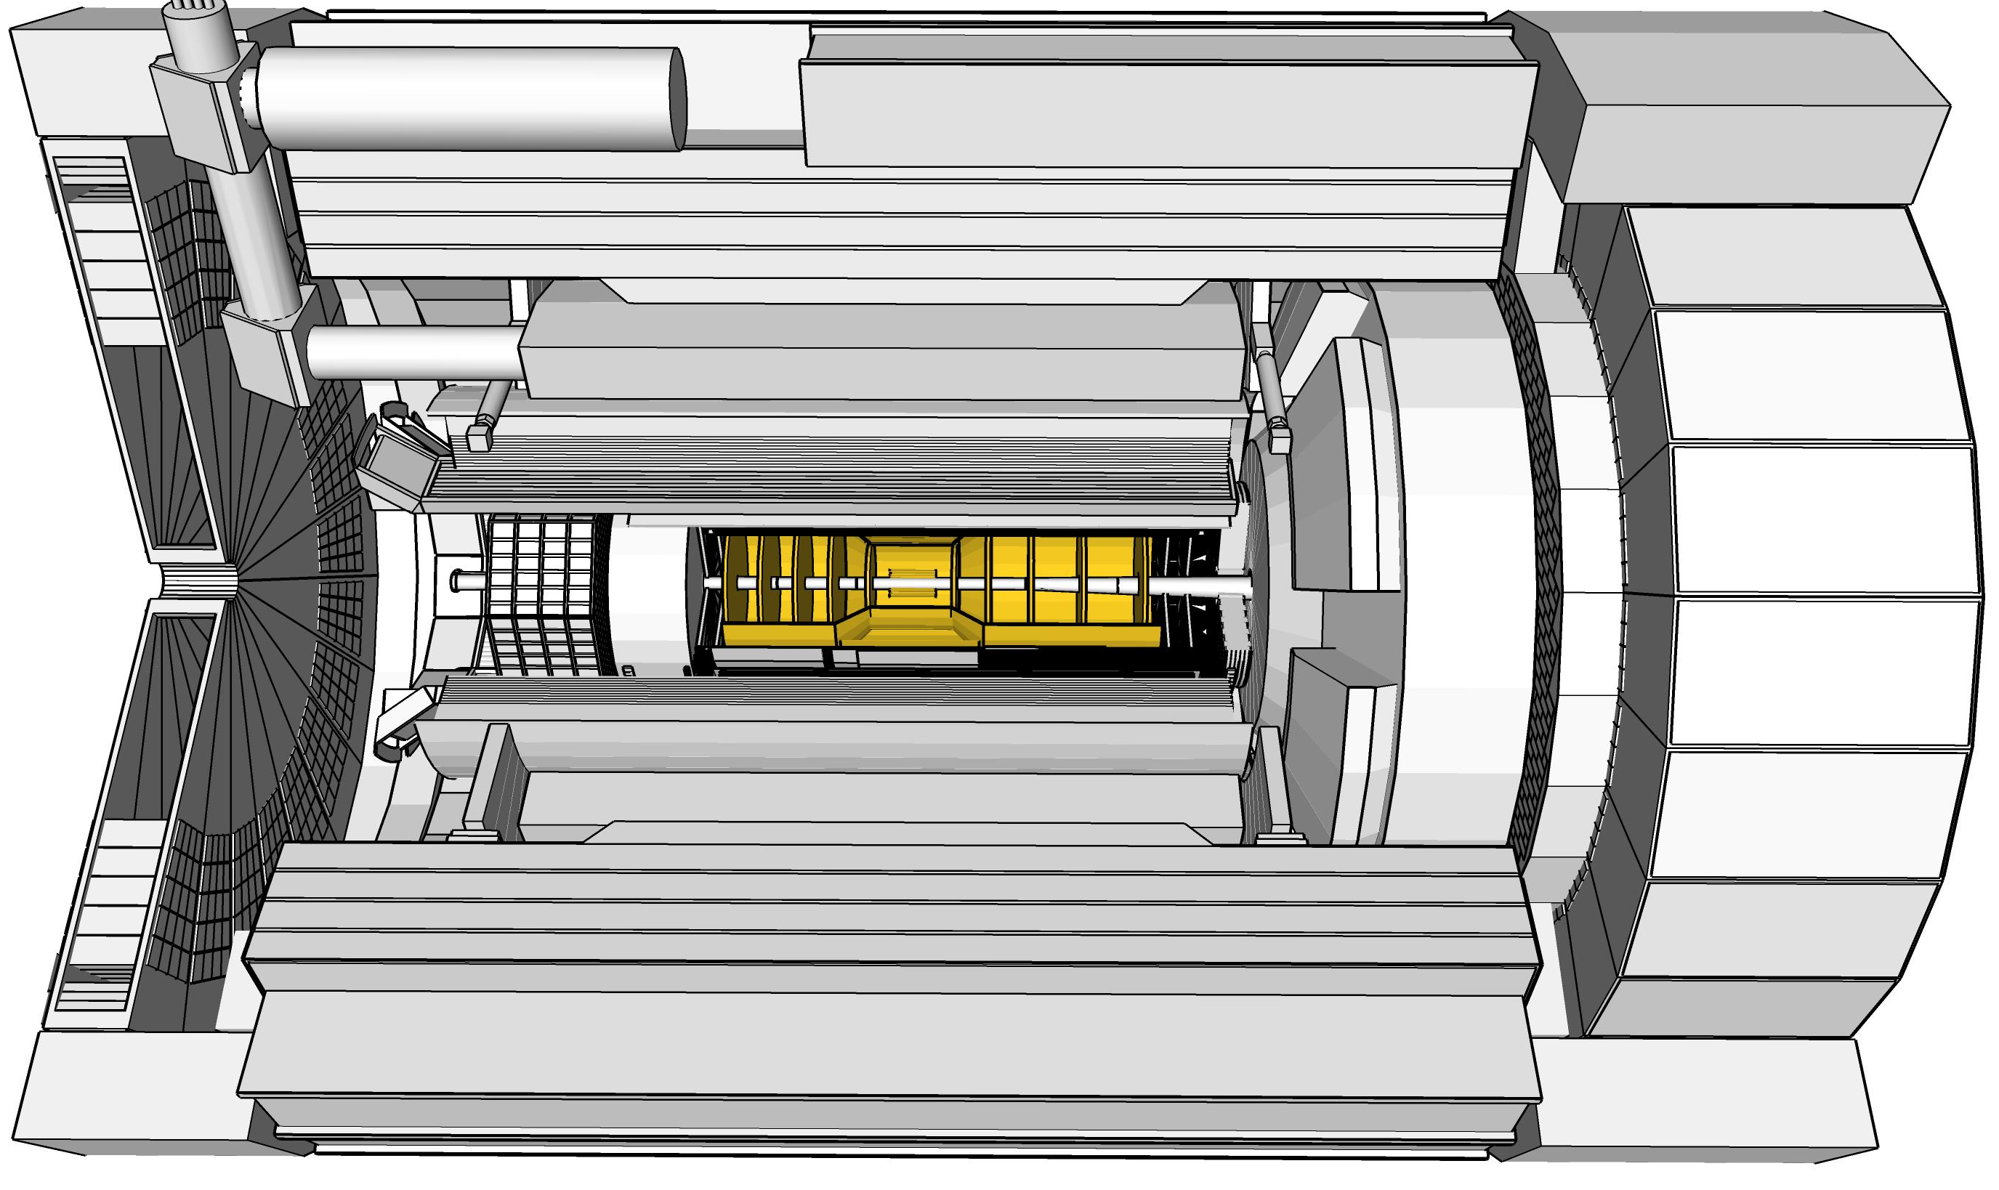
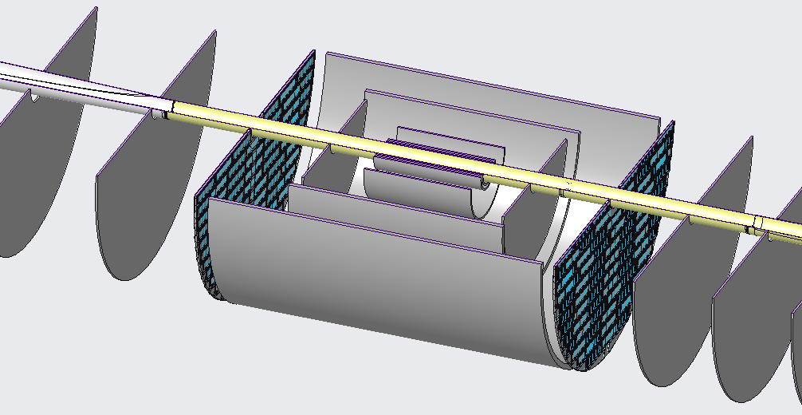
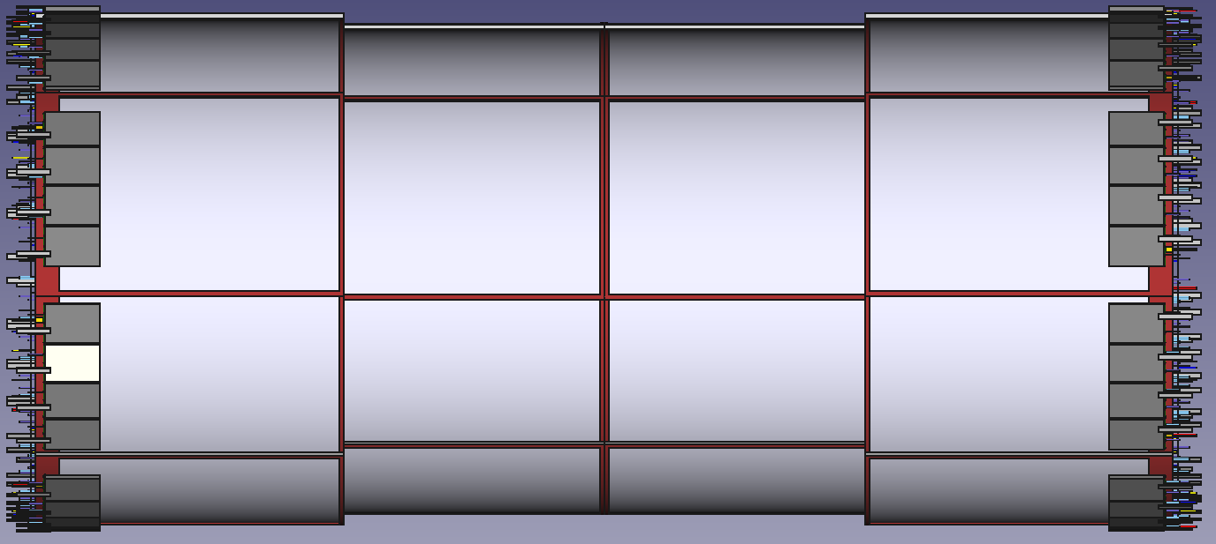
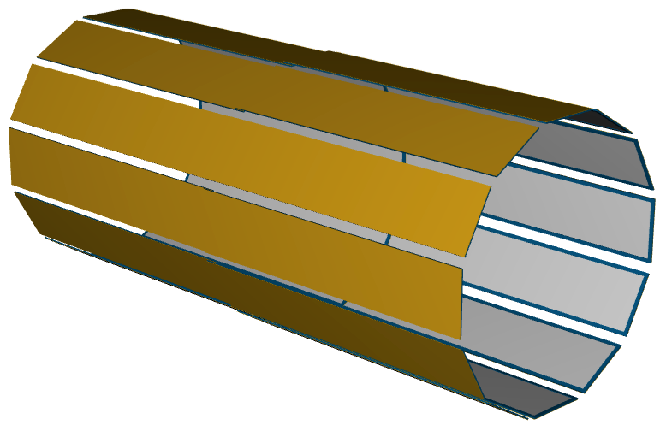
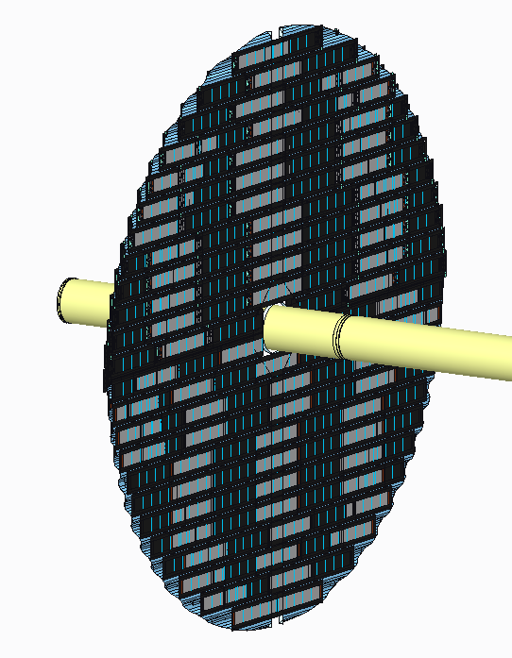
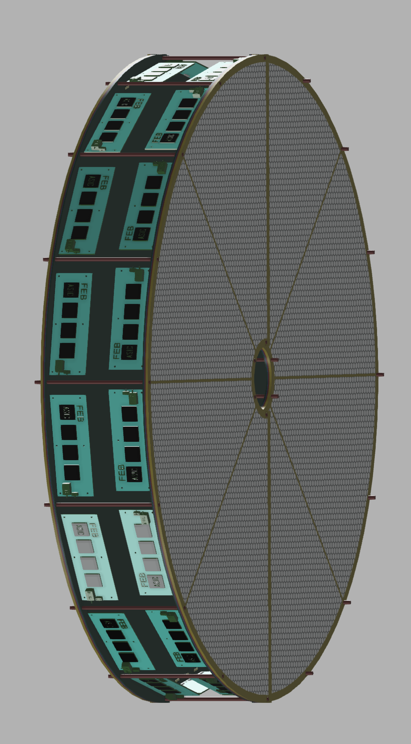
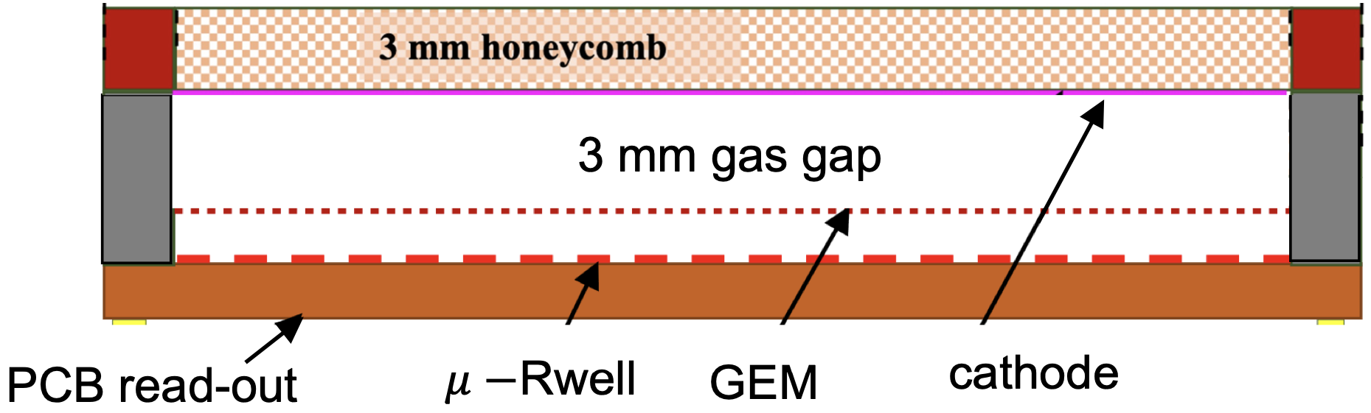
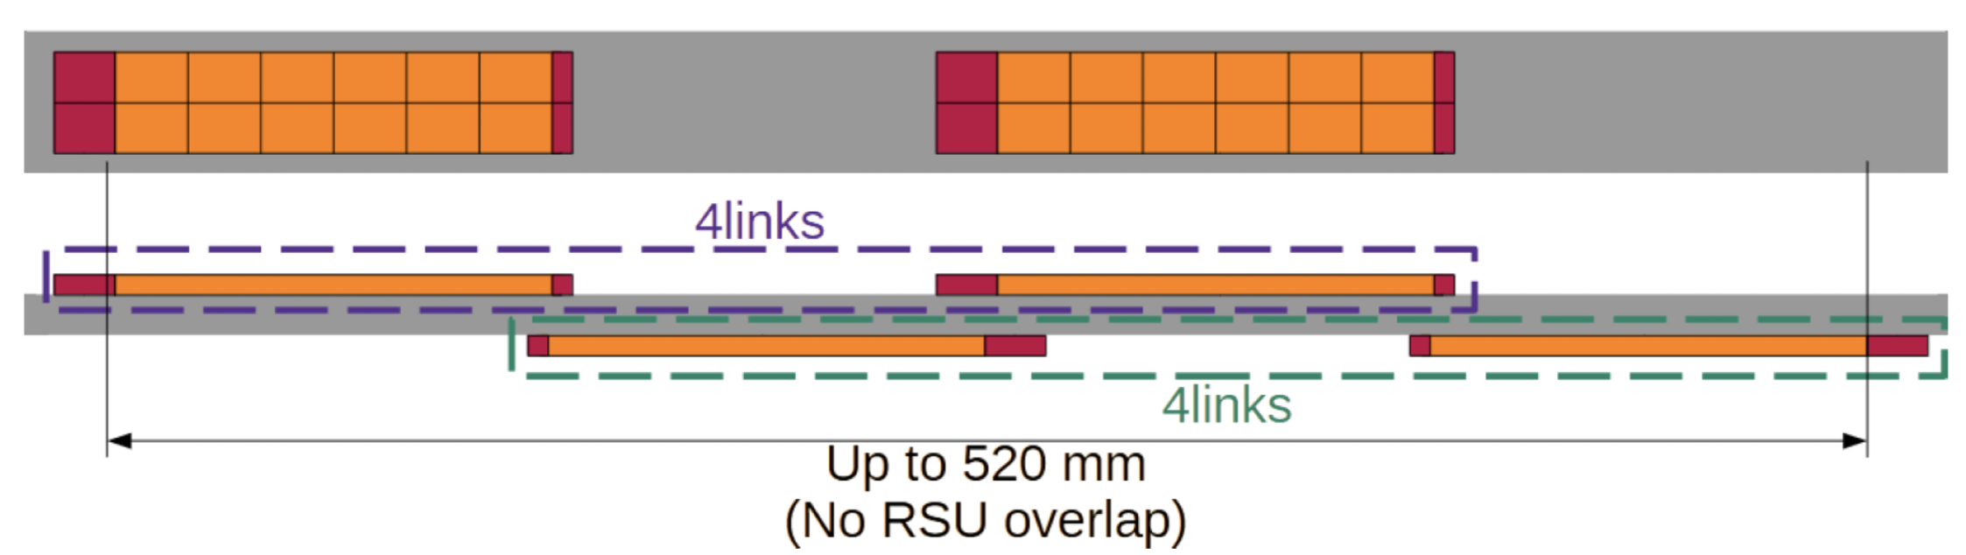
ePIC Tracking Detectors
Overview Slide
from EIC Project
μVertex Tracker
Barrel Tracker
Outer Barrel MPGD Tracker
EndcapTracker
MicroMegas Tracker
μRWELL Tracker
MAPS
Disks
μRWELL
Disks
Main Function
Excellent momentum 0.05%pT⊕0.5%
and spatial resolution 20μm/pT⊕ 5μm
Provide redundancy and pattern recognition for tracking
Tracking close to hpDIRC detector to improve angular and space point resolution.
Redundancy and pattern recognition for tracking
Excellent momentum 0.05 (0.10)% pT⊕1.0 (2.0)%
and spatial resolution
30μm/pT⊕ (20 – 40) μm
Provide redundancy and pattern recognition for tracking
Displaced vertex reconstruction
Proven Technology
Monolithic Active Pixel Sensor → ALICE ITS3 MOSAIX sensor (65 nm)
small pixels (~18 mm) and power consumption (<20 mW/cm²)
Cylindrical resistive Micromegas technology Used: ATLAS NSW, CLAS12, SPHENIX, MINOS& T2K TPC
EIC Large Area Sensor (LAS), modification of ITS3 sensor with 5 or 6 RSU forming staves as the basic building elements for the Outer Barrel
world’s first at
EIC Large Area Sensor (LAS), staves as the basic building elements for the MAPS disks
GEM- 𝜇Rwell hybrid configuration with increased gain
24 planar Thin-gap & double amplification (GEM & μRWELL) modules &
2D-strip readout

Slide 12
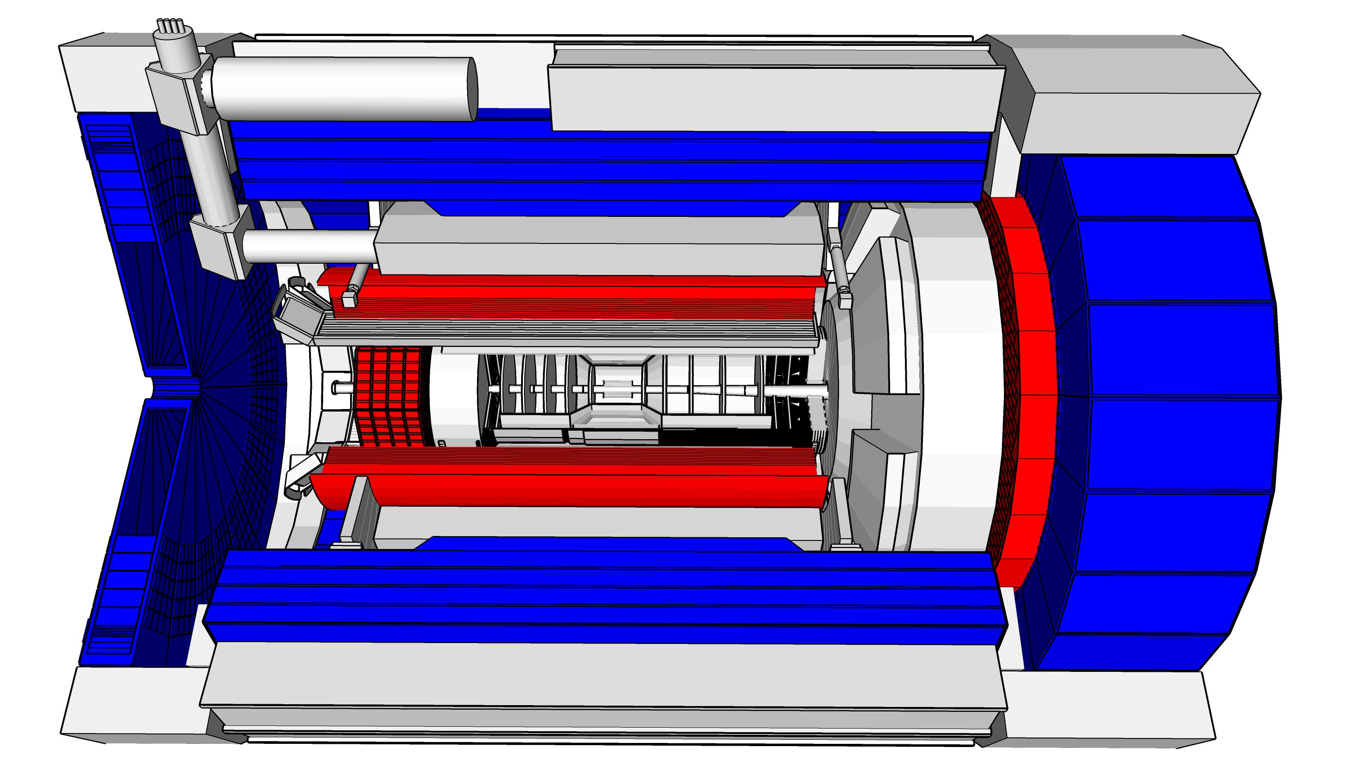
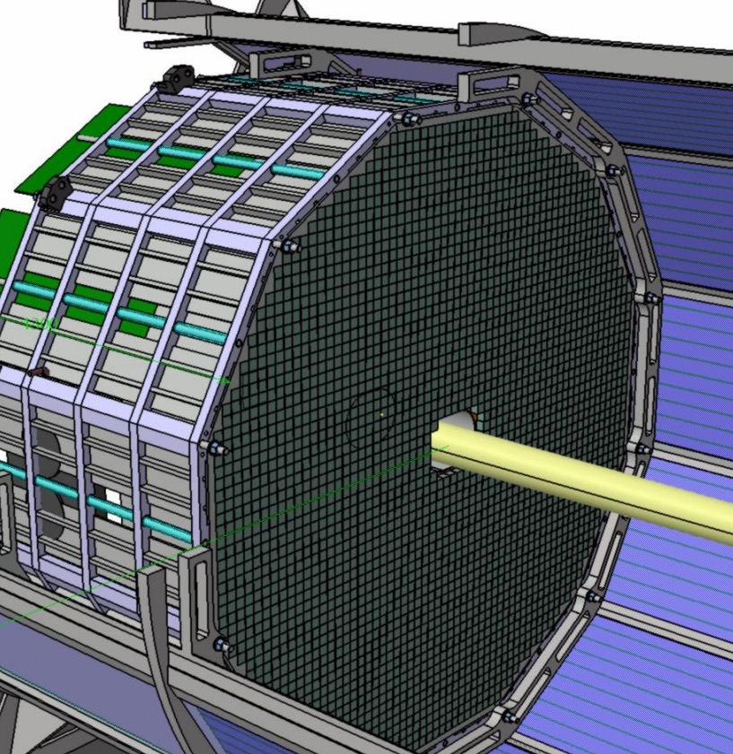
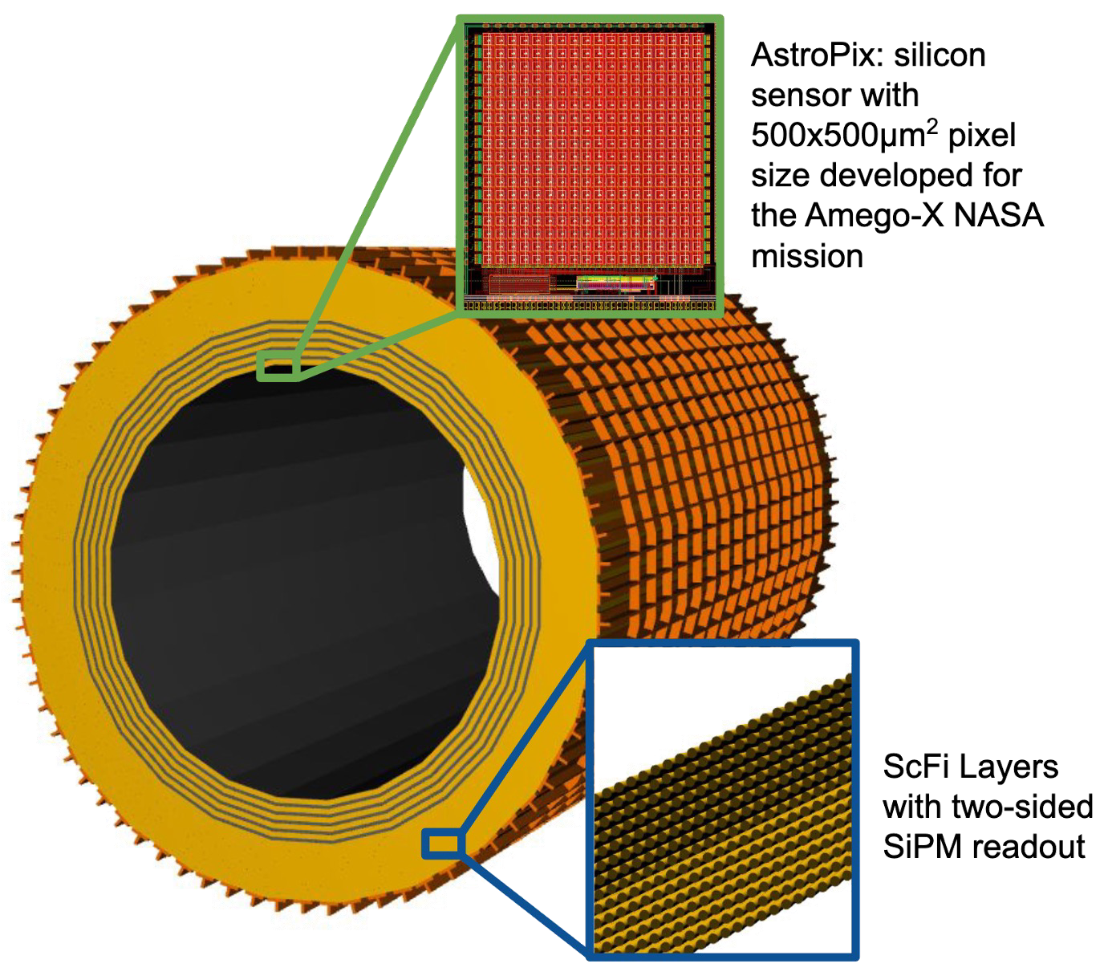
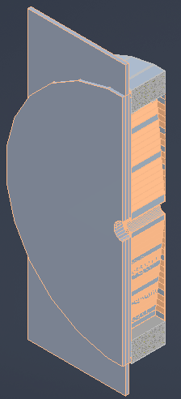
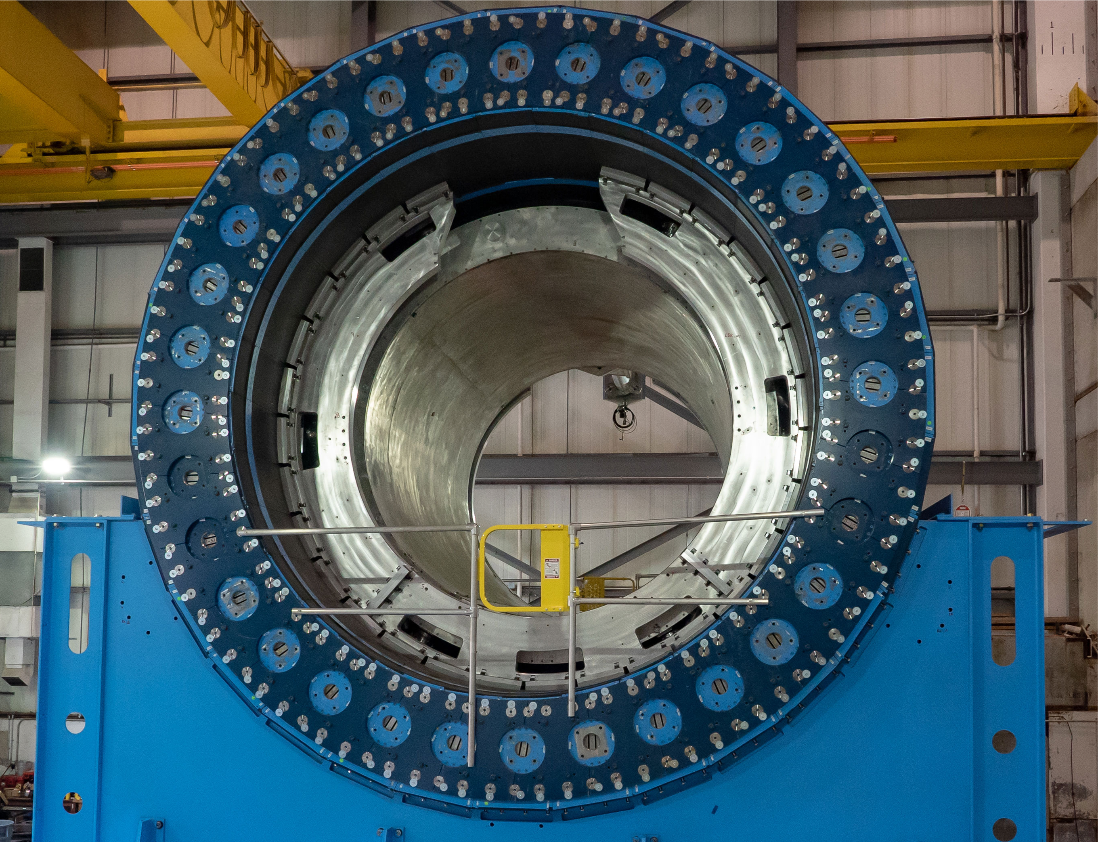
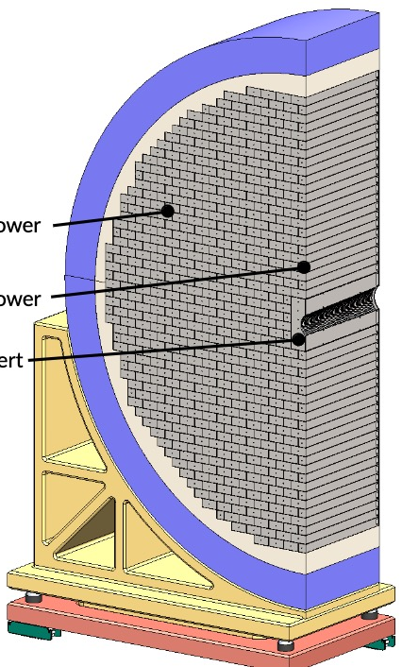
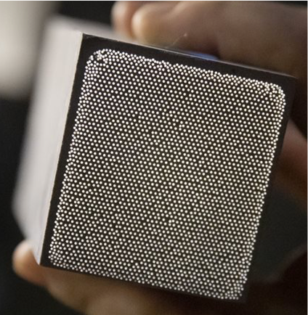
ePIC Calorimetry
Backward ECal
Barrel ECal
Forward ECal
Backward HCal
Barrel HCal
Forward HCal
Main Function
lepton and γ detection, hadronic final state characterization → π⁰, γ
separation
muon and
neutral detection
→ improved jet Energy reconstruction
muon and neutral detection
→ improved jet Energy reconstruction
scattered lepton detection
→ very high-precision
scattered lepton and γ detection, hadronic final state characterization
particle-flow measurements
Proven Technology
longitudinal segmented Steel + Scintillator SiPM-on-tile
Pioneered by CALICE analog HCal
High resolution insert next to beam-pipe
PbWO4 – crystals
→ long lead procurement
Pb/SciFi sampling part using SiPMs combined with imaging section (6 layers) interleaving Pb/SciFi with ASTROPIX
Tungsten-powder + SciFi SPACAL design
Developed through EIC R&D and applied successfully in sPHENIX
Steel + Scintillator SiPM-on-tile
Steel + Scintillator design
re-used from sPHENIX
world’s first at
first-time full-size CALICE like calorimeter in collider experiment
SiPM as Photonsensors
Use of ASTROPIX in Calorimetry
Overview Slide
from EIC Project

Slide 13
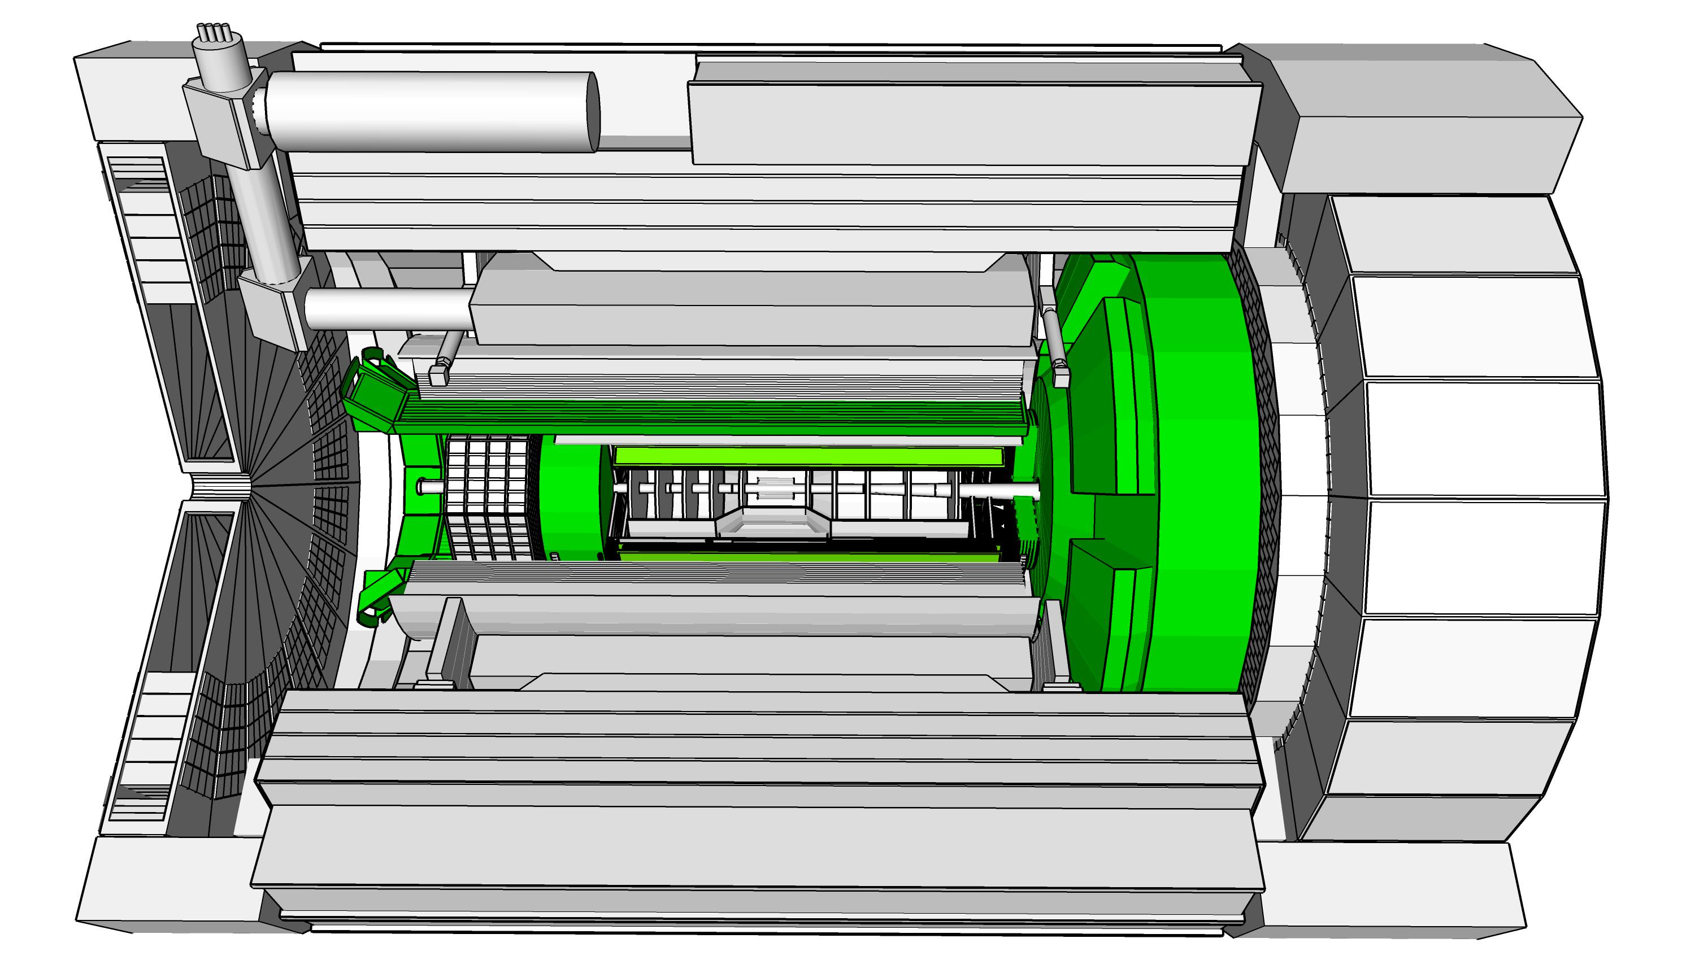
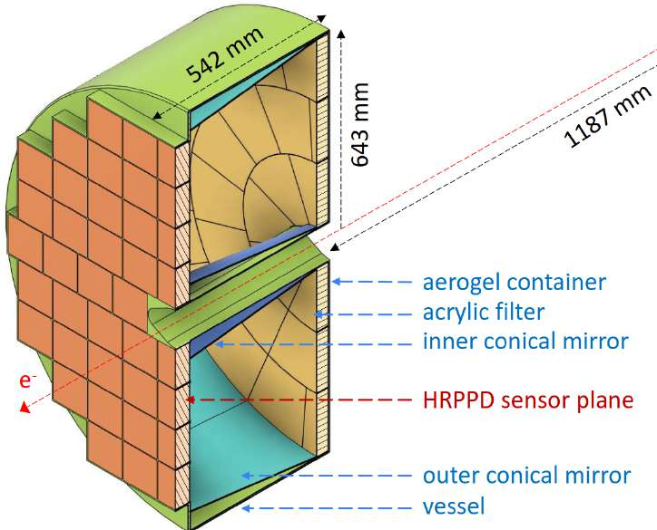
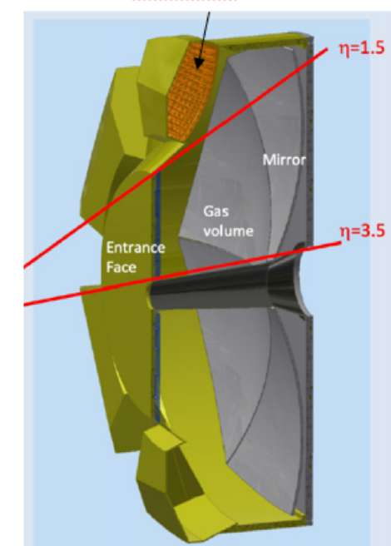
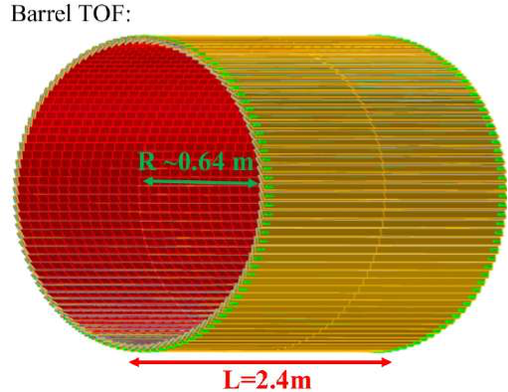
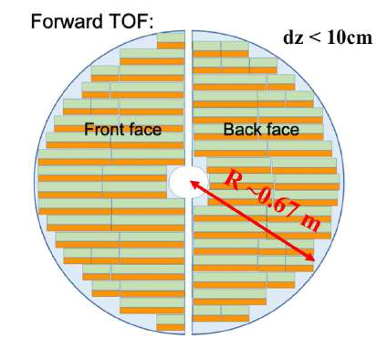
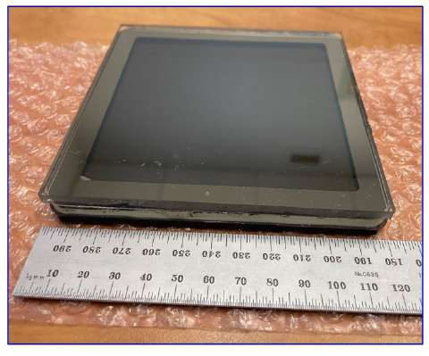
ePIC Particle Identification Detectors
Backward RICH
Barrel DIRC
Forward RICH
Time-of-Flight (Barrel, Forward)
Main Function
e, π, K, p separation
→ π/K 3σ sep. up to 9 GeV/c
and 10-20 ps timing → ToF
e, π, K, p separation
→ π/K 3σ sep. at 6 GeV/c
e, π, K, p separation
→ π/K 3σ sep. up to 50 GeV/c
e, π, K, p separation through 20-35 ps ToF
Barrel: 0.15 < p_{T} < 1.5 GeV/c
Forward: 0.15 < p_{T} < 2.5 GeV/c
Accurate space point for tracking
Proven Technology
Classical single volume proximity focusing aerogel RICH with long proximity gap (~30 cm)
High Performance DIRC
Quartz bar radiator
→ Reuse of BaBAR DIRC bars
light detection with MCP-PMTs
Fully focused
Dual Radiator RICH
Aerogel and C₂F₆ gas
Spherical Mirrors (6 Azimuthal Sectors)
Photon-Sensors tiled on spheres
world’s first at
First time use of
AC-LGAD (Low Gain Avalanche Detector)
in collider detector
Photonsensors:
HRPPDs for Time-of-Flight
First use of SiPMs as Photonsensors in a RICH
Overview Slide
from EIC Project

Slide 14
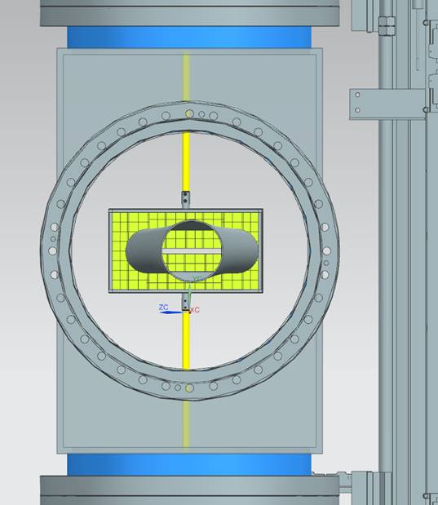
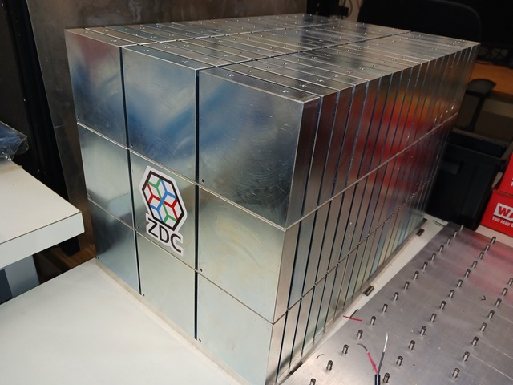

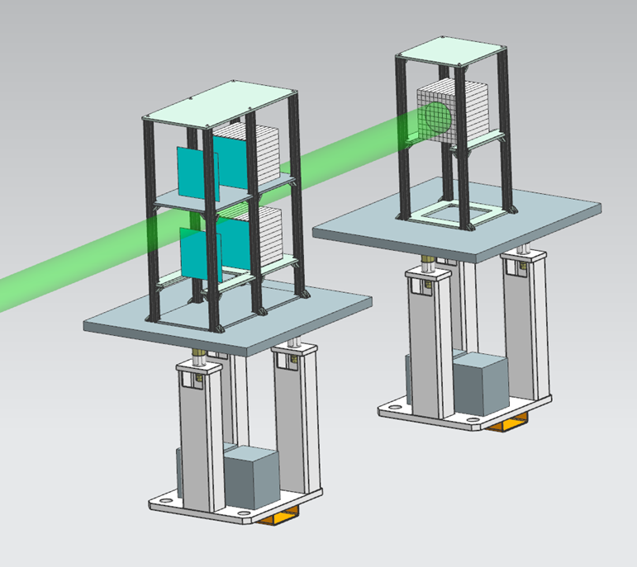


ePIC Far-Forward/Far-Backward Detectors
Main Function:
detection of forward scattered neutrons and γ
Technology:
EMCAL: 2x2x20 cm³ PbWO₄ calorimeter
Synergy with backward ECal
HCAL: Steel-SiPM-on-Tile
Synergy with forward HCal
Zero Degree Calorimeter
e beam
Main Function:
measure bunch-by-bunch luminosity through Bethe-Heitler process
Technology:
Pair-spectrometer: each with
2 tracking layers of AC-LGAD / FCFD
Synergy with Barrel-ToF
Calorimeter: Tungsten-powder + SciFi SPACAL
Synergy with forward ECal
Roman Pots and
Off-Momentum Detectors
Main Function:
detection of forward scattered protons and nuclei
Technology:
2 stations with 2 tracking layers each
AC-LGAD / EICROC ( 500x500 μm² pixel)
Synergy with forward ToF
B0 Magnet Spectrometer
p/A beam
Main Function:
detection of forward scattered protons and and γ
Technology:
4 tracking layers each
AC-LGAD / EICROC ( 500x500 μm² pixel)
Synergy with forward ToF
EMCAL: 2x2x20 cm³ PbWO₄ calorimeter
Synergy with backward ECal
Luminosity System
Low-Q2 Taggers
Main Function:
detection of scattered electrons
Technology:
2 stations with 4 tracking layers each (16x18cm²)
Si / Timepix4
Calorimeter: Tungsten-powder + SciFi SPACAL
Synergy with forward ECal
Overview Slide
from EIC Project

Slide 15

High level installation schedule

Slide 16

The Highly-Integrated ePIC Experiment
Integrated Interaction and Detector Region (90 m)
Get close to full acceptance for all final state particles, and measure them with good resolution. All particles count!
Compute-Detector Integration
Seamless data processing from detector readout to analysis using streaming readout and streaming computing.
Definition of Streaming Readout
Data is digitized at a fixed rate with thresholds and zero suppression applied locally.
Data is read out in continuous parallel streams that are encoded with information about when and where the data was taken.
Event building, filtering, monitoring, and other data processing is deferred to computing.
Advantages of Streaming Readout
Simplification of readout (no custom trigger hardware and firmware) and increased flexibility.
Event building from holistic detector information.
Continuous data flow provides detailed knowledge of backgrounds and enhances control over systematics.

Slide 17

Compute-Detector Integration to Maximize Science
Broad ePIC Science Program:
Plethora of observables, with less distinct topologies where every event is significant.
High-precision measurements: Control of systematic uncertainties of paramount importance.
Streaming Readout Capability Due to Moderate Signal Rate:
Capture every collision signal, including background.
Event selection using all available detector data for holistic reconstruction:
  Eliminate trigger bias and provide accurate estimation of uncertainties during event selection.
Streaming background estimates ideal to reduce background and related systematic uncertainties. High-precision measurements: Control of systematic uncertainties paramount.
 | EIC | RHIC | LHC → HL-LHC
Collision species | $\overset{⃑}{e}+\overset{⃑}{p}$, $\overset{⃑}{e}+A$ | $\overset{⃑}{p}+\overset{⃑}{p}/A$, $A+A$ | $p+p/A$, $A+A$
Top x-N C.M. energy | 140 GeV | 510 GeV | 13 TeV
Peak x-N luminosity | 10³⁴ cm⁻² s⁻¹ | 10³² cm⁻² s⁻¹ | 10³⁴ → 10³⁵ cm⁻² s⁻¹
x-N cross section | 50 μb | 40 mb | 80 mb
dN_{ch}/dη | 0.1-Few | ~3 | ~6
Charged particle rate | 4M N_{ch}/s | 60M N_{ch}/s | 30G+ N_{ch}/s

Slide 18

Compute-detector integration
Accelerating the science turnaround
Problem: Data for physics analyses and the resulting publications available after O(1year) due to complexity of NP experiments (and their organization).
  Alignment and calibrations, reconstruction and validation time-consuming.
Goal: Rapid turnaround of 2-3 weeks for data for physics analyses.
  Timeline driven by alignment and calibrations.
  Preliminary information from detector groups indicates that 2-3 weeks are realistic.
Solution: Compute-detector integration

Slide 19

The epic collaboration
ePIC initiated in
July 2022.
Currently (from 2024 Institutional Survey):
> 850 collaborators
from
173 institutions
from
25 countries
from
4 world regions.

Slide 20
(pre)TDR Strategy and Publications
The EIC (pre)TDR is the top priority for the ePIC Collaboration,
process design phase
structuring the
effort
draft ePIC pre-TDR
ePIC pre-TDR (CD-2)
writing
(TDR/notes)
Preparing papers for
publication
Mid Jan.24
Mid Mar.24
End Oct. 24
Late 2024
Early 2025
Timeline driven by the EIC Project (CD-2/CD-3).
Extended versions of the sections on the detector, physics performance, and software & computing will be published in scientific journals.

Slide 21

Early science program
Discussion between the EIC Project and ePIC based on phasing of EIC operations
e-p Luminosity in EIC Phase I
Phase I: Under Discussion
  HSR: no strong hadron cooling (SHC), add precooler, no 41-GeV bypass
  ESR: 5-10 GeV, 7 nC max (means fewer rf cavities and amps); maybe no crabs (may require lower proton bunch intensities)
  RCS: operates with a 7-nC (single bunch), 3 –> 5 or 10 GeV, ramps at 1 Hz
Phase II: Under Discussion
  HSR: add SHC, add 41-GeV bypass
  ESR: add rf cavities and power to operate at 28 nC and 18 GeV;
  RCS: upgraded to 28 nC and 3 -> 18 GeV ramps (at 1 Hz);
Early science program driven by:
  Start of EIC Science program.
  Alignment with expected order in commissioning the collider and ramp up of performance that comes with gain of operational experience.
  Having access to new physics results early to get high impact publications.
Luminosity w/wo SHC

Slide 22
ePIC – Leveraging the EIC on Day 1
This work is supported by the U.S. Department of
Energy, Office of Science, Office of Nuclear Physics,
under contract DE-AC02-06CH11357.
The EIC will enable us to embark on a precision study
of the nucleon and the nucleus at the scale of sea quarks and gluons. We will explore nucleon structure and observed properties in terms of the quark and gluon dynamics.
The ePIC collaboration is large for NP: over 850 scientists from 173 institutions across 25 countries in four world regions
ePIC, together with the EIC Project, is realizing a highly integrated, multi-purpose detector:
The detector is design to maximize its physics reach
State-of-the-art technologies and computing ensure that ePIC will deliver on EIC Science from its start
The EIC (pre)TDR is the current top priority ePIC;
timeline driven by the CD-2/CD-3 Project timeline.
Joosten & Diefenthaler, DNP 2024

Slide 23
BACKUP

Slide 24

The ePIC Streaming Computing Model
Echelon 0: ePIC Streaming DAQ.
Echelon 1: Two host labs, two primary ePIC computing facilities.
Echelon 2: Global contributions leveraging commitments to ePIC computing from labs and universities, domestically and internationally.
Echelon 3: Supporting the analysis community where they are at their home institutes, primarily via services hosted at Echelon 1 and 2.

Slide 25

Computing Use Cases and Their Echelon Distribution

Slide 26

Computing Resource Needs and Their Implications

Slide 27

Streaming DAQ and Computing Milestones

