Slide 1
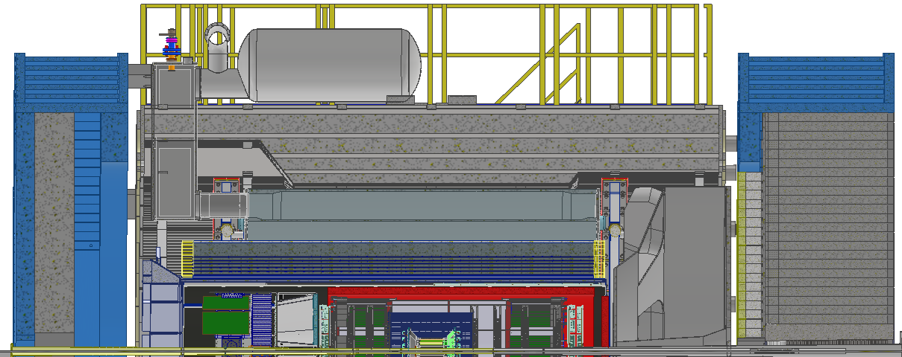
^{Medium-x hadrons}
η = 0
θ = 90°
High Q²
Scattered Electron
η = -0.88
θ = 135°
η = 0.88
θ = 45°
HCAL
HCAL
ECAL + HCAL
High-x hadrons
Low Q²
Low-x hadrons
PID + ECAL
η = -3.5
θ = 176.5°
PID
η = 3.5
θ = 3.5°
PID + ECAL
Central Tracker
Proton or Ion Beam
Electron Beam

